Slide 1

AI MLOps, Training, Performance and Observability
Stanley Muchemwa : Data and Digital Transformation Consultant
June 2026

Slide 2

AI: The Next Industrial Revolution
AI is becoming the operating system of modern economies
Industrial Revolution mechanized work
Electricity powered economies
Internet connected the world
AI augments intelligence itself
Notes:
Speaker guidance for AI: The Next Industrial Revolution: Expand with African, government, banking, telecom and startup examples. Aim for approximately 3 minutes on this slide.

Slide 3

Why AI Matters to Africa
Africa can leapfrog traditional development paths:
  Financial inclusion
  Smarter agriculture
  Better healthcare
  Improved public services
  Job creation
Notes:
Speaker guidance for Why AI Matters to Africa: Expand with African, government, banking, telecom and startup examples. Aim for approximately 3 minutes on this slide.

Slide 4

The AI Reality Check
Why most AI projects fail:
  Poor data quality
  Skills shortages
  Weak governance
  No operational framework
Building a model is easy. Operating AI at scale is hard.
Notes:
Speaker guidance for The AI Reality Check: Expand with African, government, banking, telecom and startup examples. Aim for approximately 3 minutes on this slide.

Slide 5
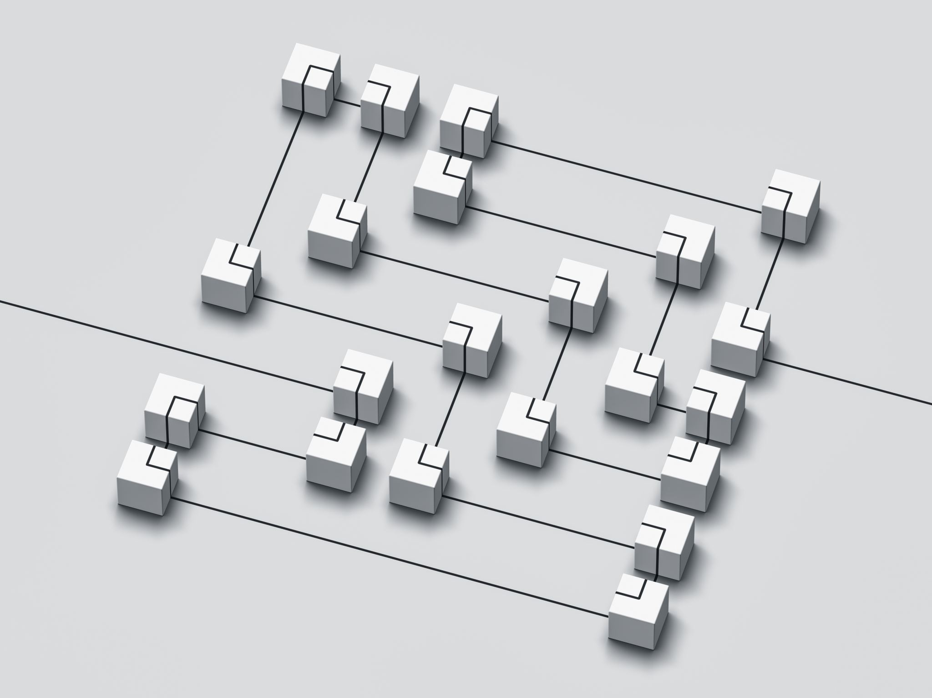
What is MLOps?
MLOps (Machine Learning Operations) is the set of practices, processes, tools, and governance frameworks used to develop, deploy, monitor, manage, and continuously improve AI and Machine Learning models in production.
Think of it this way:
Software Development uses DevOps (or DevSecOps)
Artificial Intelligence uses MLOps
MLOps bridges the gap between data scientists who build AI models and IT operations teams who run and maintain systems.
Data → Training → Validation → Deployment → Monitoring → Continuous Improvement
MLOps transforms AI from experiments into repeatable business capabilities
MLOps delivers reliability, governance, scalability and repeatability

Slide 6

The MLOps Lifecycle
↓ Data Collection
↓Data Preparation
↓Model Training
↓Testing & Validation
↓Deployment
↓Monitoring
↓Retraining
↓Continuous Improvement

Slide 7
Area | DevOps | MLOps
Primary Goal | Deliver software faster and more reliably | Deliver AI/ML models faster and more reliably
Main Asset Managed | Application code | Application code + data + machine learning models
Key Teams | Developers, Operations, QA | Data Scientists, ML Engineers, Developers, Operations
Deployment Unit | Software release | Software release + trained model
Testing Focus | Functional, integration, performance, security | Functional, model accuracy, bias, drift, explainability
Monitoring Focus | Application availability, performance, errors | Application performance + model performance and prediction quality
CI/CD | Continuous Integration & Continuous Delivery | Continuous Integration, Continuous Delivery & Continuous Training (CT)
Change Trigger | New code release | New code, new data, or model degradation
Success Metric | Faster software delivery and stability | Business outcomes from AI predictions and automation

Slide 8
AI Training: The New Strategic Asset
The four pillars of AI success:
  Data
  Compute
  Talent
  Governance
The success of AI training depends on five key things:
Clear business problem
Quality, quantity and diversity of data
Sufficient computing power
Skilled people, and
Strong governance.
If any one of these is missing, AI becomes an expensive experiment rather than a strategic asset
Notes:
Speaker guidance for AI Training: The New National Infrastructure: Expand with African, government, banking, telecom and startup examples. Aim for approximately 3 minutes on this slide.

Slide 9
Performance Matters
Performance – the Ultimate Measure of AI Success
Measure AI by:
Accuracy
Speed
Cost
Reliability
Business Impact
AI must deliver measurable business outcomes
Notes:
Speaker guidance for Performance Matters: Expand with African, government, banking, telecom and startup examples. Aim for approximately 3 minutes on this slide.

Slide 10
The Hidden Risk: Model Drift
Performance Matters
Use Case | Performance Measure
Lending | Faster approvals
Fraud | Reduced losses
Marketing | Higher conversions
Contact Center | Reduced call volumes
Customer Service | Improved satisfaction
AI models degrade over time because:
  Customer data changes
  Economic shifts – new regulations, market shifts
  Concept drift
  Emerging fraud patterns
Notes:
Speaker guidance for The Hidden Risk: Model Drift: Expand with African, government, banking, telecom and startup examples. Aim for approximately 3 minutes on this slide.

Slide 11
Observability: The Foundation of Trust
Monitor:
Accuracy
Bias
Hallucinations
Security
Compliance
Explainability
If you cannot see it, you cannot trust it.
Notes:
Speaker guidance for Observability: The Foundation of Trust: Expand with African, government, banking, telecom and startup examples. Aim for approximately 3 minutes on this slide.

Slide 12

The AI Factory
Business Strategy → Data Platform → AI Platform → MLOps → Applications → Business Value
Winning organizations industrialize AI.
Notes:
Speaker guidance for The AI Factory: Expand with African, government, banking, telecom and startup examples. Aim for approximately 3 minutes on this slide.

Slide 13
Building Africa's AI Future
Government
  National AI strategies
  Digital infrastructure
  Regulatory frameworks
Industry
  AI Centres of Excellence
  Digital infrastructure
  MLOps capability
  Responsible AI
Universities
  Produce AI engineers
  Produce MLOps specialists
Startups
  Solve African problems using AI
Four strategic pillars:
  Infrastructure
  Skills
  Governance
  Innovation
Notes:
Speaker guidance for Building Africa's AI Future: Expand with African, government, banking, telecom and startup examples. Aim for approximately 3 minutes on this slide.

Slide 14
Summary – Key Take Away
Artificial Intelligence is not a technology project. It is an economic transformation project.
Training gives capability.
MLOps gives scale.
Performance gives value.
Observability gives trust.
The nations and organizations that master these four disciplines will define the next decade of growth, innovation and competitiveness.
The future is not waiting for us. It is being built now!!
Notes:
Speaker guidance for Building Africa's AI Future: Expand with African, government, banking, telecom and startup examples. Aim for approximately 3 minutes on this slide.

Slide 15

13

