Slide 1








NATIONAL AI READINESS, DIGITAL SOVEREIGNTY AND EMERGING RISKS
A Proposed AI Readiness and Sovereignty Framework (AIRSF) for Zimbabwe, Africa and the Global South
18 June 2026
Dr Eng. Martin Manuhwa, Pr. Eng (Z), FZwIE
+263773803310
mmanuhwa1@yahoo.com
1

Slide 2



Dr Eng. Martin Manuhwa, Pr. Eng (Z), FZwIE
Managing Consultant – ZAIDG Consulting Engineers
Vice President – World Federation of Engineering Organisations
Vice Chairperson – AIIA Board
Chair, CUT Council, Zimbabwe
WCCE Chair Education, Training & Capacity Building
WFEO Chair, Engineering Capacity Building Committee
Distinguished Fellow (FAEO) | F.ASI (USA) | F.AETDEW | F.AAET (ASEAN) | Aff. MASCE
Chair, Ziscosteel Board |

Slide 3
Presenter profile
Dr Eng. Martin Manuhwa — Professional Engineer, Distinguished Fellow, and Global Engineering Leader
Martin holds an Honours Engineering Degree, an MBA, and a PhD in Energy, Engineering and Sustainability. He is the Vice President of the World Federation of Engineering Organisations (WFEO), he leads education and capacity-building efforts globally as Chair of the World Council of Civil Engineers (WCCE) Education and Training Committee and Chair of the WFEO Capacity Building Committee. In Zimbabwe, he serves as Chair of the Ziscosteel Board and the Chinhoyi University of Technology (CUT) Council. He also represents the Scientific and Technological Community within Africa’s Major Groups and Other Stakeholders, hosted by the United Nations Economic Commission for Africa.
Martin previously served as Chair of the Engineering Council of Zimbabwe (ECZ) and led the Zimbabwe Institution of Engineers (ZIE), the Southern African Federation of Engineering Organisations (SAFEO), and the Federation of African Engineering Organisations (FAEO).
Martin works in energy, construction, and project management. He is the Director and Managing Consultant of the Zimbabwe Africa Infrastructure Development Group (ZAIDG), a firm that manages engineering, procurement, and construction projects and provides consulting services. ZAIDG partners with Hatch Africa in Zimbabwe to deliver solutions in the power, mining, and public sectors. Together, they served as technical advisors on the Kariba Extension (now complete) and the Hwange Power Station Expansion.
Martin is recognised by leading engineering bodies worldwide, including as a Fellow of the African Scientific Institute and of the ASEAN Academy of Engineering and Technology. He was honoured as the founding president of SAFEO and awarded a medal for distinguished service to Southern Africa in 2025. He has earned many honours, including the WCCE Excellence Award, the ZIE Lifetime Achievement Award, and the SKF Award for engineering service. He has presented on infrastructure topics at major events across Africa, China, Australia, Japan, Switzerland, France, and the United Kingdom. In 2021, he received the FAEO Distinguished Fellowship and the FAEO Special Award for contributions to engineering across Africa.

Slide 4

The Vision
We shall accumulate machinery and establish steel works, iron foundries and factories; we shall link the various states of our Continent with communications; we shall astound the world with our hydroelectric power; we shall drain marshes and swamps, clear infested areas, feed the undernourished, and rid our people of parasites and disease. It is within the possibility of science and technology “ENGINEERING” to make even the Sahara bloom into a vast field with verdant vegetation for agricultural and industrial developments”.
President Kwame Nkrumah's first speech at the foundation summit of the Organisation of African Unity (OAU), Addis Ababa, 24 May 1963

Slide 5

Presentation outline
Introduction & Background
New Infrastructure and Key Digital Drivers
Emerging Risks and Ethics
Africa’s AI Readiness Frameworks
National Impact and Call to Action
Recommendations and Key Takeaways
Conclusion
5

Slide 6

Introduction
AI is no longer simply technology. It is becoming strategic national infrastructure.
Will Africa become:
A consumer of AI?
or
A creator of AI?
or
A sovereign participant in the global AI economy?
The answer will shape Africa’s economic future for decades.
THE QUESTION OF OUR GENERATION IS:

Slide 7

THE NEW INFRASTRUCTURE
Previous eras were defined by traditional infrastructure:
• Roads
• Railways
• Electricity
• Telecommunications
• Internet
Today:
AI + Data + Compute + Energy
have become strategic infrastructure.

Slide 8

Key Digital Drivers
Artificial Intelligence & 4IR
  Machine Learning
  Internet of Things (IoT) & Smart Sensors
  Digital Twins & Simulation
  Cloud Computing & Big Data Analytics

Slide 9

INDUSTRY 4.0
Connecting digital technology with physical systems
Connected devices, cloud computing, big data, robotics, and AI
Automation and smarter decision-making
Technologies Coming Together
  *Artificial Intelligence (AI)
  * Internet of Things (IoT)
  * Robotics and Big Data
  * Cloud Computing
  * Connected Digital-Physical Systems
  * Self-Operating Systems
  * Digital Twins
Engineering is Moving From:
  * Fixed systems to smart systems
  * Systems that react to systems that predict
  * Standalone systems to connected networks
Automation and robotics for efficiency
  Real‑time monitoring to reduce waste
  Predictive maintenance to extend asset life

Slide 10
With Industry 4.0 Smart Manufacturing should be our industry model in Africa - Our Objective – to move from Buzz to Reality!
Devices
Smart homes
Vertical networking
50Bio. Connected devices
Consumer
Data Sharing
Information
Analysis
Marketing
Web
Smart Grid
Energy efficiency
Digital natives
Global
Statistics
Virtual
Social Media
Artificial
Social Machines
Applications
Interface
M2M
Factory of the future
Multimodality
Exploitation
Sensors
Smart Products
Internet
Real Time
Complexity
Industry 4.0
Automation
Data Collection
Big Data
Internet of Things
Networking
Electrification
Innovation
Apps
Intelligent Systems
Cyber physical systems
Solutions
Stabile Connectivity
Digital Transformation
Cloud
Interconnected
www
Costs
Engineering
HMI
Embedded Systems
Knowledge networks
Productivity
Advanced robotics
2
Real time services
Vision
Automotive Electronics | RBAI/PJ-I4.0 | 15.11.2017
© Bosch Automotive Electronics India Private Limited 2017. All rights reserved, also regarding any disposal, exploitation, reproduction, editing, distribution, as well as in the event of applications for industrial property rights.
Horizontal integration

Slide 11





From Industry 1.0 to Industry 4.0: Towards the 4th Industrial Revolution
Degree of Complexity
First Mechanical Loom
1784
1. Industrial Revolution mechanical production facilities powered by water and steam
Industry 1.0
End of
18th
Century
t

Slide 12

From Industry 1.0 to Industry 4.0: Towards the 4th Industrial Revolution
Degree of Complexity
First Mechanical Loom
1784
2. Industrial Revolution
mass production
based on the division
of labor powered by
electrical energy
Industry 2.0
1. Industrial Revolution mechanical production facilities powered by water and steam
Industry 1.0
End of
18th
Century
Start of
20th
Century
t

Slide 13


From Industry 1.0 to Industry 4.0: Towards the 4th Industrial Revolution
Degree of Complexity
3. Industrial Revolution
electronics, IT and heavy- duty industrial robots for further automisation of production
Industry 3.0
First Mechanical Loom
1784
2. Industrial Revolution
mass production
based on the division
of labour powered by
electrical energy
Industry 2.0
1. Industrial Revolution mechanical production facilities powered by water and steam
Industry 1.0
End of
18th
Century
Start of
20th
Century
Start of
70s
t

Slide 14

From Industry 1.0 to Industry 4.0: Towards the 4th Industrial Revolution
4. Industrial Revolution based on Cyber-Physical Production Systems
Degree of Complexity
010001101
001010100
100101010
010010101
3. Industrial Revolution
electronics and IT and heavy- duty industrial robots for a further automization
of production
Industry 3.0
First Mechanical Loom
1784
2. Industrial Revolution
mass production
based on the division
of labor powered by
electrical energy
Industry 2.0
1. Industrial Revolution mechanical production facilities powered by water and steam
Industry 1.0
End of
18th
Century
Start of
20th
Century
Start of
70s
today
t

Slide 15

Industry 4.0 – Where Are We?
3

Slide 16
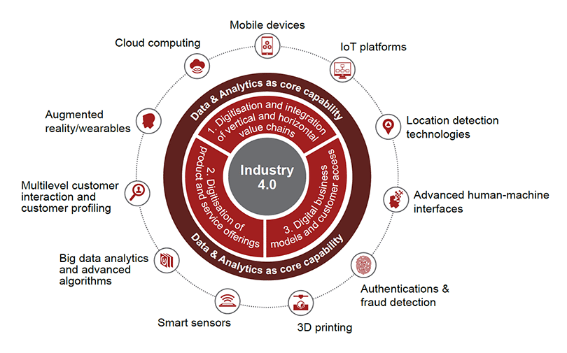
From Industry 1.0 to Industry 4.0: Towards the 4th Industrial Revolution
Source: PWC, 2017

Slide 17



From Industry 1.0 to Industry 4.0: Towards the 4th Industrial Revolution

Slide 18
The Core Message
AI Can Generate Answers, But Cannot Replace:
Judgment
Ethical reasoning
Contextual understanding
Empathy and curiosity
Wisdom and leadership
Personal responsibility
The Future Does Not Belong to those Who Compete with AI
It belongs to those who think beyond it, question it, guide it, humanise it, and use it responsibly
18

Slide 19


WHY THIS MATTERS NOW
AI is Reshaping Society:
National strategy
The economy
Government systems
Education systems
Global power structures
WHY AI MATTERS NOW
AI is transforming:
Government
Healthcare
Agriculture
Mining
Education
Manufacturing
Defence
Finance
AI is becoming a horizontal technology
affecting every sector.

Slide 20
Benefits of AI Adoption
Increased efficiency and productivity
Improved safety and quality control
Enhanced innovation and research
Better resource utilisation

Slide 21

AI in Practice
Predictive maintenance
Smart infrastructure and digital twins
Project management optimisation
Data-driven decisions

Slide 22
AI in Practice
THE GLOBAL AI LANDSCAPE
Current Leaders:
USA
China
European Union
Control:
Compute
Chips
Models
Platforms
Cloud infrastructure
The AI race is rapidly becoming a sovereignty race.

Slide 23
THE EMERGING AI ARMS RACE
Key Concerns:
Autonomous weapons
AI warfare
Cyber conflict
Disinformation
Deepfakes
“The future of AI must remain subordinate to humanity.”

Slide 24

Ethical and Professional Challenges
Bias and transparency in AI systems
Data privacy and cybersecurity
Impact on employment and skills
Responsible engineering leadership

Slide 25
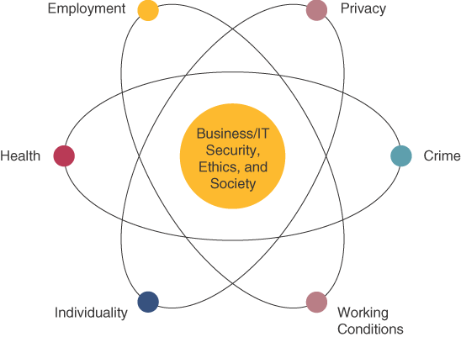
AI, IT/OT Security, Ethics & Society
Notes:
AI and most of Information Technology has had both beneficial and detrimental effects on each of these areas.

Slide 26

PROFESSIONAL Ethics
There are questions that professionals must confront as part of their daily business decision making including:
  Equity
  Rights
  Honesty
  Exercise of Corporate Power
  Professionals have a responsibility to promote ethical uses of technology especially IT/OT and AI at all times.

Slide 27
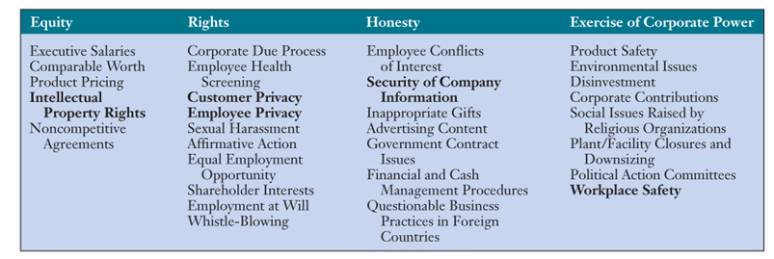
Ethical Issues & Categories

Slide 28
Principles of Technology Ethics
Proportionality – the good achieved by the technology must outweigh the harm or risk
Informed Consent – those affected by the technology should understand and accept the risks
Justice – the benefits and burdens of the technology should be distributed fairly
Minimized Risk – even if judged acceptable by the other three guidelines, the technology must be implemented so as to avoid all unnecessary risk

Slide 29
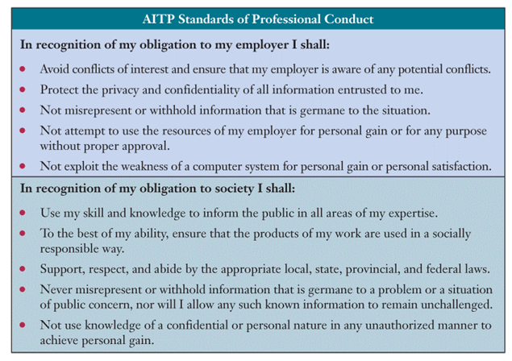
AITP Standards of Professional Conduct

Slide 30
Responsible Professional Guidelines
Acting with integrity
Increasing your professional competence
Setting high standards of personal performance
Accepting responsibility for your work
Advancing the health, privacy, and general welfare of the public

Slide 31
Ethics and Responsible AI
Ethics Must Be at the Centre
Key concerns:
Bias
Surveillance
Exclusion
Unfair data extraction
Data colonialism
Cybersecurity
Accountability
Misinformation
Ethical practice must be a core requirement — not an afterthought.
'AI in itself is neither good nor bad, amoral, we can say, however the design and use of all technology should be guided by ethics, and that of enabling benevolence in the global society’ ‎

Slide 32

THE AI RISK PYRAMID
Tier 1
Operational Risks
Tier 2
Organisational Risks
Tier 3
National Risks
Tier 4
Strategic Risks
AI risks include:
• Infrastructure attacks
• Election interference
• Deepfakes
• Economic coercion

Slide 33

Challenges & Risks OF TECHNOLOGY
Cybersecurity and data privacy
Digital divide and access inequality
High implementation costs and legacy systems

Slide 34

AFRICA’S AI FUTURE
“We face neither East nor West; we face forward.”
— Kwame Nkrumah
Africa’s AI Future Must Be Led Primarily by Africans (with support from the International Communities)
Africa cannot remain merely consumers of AI, users of imported systems, providers of raw data, or passive participants in the shift to digital.
Africa must become creators, innovators, builders, regulators, and owners of AI ecosystems, too.

Slide 35
AFRICA’S AI PARADOX
Africa has:
Youngest population
Largest future workforce
Fastest digital growth
Yet:
Less than 1% of global AI compute
Minimal foundation models
Limited sovereign infrastructure

Slide 36
Africa’s AI Readiness Gap
Unequal Access in the Global AI Landscape
Less than 1% of the world’s AI computing power is based in Africa
Less than 0.02% of AI training data reflects African languages and experiences
Fewer than 3% of leading AI researchers work in Africa
Implication:
AI systems are increasingly shaping Africa — without fully reflecting its people and needs.

Slide 37
Four Key AI Gaps in Africa
1. Computing Power Gap
Few local data centres, reliance on foreign cloud services, which brings high costs and reduced access
2. Data and Language Gap
African languages are underrepresented, local data is limited, and algorithms often leave Africa out
3. Skills and Talent Gap
Few AI specialists, talent leaving the continent, and limited training options
4. Policy and Regulation Gap
Inconsistent policies, weak oversight, and limited coordination between institutions

Slide 38
AI READINESS
AI READINESS IS NOT A TECHNOLOGY ISSUE
It is:
A sovereignty issue
A governance issue
A capacity issue
An infrastructure issue
A leadership issue

Slide 39
Africa and the New Industrial Era
Africa’s Unique Opportunity
Africa has a unique advantage: We have the youngest and fastest-growing population on the globe. We are building systems for the future — not maintaining legacy systems of the past.
This creates opportunities to:
Skip ahead (leapfrog) in development
Build economies around digital technology
Create smart infrastructure
Modernise agriculture
Bring more people into the financial system
Make education accessible to all

Slide 40

THE FUTURE WE MUST BUILD
Trusted AI
Sovereign AI
Inclusive AI
African AI
Human-Centred AI
HUMAN-CENTRED AI
AI cannot replace:
• Wisdom
• Judgment
• Ethics
• Accountability
• Leadership

Slide 41
AI Readiness and Sovereignty Framework
A comprehensive 7 Layer AI Readiness framework to harness AI for inclusive national development while maintaining digital sovereignty.
Anchored in the Ubuntu philosophy, the framework balances global technological integration with local data control and ethical governance across key sectors such as agriculture, mining, and healthcare.
LAYER 1 – ENERGY SOVEREIGNTY
LAYER 2 – COMPUTE SOVEREIGNTY
LAYER 3 – DATA SOVEREIGNTY
LAYER 4 – CONNECTIVITY SOVEREIGNTY
LAYER 5 – TALENT SOVEREIGNTY
LAYER 6 – GOVERNANCE SOVEREIGNTY
LAYER 7 – STRATEGIC SOVEREIGNTY

Slide 42

LAYER 1 – ENERGY SOVEREIGNTY
No Power
No AI
Measures:
Grid reliability
Data-centre resilience
Renewable energy leadership
  Smart agriculture and biodiversity monitoring
  Regional digital innovation hubs

Slide 43
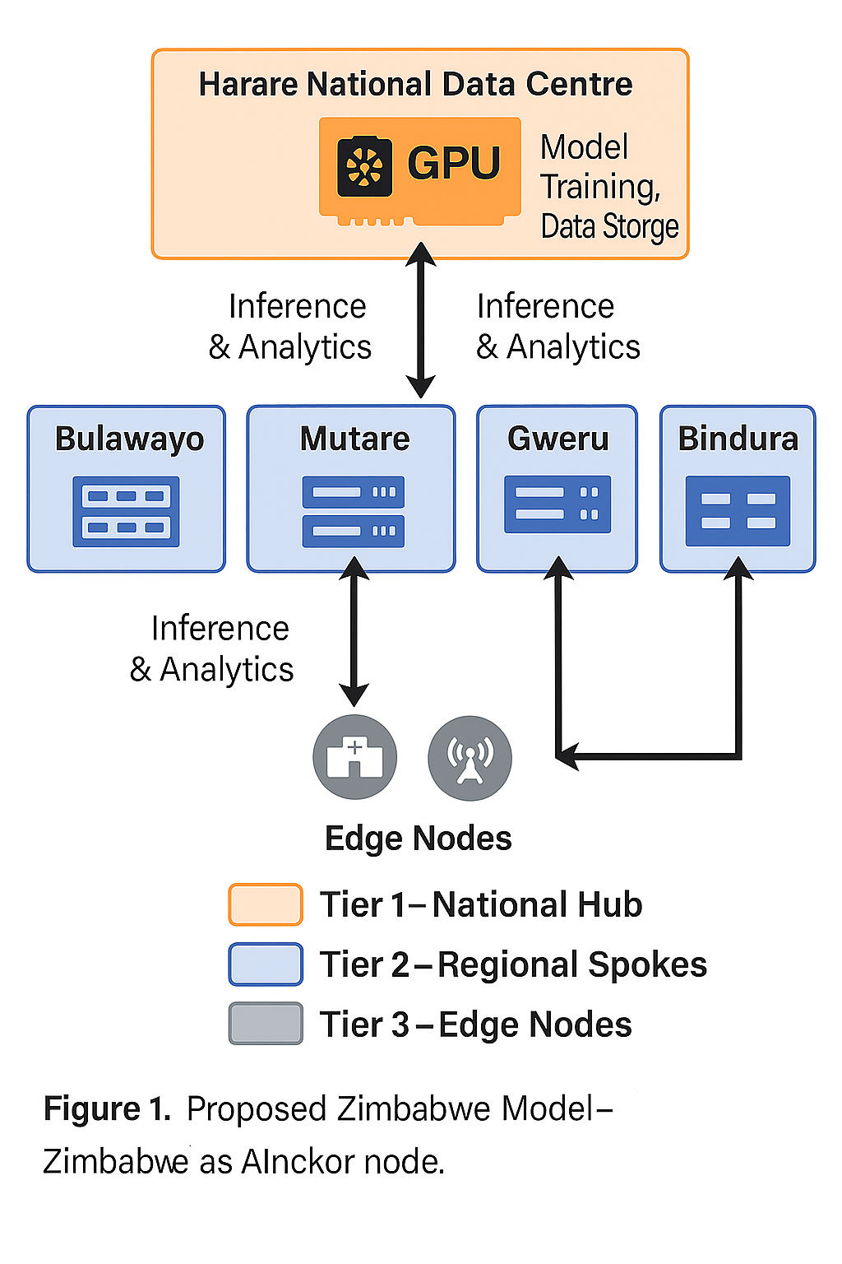
LAYER 2 – COMPUTE SOVEREIGNTY
Measures:
GPU clusters
HPC capability
AI cloud infrastructure
THE CASE FOR NATIONAL AI INFRASTRUCTURE
National AI Hub
Regional AI Nodes
Edge AI Infrastructure
Benefits:
Sovereignty
Resilience
Cost optimisation
Does Zimbabwe have enough compute power to train frontier AI models or run large national-scale AI workloads comparable to what is being done in the US, China, UAE, Saudi Arabia, or South Africa?
A Hypothetical Hybrid Hub-and-Spoke Architecture for Zimbabwe’s AI Infrastructure

Slide 44
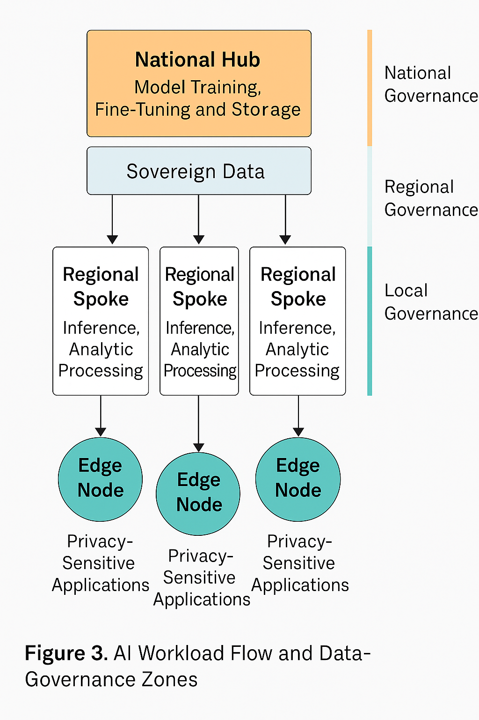

LAYER 3 – DATA SOVEREIGNTY
Is data the oil? The new gold?
Actually, Data is the soil from which AI grows.
Measures:
• Data residency
• Governance
• Protection
DATA COLONIALISM
Questions:
Who owns the data?
Who trains the models?
Who captures the value?
Who controls the future?
⸻
AI Workload Flow and Data-Governance

Slide 45
LAYER 4 – CONNECTIVITY SOVEREIGNTY
Measures:
Fibre
Broadband
Rural access
IXPs – Internet Exchange Points, e.g. DE-CX, AMS-IX
Mobile coverage

Slide 46

LAYER 5 – TALENT SOVEREIGNTY
Critical Skills:
• AI Engineers
• Data Scientists
• MLOps
• AI Auditors
• AI Governance Experts
The Talent Challenge
Africa needs:
Thousands of AI professionals
Not hundreds.
Capacity building is Africa’s greatest AI challenge.

Slide 47

LAYER 6 – GOVERNANCE SOVEREIGNTY
Measures:
Policies
Regulation
Standards
Ethics
Trust is The New Currency
Without trust:
No adoption
Without governance:
No trust
Without sovereignty:
No sustainability

Slide 48
LAYER 7 – STRATEGIC SOVEREIGNTY
Measures:
• Cyber resilience
• Defence readiness
• Critical infrastructure protection
• Geopolitical resilience

Slide 49

KEY RECOMMENDATIONS
Establish National AI Hub
Build Sovereign Compute
Develop AI Skills Pipeline
Create AI Governance Framework
Strengthen Regional Cooperation
Collaboration between academia, government, society and industry
Human-centred AI systems

Slide 50
Final Reflection
“The nations that thrive in the AI era will not necessarily be those possessing the most powerful algorithms.”
They will be those possessing the strongest institutions, the most trusted governance systems, the most resilient infrastructure, and the wisdom to ensure that artificial intelligence remains subordinate to human values.”

Slide 51
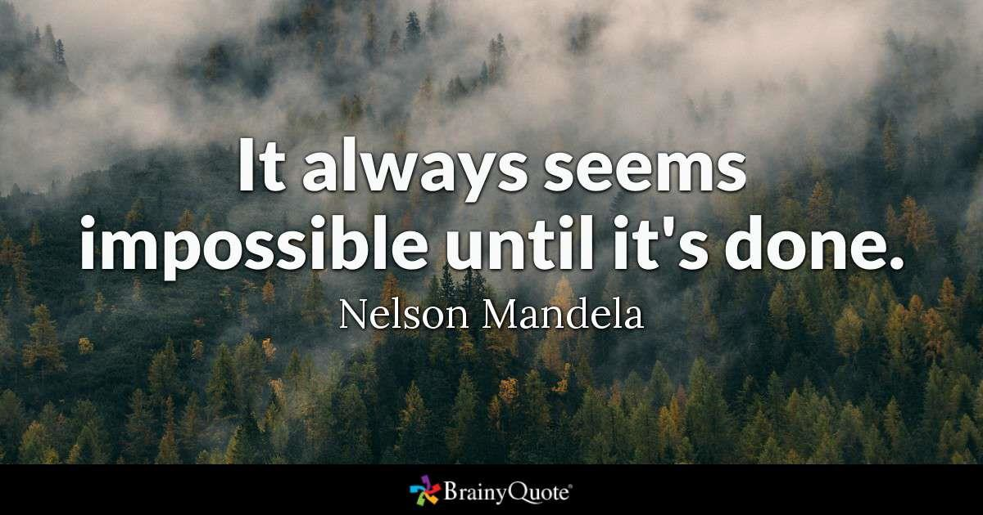
Africa’s AI Transformation Is Possible
But it requires:
Vision
Leadership
Investment
Partnerships
Systems thinking

Slide 52
BOTH WFEO-CECB & WCCE-ETCB WILL WORK AS A TEAM AND IN PARTNERSHIP WITH YOU
WE WILL ALWAYS REPEAT THIS AFRICAN PROVERB
If you want to go fast, go alone
If you want to go far, go together
YES WE CAN GO FASTER TOGETHER
Thank you!
52

Slide 53
Questions • Discussion • Collaboration
Dr Eng. Martin Manuhwa, Pr. Eng (Z), FZwIE
Distinguished Fellow (FAEO) | F.ASI (USA) | F.AETDEW | F.AAET (ASEAN) | Aff. MASCE
Chair, WCCE Education, Training & Capacity Building, WFEO Capacity Building Committee
Managing Consultant, Zimbabwe Africa Infrastructure Development Group (ZAIDG)
THANK YOU
53

