Slide 1

Intelligence Transformation
Beyond AI – The Rise of Distributed Intelligence
Dr Dennis Magaya
17 June 2026

Slide 2
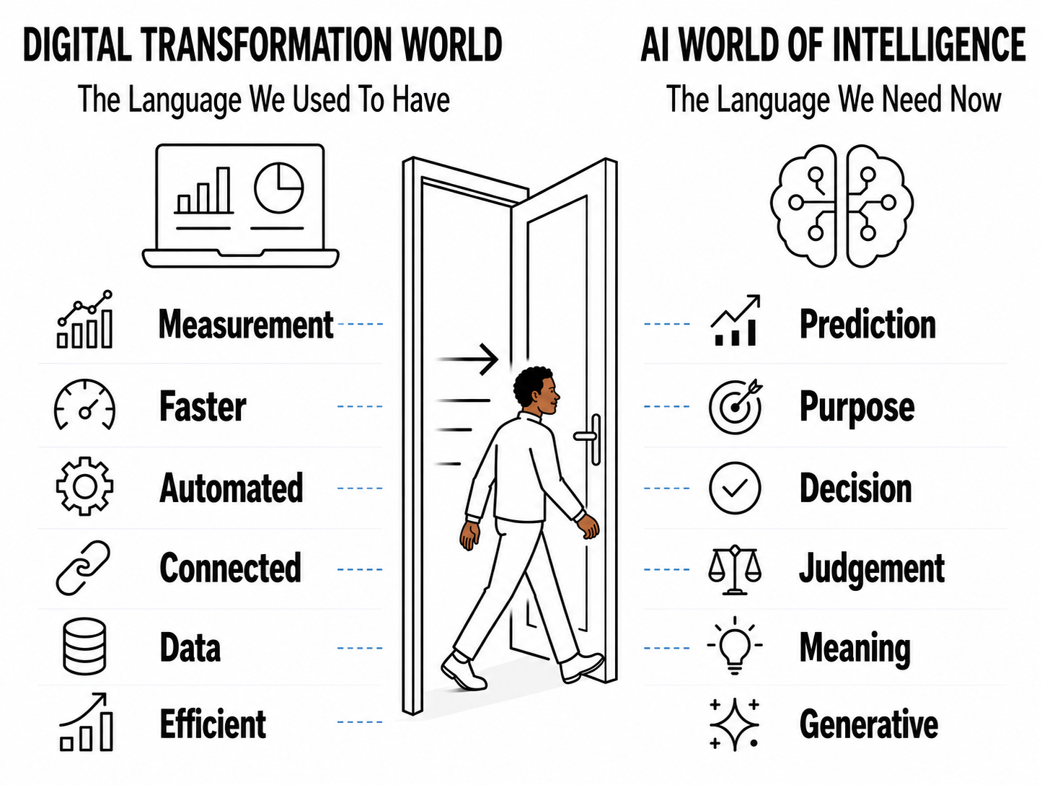
“In the beginning there was the word”
Digital Transformation language no longer describes happens when intelligence moves into systems that decide for us.

Slide 3

Transformation doesn’t happen when systems fail; but when success itself stops making sense
A system can perform better inside an old logic, while the world around it has moved on.

Slide 4
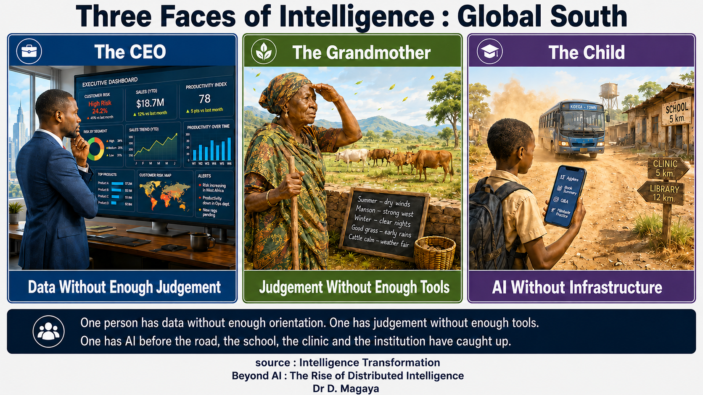
Africa is where dashboard, the sky and dust meet
The task is not to choose between dashboard and sky; it is to organise both
before the child standing in dust is organised by AI systems she did not design.

Slide 5
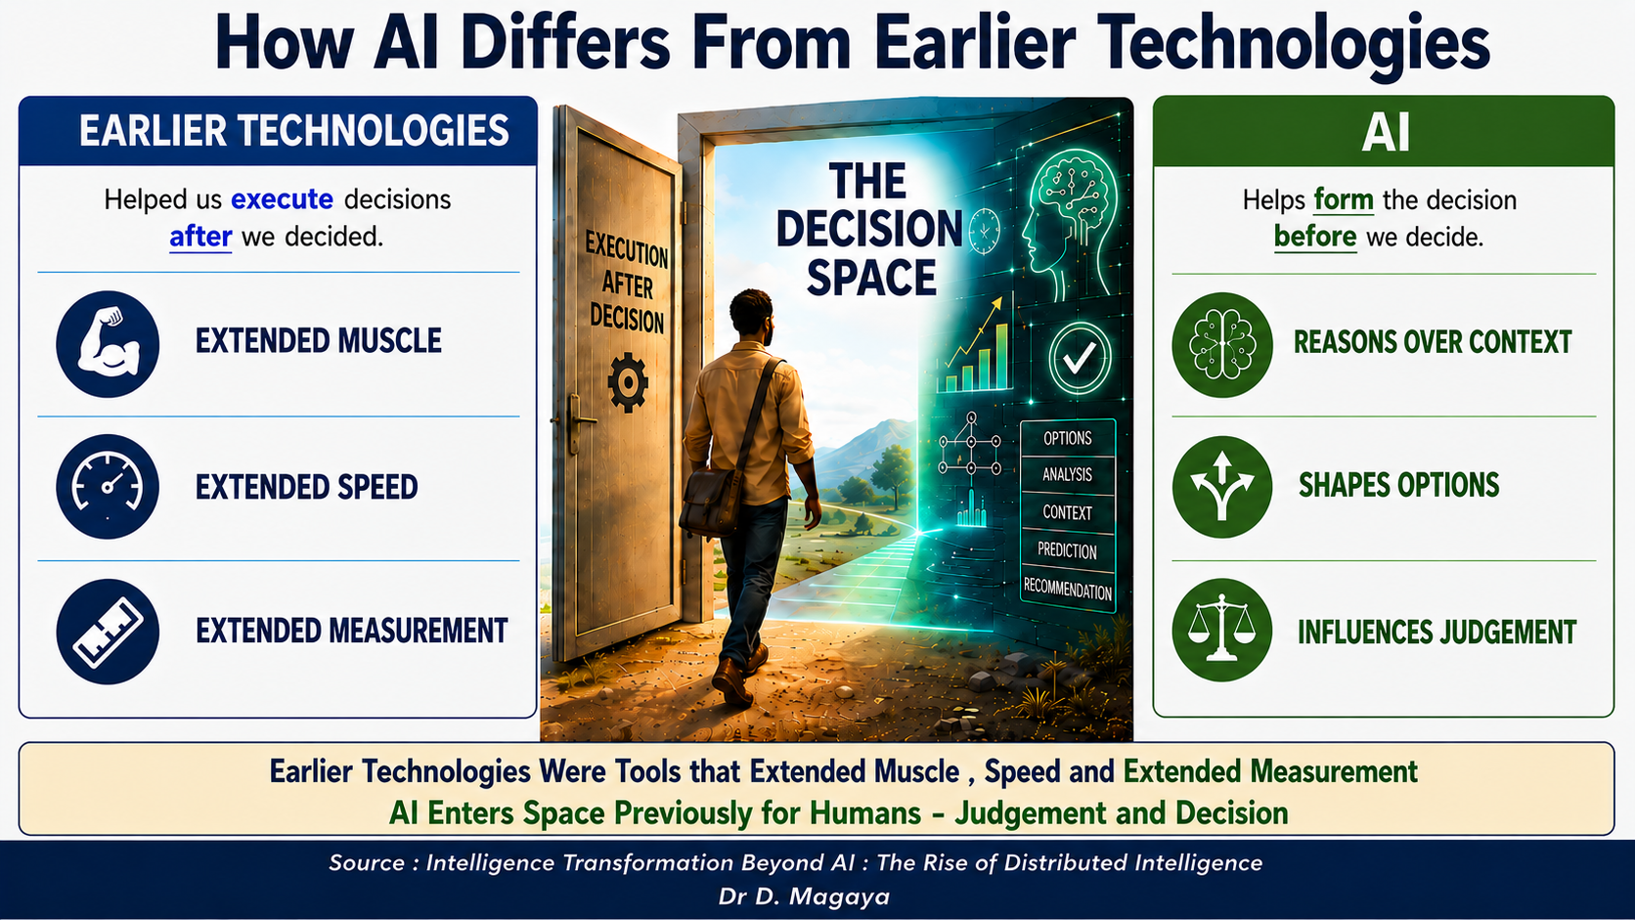
AI Are Computer Systems that Mimic Intelligence Found in Human Beings
AI Reasons, Thinks , Learns - Is that a Tool?
Civilisation has been about tools and intelligence

Slide 6
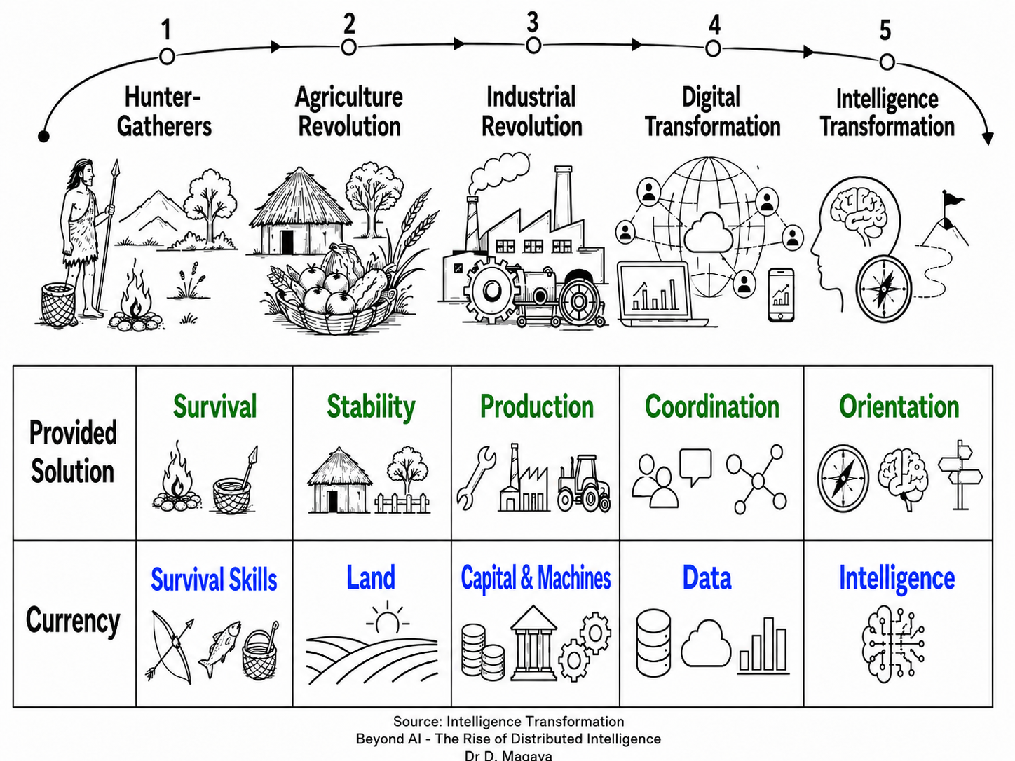
Civilisation is staircase of intelligence: survival, stability, production, coordination and now orientation.
Each step solves one problem and reaches a limit (next problem)
AI is part of longer civilisation movement on how human beings organise intelligence to solve dominant problem of each age.

Slide 7
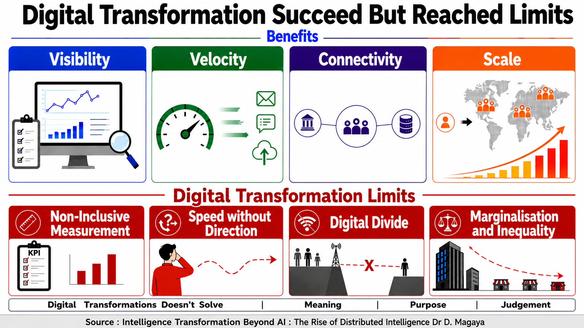

Slide 8
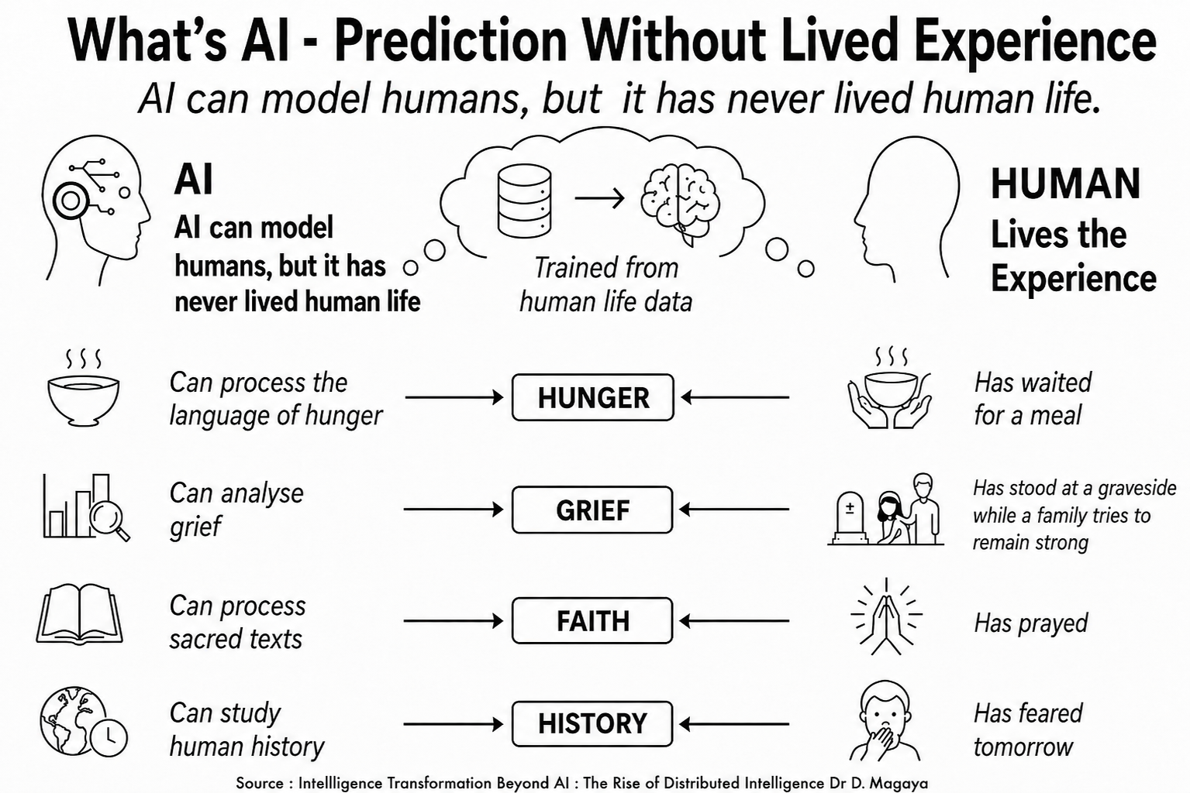
AI can predict, generate, classify and automate but it does so life
One of AI usefulness is prediction; its danger is when prediction looks like judgement.

Slide 9
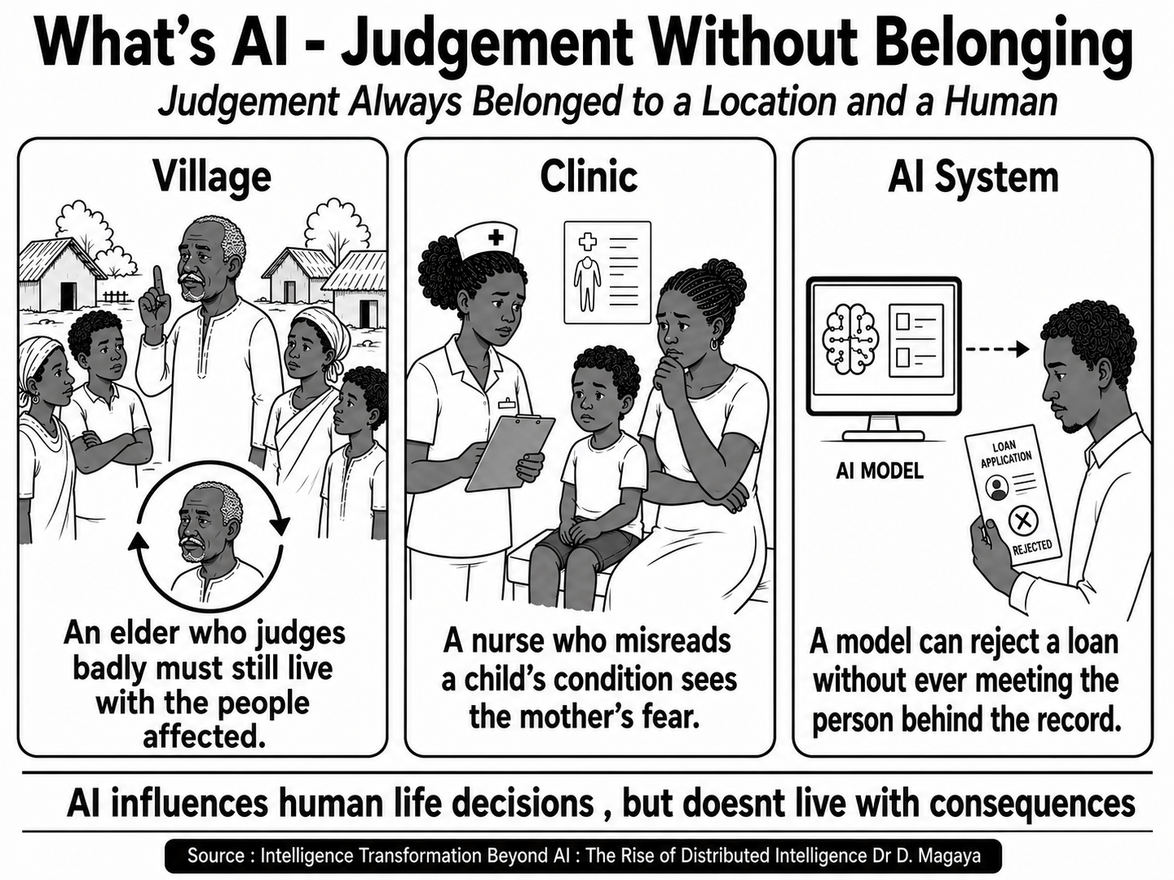
Judgement without belonging can become power without memory, context or shame.
What standard should intelligent systems be judged by if they are powerful but not human?
The danger is that non-human systems increasingly shape human judgement.

Slide 10
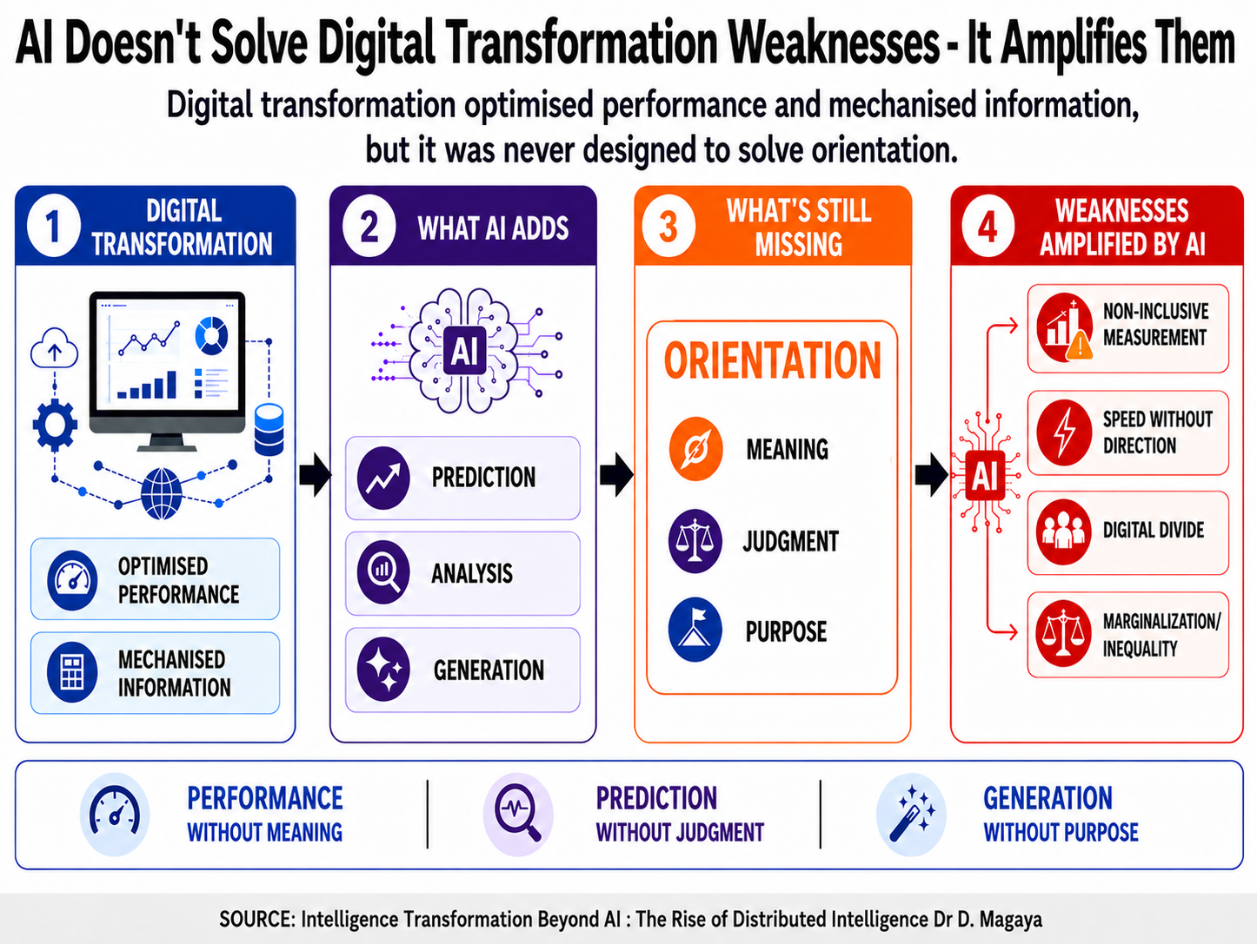
Judgement without belonging can become power without memory, context or shame.
What standard should intelligent systems be judged by if they are powerful but not human?

Slide 11
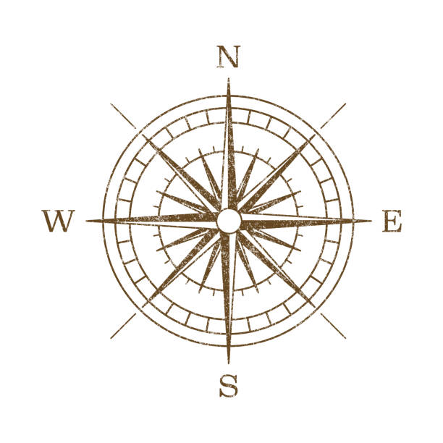
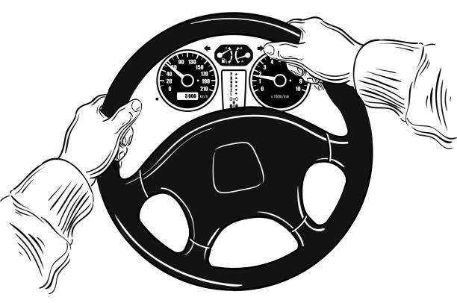
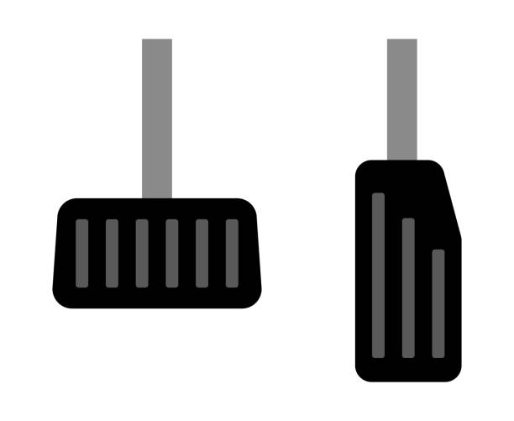
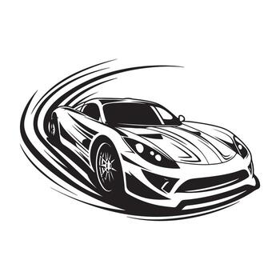

Beyond AI Adoption: Intelligence Transformation
Intelligence Transformation
Guiding Framework
Artificial Intelligence
Capability
Digital Transformation
Foundation
Its not about choosing digital transformation, AI and Intelligence Transformation;
Its about placing them in the right order.

Slide 12
Intelligence Transformation
The Discipline to Design Intelligence –
- So that Humans Remain Humane When Intelligence is -
- Abundant and Distributed -

Slide 13
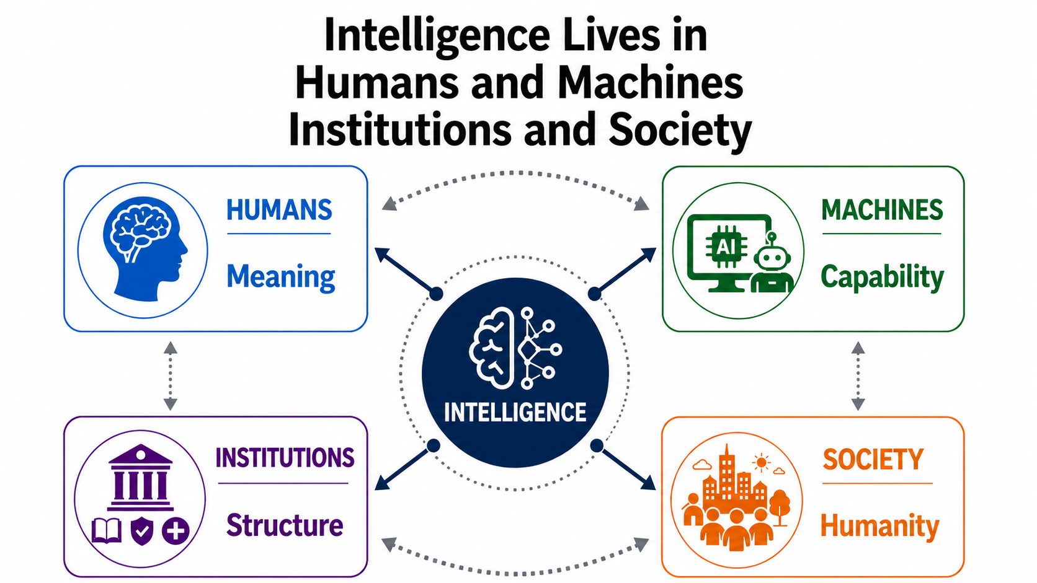
What is the Intelligence Located
AI is a Catalyst to Distribute Intelligence in Multiple Locations

Slide 14
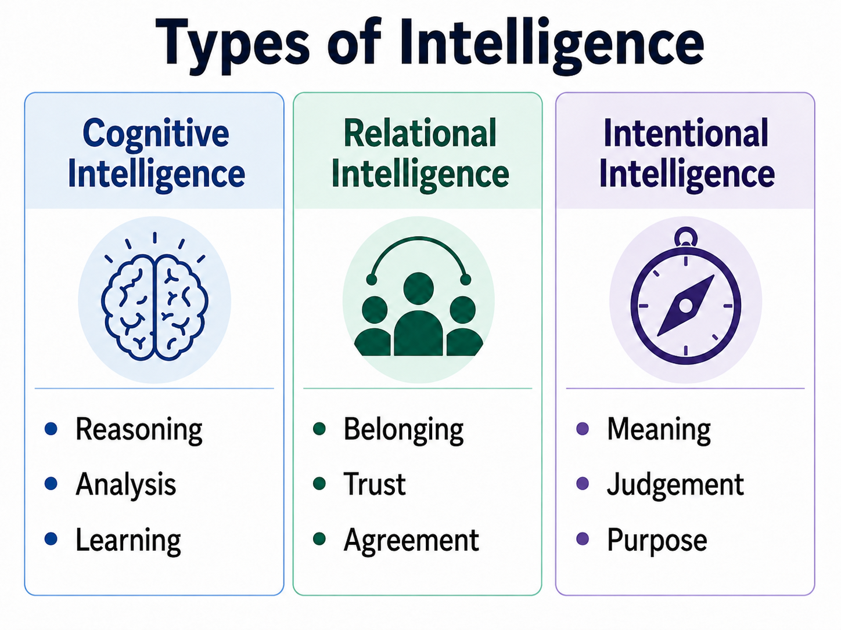
What Type of Intelligence Do We Have
AI is a Capability added to Types of Intelligence

Slide 15
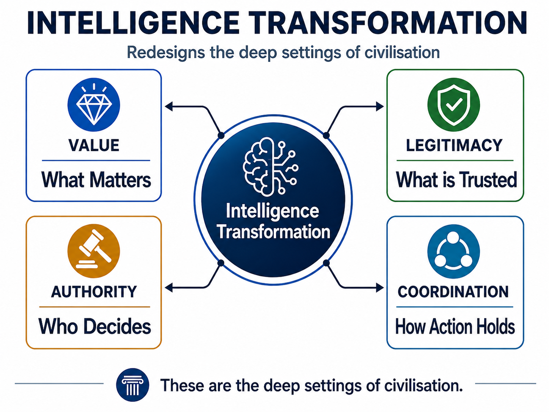
What Should Intelligence Change
If we do not redesign what counts, what is trusted, who decides and how action holds
together, AI will only accelerate the old logic.

Slide 16
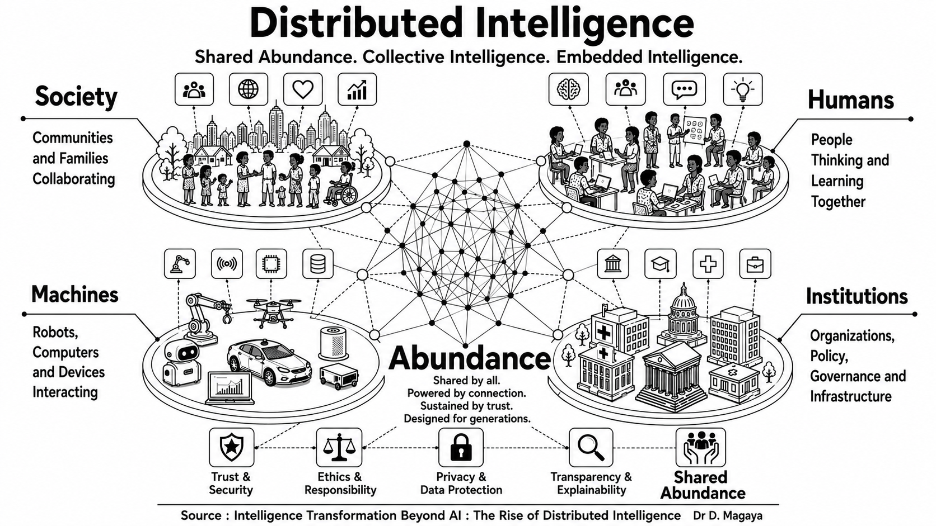

Slide 17

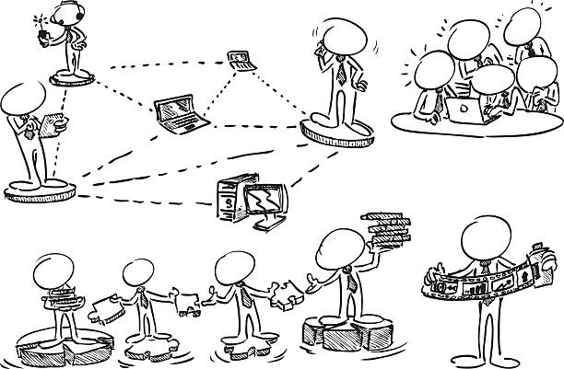
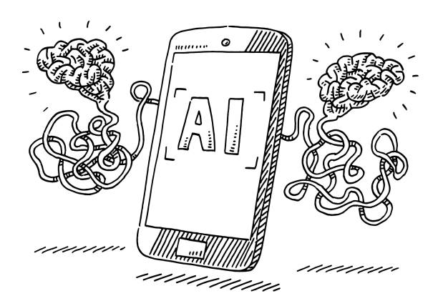
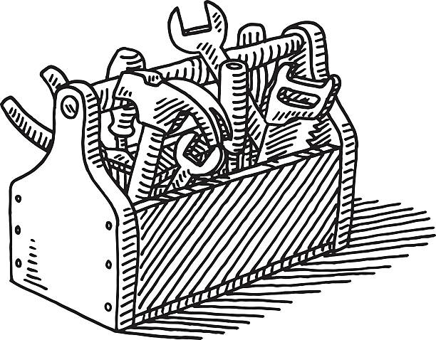
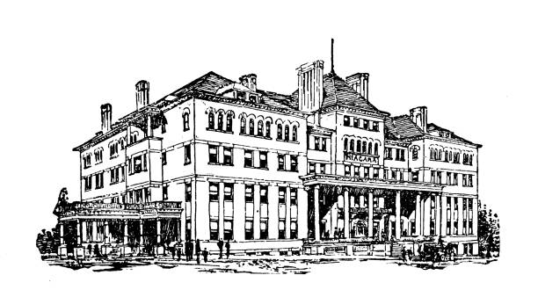
#7. The Monday Morning Question

Slide 18
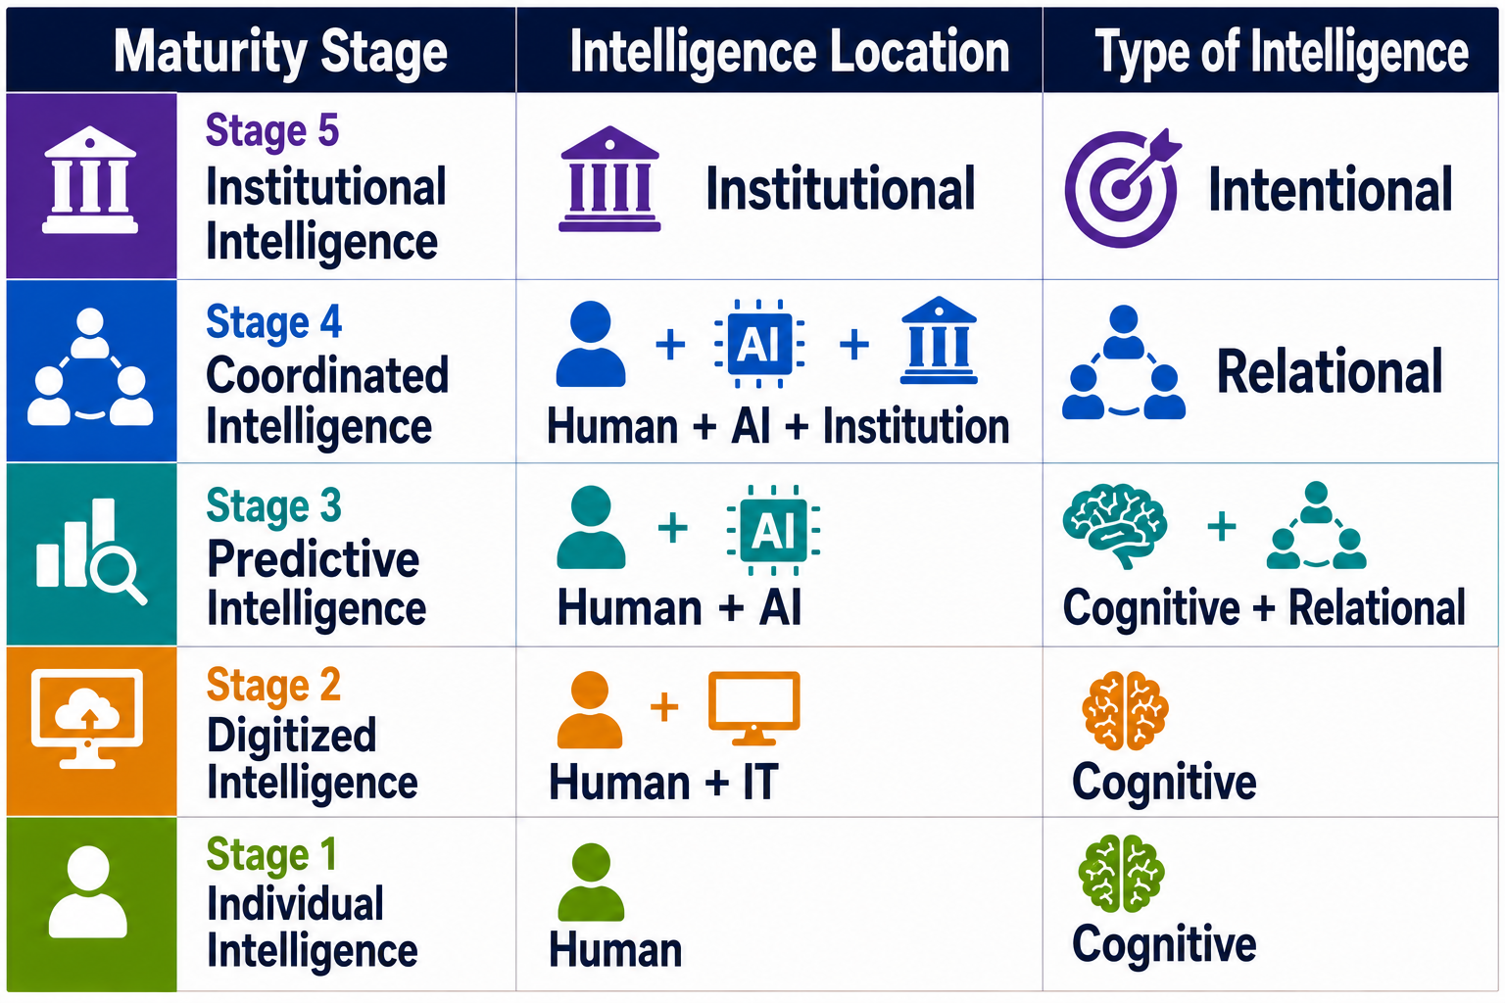

Slide 19
National AI Strategy will not succeed because a country adopts AI.
It will succeed if the country organises intelligence across
people, machines, institutions, infrastructure and values.
If we do not organise intelligence, intelligence will organise us.

