Slide 1
AI FOR NATIONAL TRANSFORMATION SUMMIT 2.0
AI Applications for Agriculture and Climate Resistance
Sowing Intelligence
Dr Tendai Zengeni

Slide 2
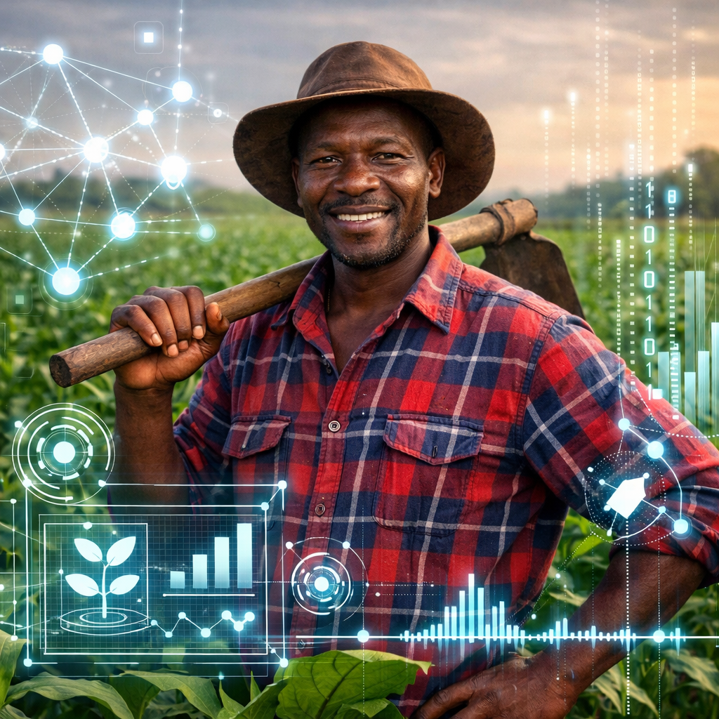
Intro
Farming in Zimbabwe: “A gamble with the sky”…..

Slide 3
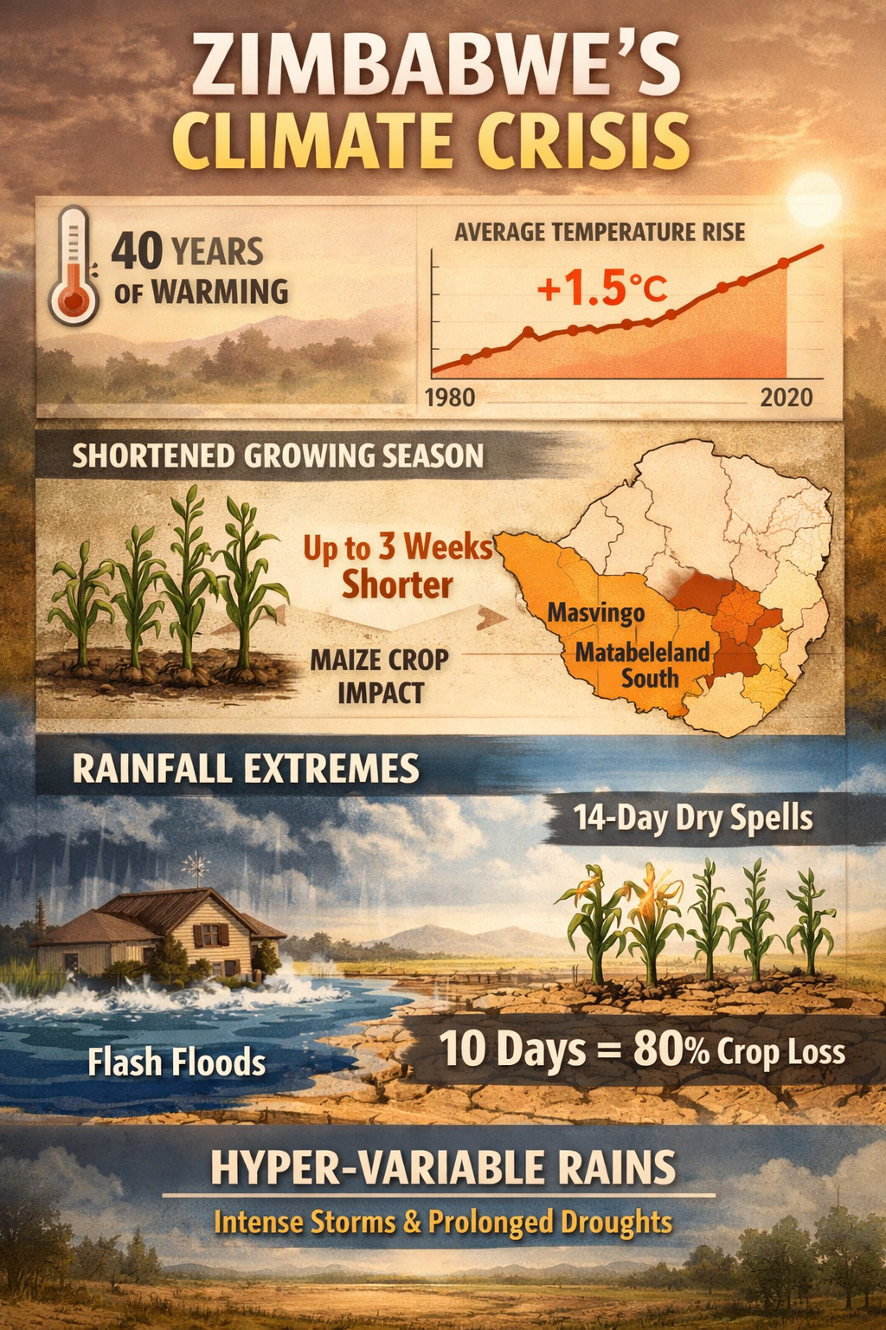
First, let us ground ourselves in facts. Because AI is nothing without data. And the data about Zimbabwe’s climate is sobering.
Over the past 40 years, our average annual temperature has risen by approximately 1.5 degrees Celsius. That might sound small. But in agronomic terms, it means that the growing season for maize – our staple crop – has shortened by nearly three weeks in parts of Masvingo and Matabeleland South.
For a young maize plant at the tasseling stage, a dry spell of just 10 days can destroy 80% of the yield.

Slide 4
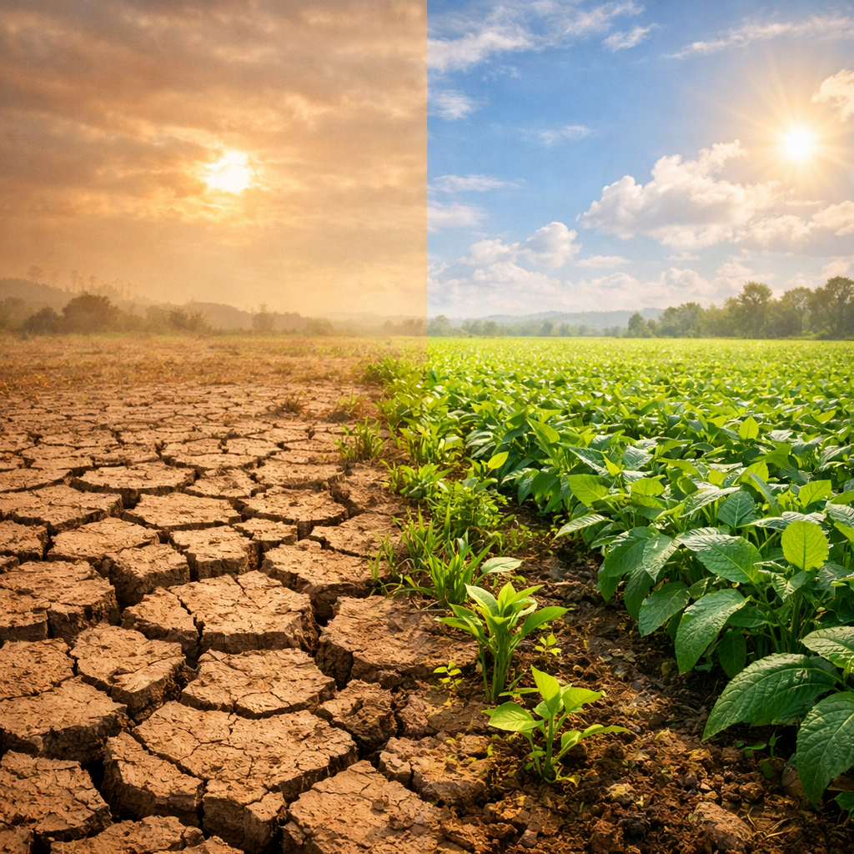
Erratic rains & prolonged droughts
El Niño Met dpt has issued preliminary warnings regarding the upcoming rainy season
Soil degradation & declining fertility
Rising pest outbreaks
Fragmented agricultural data
Resource constraints
Need for climate resilience

Slide 5

AI transforms uncertainty into strategy
AI for national transformation
From global tech (self-driving cars, facial recognition) to local farming solutions
Optimism: AI as a weapon against climate shocks

Slide 6
Zimbabwe - "breadbasket of Africa"
    fertile soils,
    favorable climate, and
    sophisticated commercial farming sector
allowed it to produce major surpluses of maize, wheat, and tobacco.
efficiently exported food to neighboring nations and global markets.
Agriculture remains the country's largest employer
60-70% of the population depends on it for their livelihood.
Vast informal/subsistence farming sector
Subsidized agricultural inputs

Slide 7
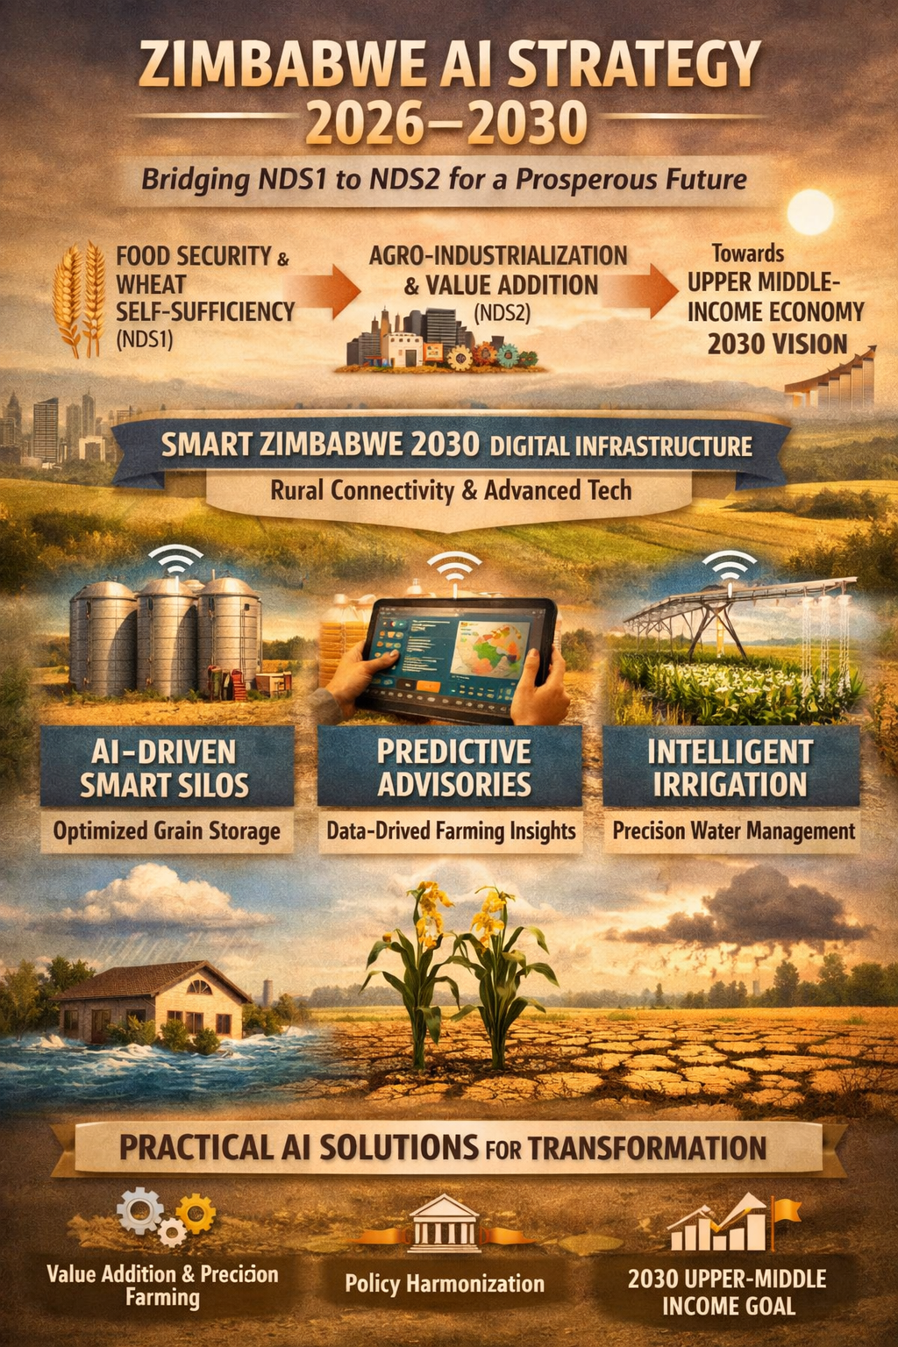
Zimbabwe’s AI Strategy (2026–2030) serves as a core catalyst, bridging the foundational agricultural gains of NDS1 (food security, wheat self-sufficiency) with NDS2’s transformative driving agro-industrialization through value-addition and precision farming. Underpinned by the "Smart Zimbabwe 2030" digital infrastructure plan, which ensures rural connectivity, the framework deploys AI-driven smart silos, predictive advisories, and intelligent irrigation to solve critical bottlenecks. This nested, practical approach ensures AI is not an abstract technology but a concrete solution that harmonizes all relevant policies, directly propelling the nation toward its 2030 vision of becoming an upper-middle-income economy.

Slide 8
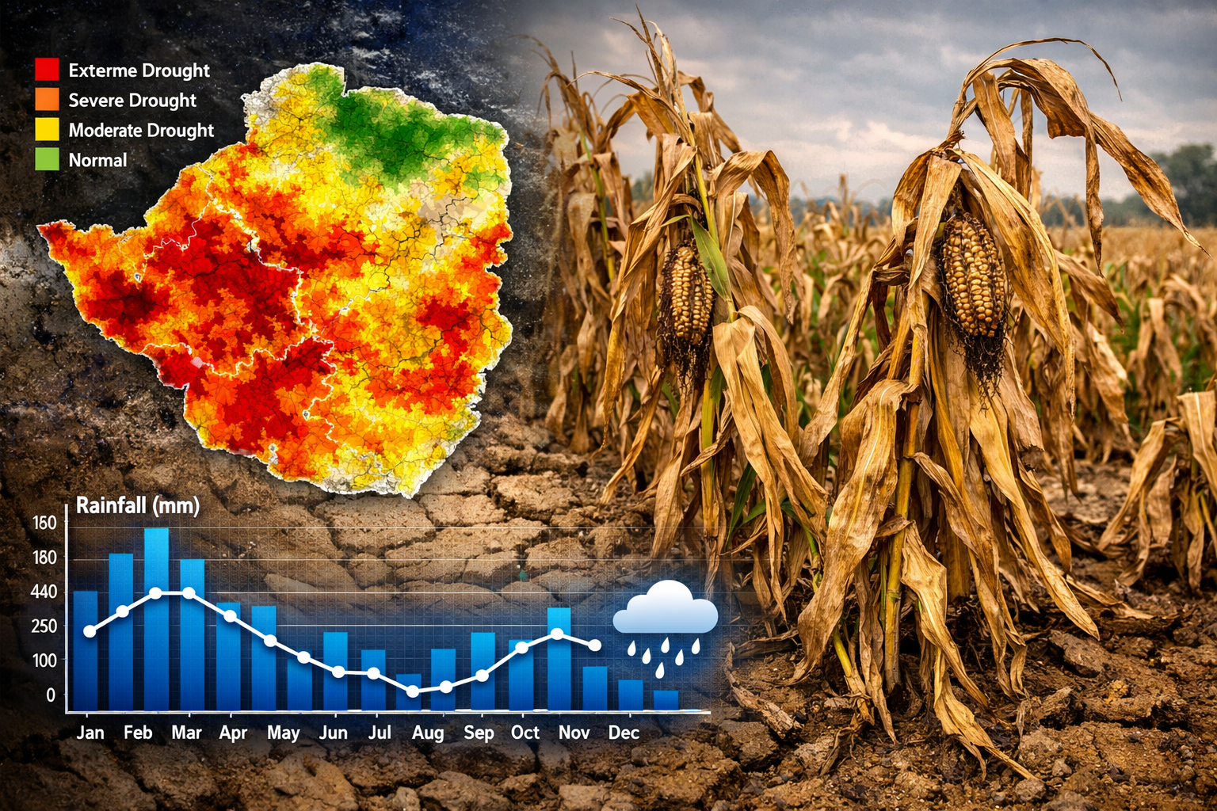
Application 1 – Predictive Early Warning Systems
AI models trained on rainfall, temperature, soil moisture, satellite data
Hyper-local forecasts (ward-level precision)
SMS alerts in local languages (Shona/Ndebele)
Example: “Dry spell in 10 days – switch to cowpeas”
Farmers gain lead time to adapt

Slide 9
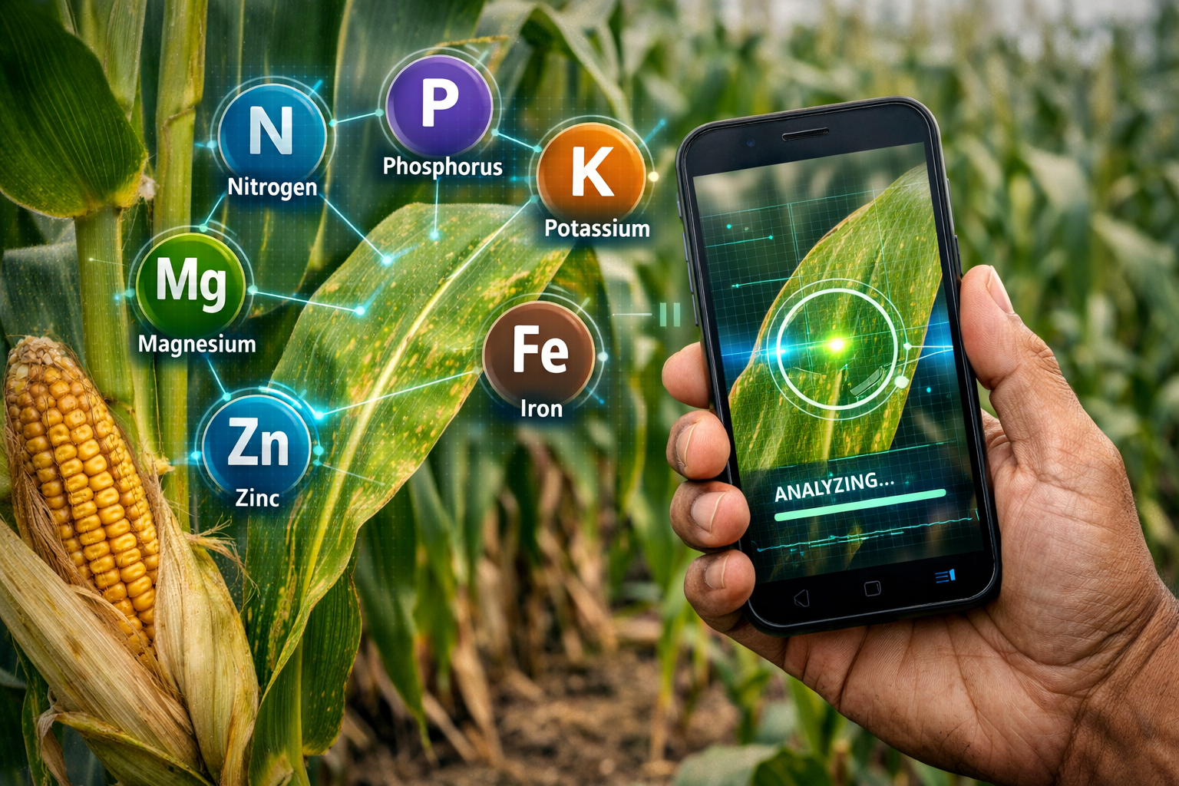
Application 2 – Precision Agriculture for Smallholders
Smartphone-based AI diagnosis of crop diseases (e.g., fall armyworm, maize lethal necrosis)
Leaf photo analysis for nutrient deficiencies
Daily rainfall (from ground stations and satellite sources like CHIRPS)
Daily temperatures (min and max)
Soil moisture (from remote sensing or in-situ sensors)
Historical crop yields from farmer records

Slide 10
Affordable, accessible tools (no drones required)
Saves harvests, strengthens food security
For a farmer in Chipinge, this means saving an entire season’s harvest. For Zimbabwe, this means national food security

Slide 11
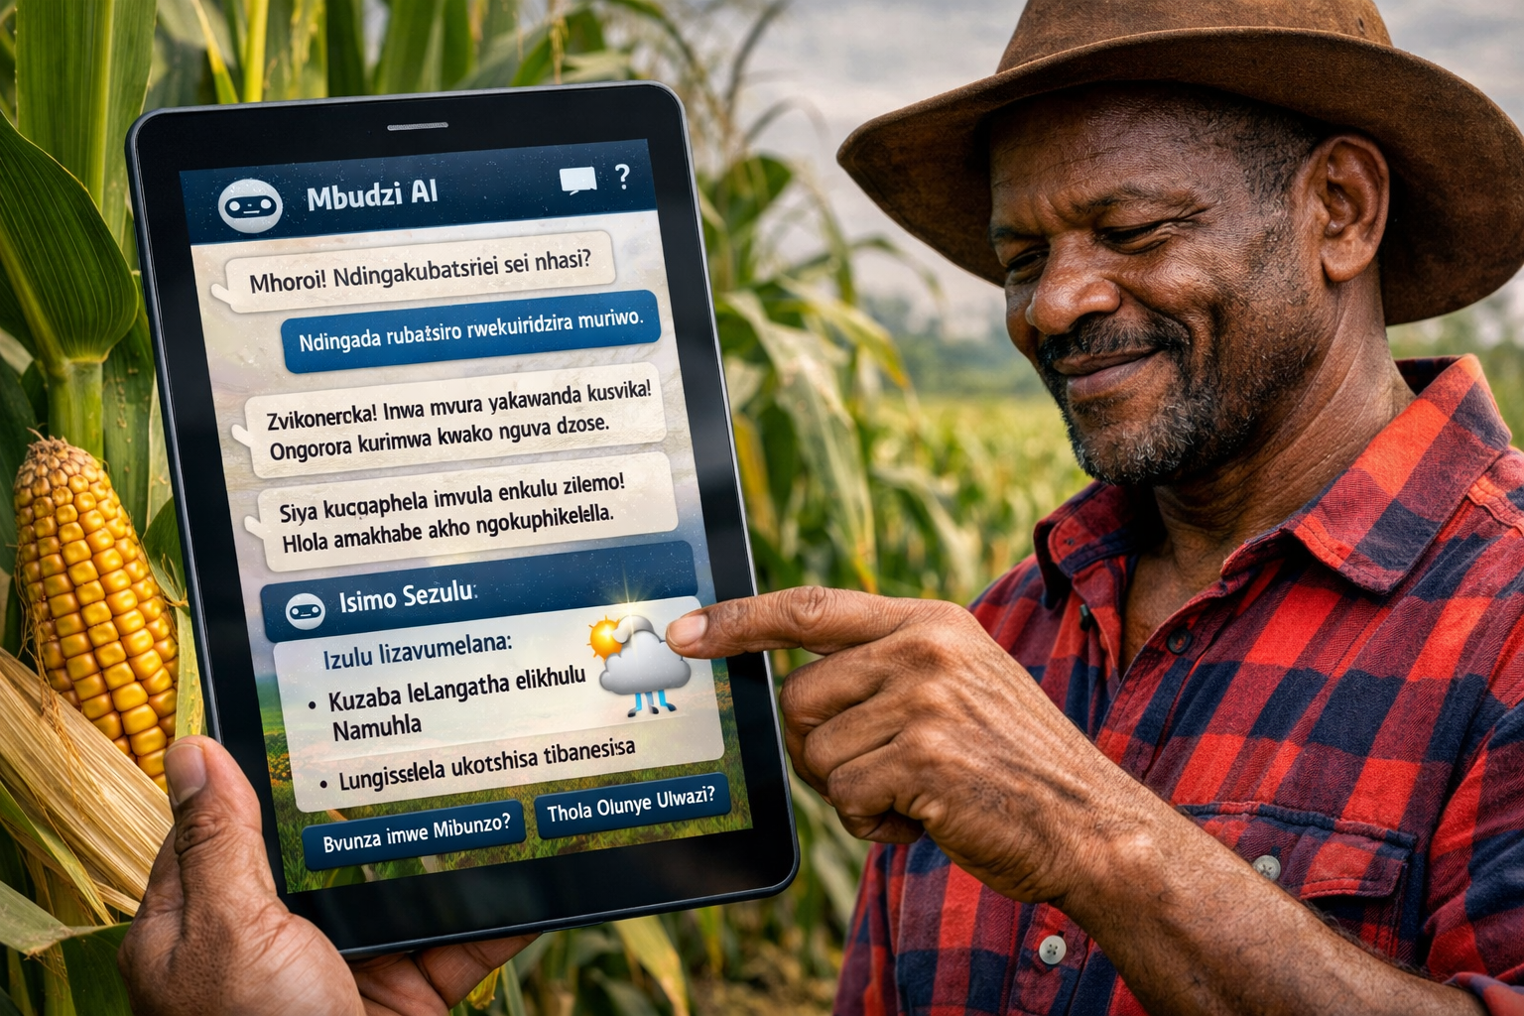
Application 3 – Climate-Smart Advisory at Scale
AI chatbots trained on Zimbabwean crop calendars
24/7 farmer support: pest control, seed selection, mulching advice
Bridges extension officer gap
Multiplies human expertise tenfold

Slide 12
Additional AI Applications for Agriculture
Smart Irrigation: AI-controlled drip systems optimize water use
Supply Chain Optimization: Predict demand, reduce post-harvest losses
Livestock Monitoring: Wearables track animal health & productivity
Soil Health Mapping: AI integrates sensor & satellite data for fertility maps
Market Price Forecasting: AI predicts commodity prices for farmer bargaining power
Carbon Farming: AI tracks soil carbon sequestration for climate credits

Slide 13
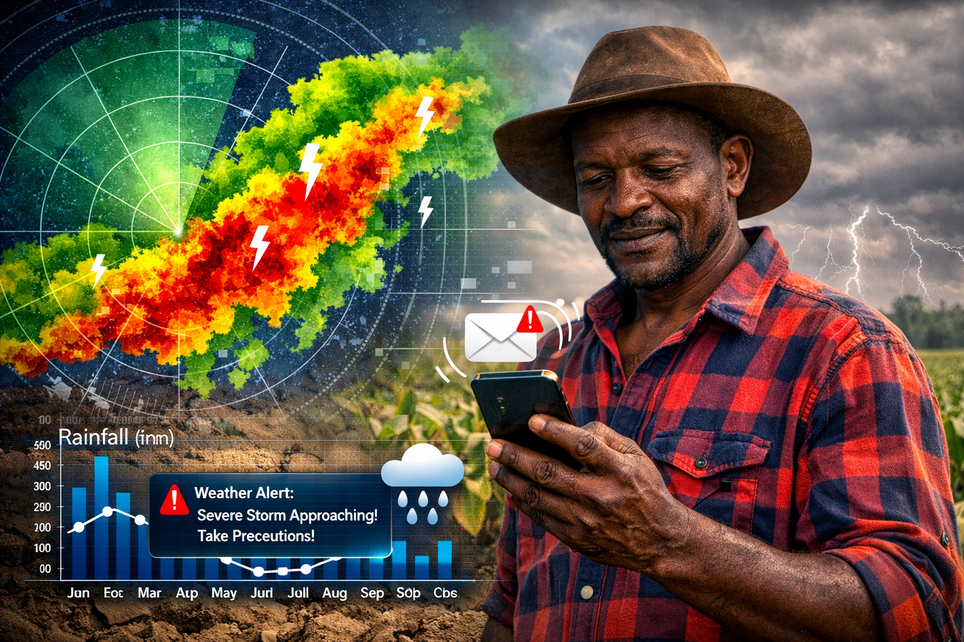
Eyes in the sky
Zimbabwe successfully launched its second earth observation satellite, ZimSat-2, into orbit on November 5, 2024.
Developed by the Zimbabwe National Geospatial and Space Agency (ZINGSA) in collaboration with Southwest State University in Kursk, Russia.
ZimSat-2 is designed to gather vital scientific data
Agricultural Support: It is equipped with a high-resolution multispectral camera to track crop health, predict agricultural yields, and identify nutrient deficiencies.

Slide 14
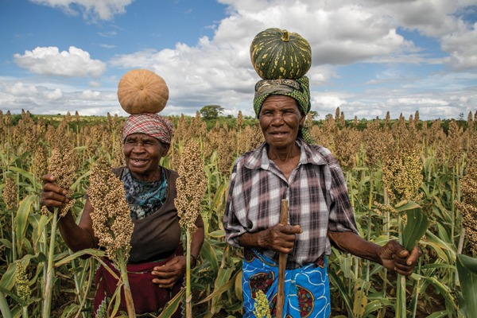
Barriers to Adoption
Fragmented, analog agricultural data
Limited rural connectivity
Need for Zimbabwe-specific AI models
Skills gap: data scientists leaving for abroad

Slide 15
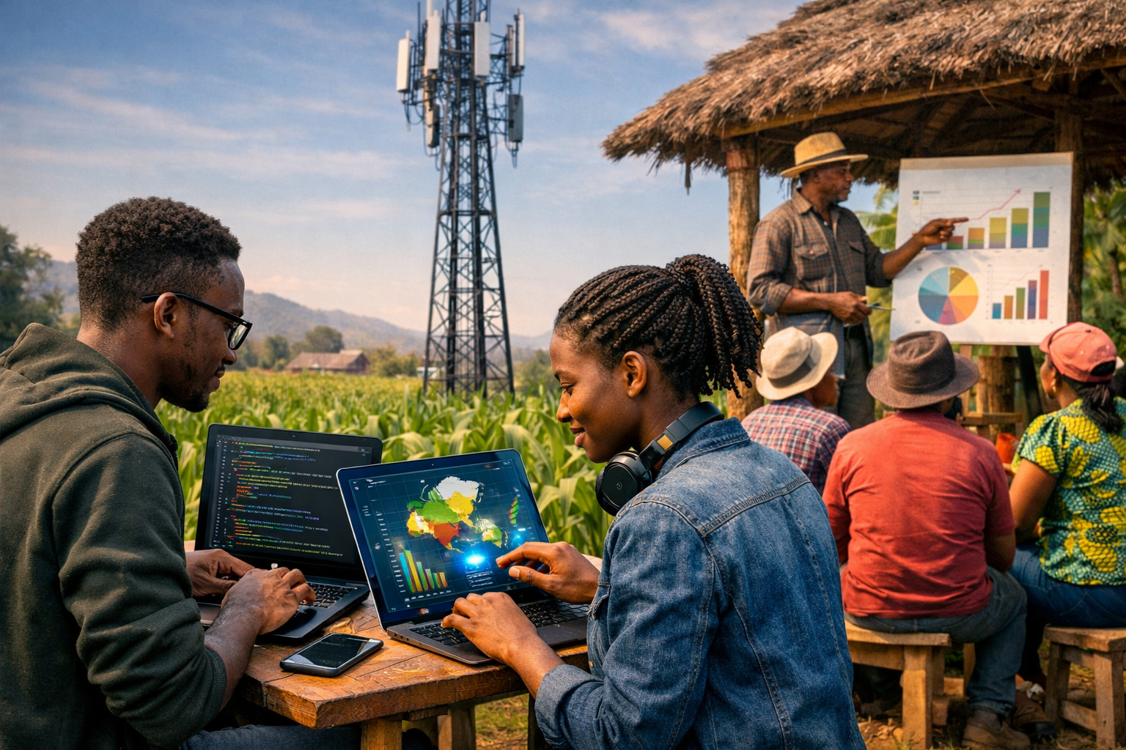
Action plan
Move from pilot projects to national infrastructure
Train young Zimbabwean data scientists locally. We have young Zimbabweans studying computer science, data science, agronomy. Keep them here. Offer fellowships, hackathons with real prizes, and access to government data. The AI grand Challenge
Partner with mobile operators, rural banks, cooperatives
Zimbabwe has better mobile penetration than some African countries
Digitize agronomic & weather data
Affordable connectivity for rural farmers- USSD code – * dial star 123# * – that any phone, even a basic feature phone, can access. That is the ultimate equity tool.

Slide 16
Digitise historical data
Every student in agricultural colleges should do a practical assignment: taking paper records from their home district and entering them into a national open repository. That is low-cost and high-impact.
Launch pilot projects in different regions
One in a semi-arid area (e.g., Mberengwa) focusing on drought prediction. One in a humid area (e.g., Chipinge) focusing on disease detection. One in a peri-urban area (e.g., Zvimba) focusing on market price and planting advisory integration.
Zimbabwe once fed a continent – it can do it again

