Slide 1

AI Education, Skills and Capacity Development
Building Human Capital for the Fourth Industrial Revolution and Beyond
Prof. Dr. Eng. Tawanda Mushiri
Executive Director Technical – SIRDC
Professor of Artificial Intelligence
AI TechForum Summit,
Masvingo
18 June 2026.
+263773245571

Slide 2
Presentation Outline.
Introduction
Why Education Matters
Zimbabwe National AI Strategy Pillars
Flagship Initiatives: Igniting the National AI Mission
Implementing AI Governance
AI Skills Gap + Pyramid
AI Education Framework, Ecosystem
Top 10 Career Opportunities

Slide 3
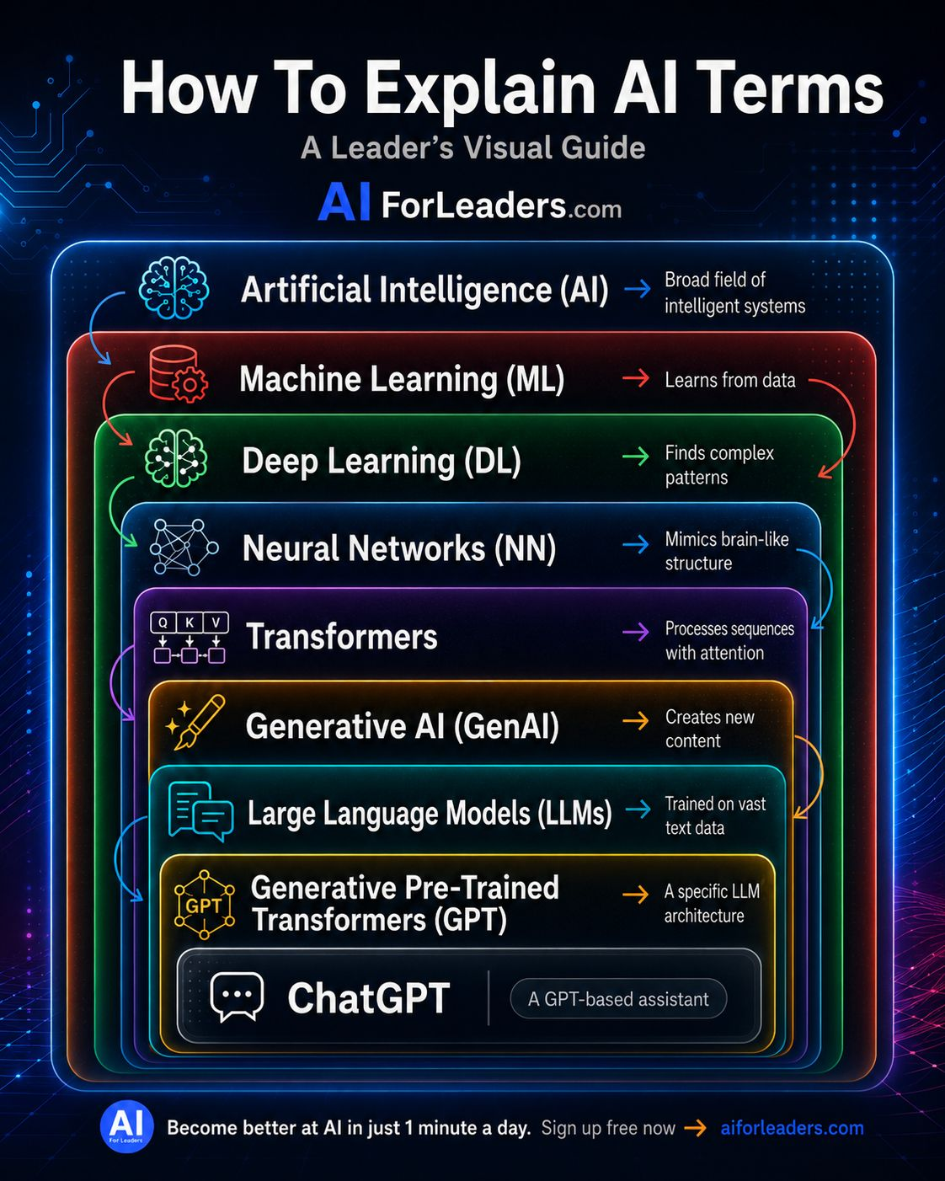
Introduction
What is Artificial Intelligence?
Learning
Reasoning
Problem Solving
Decision Making
Natural Language Understanding

Slide 4
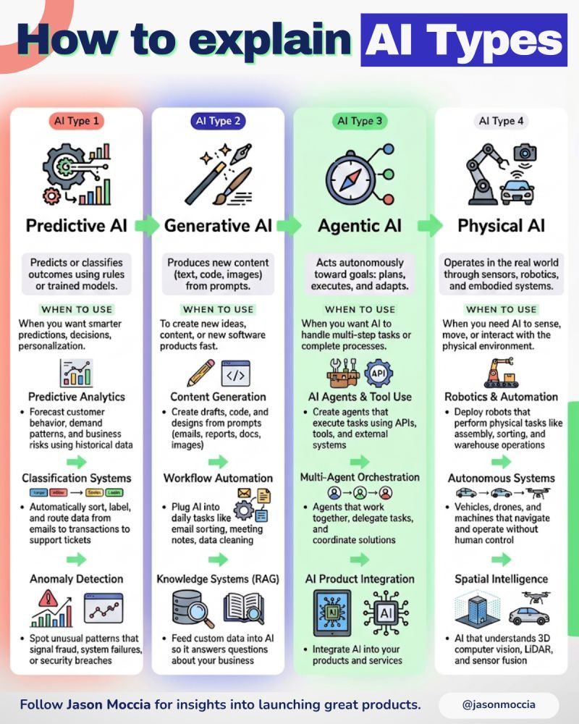
Why AI Education Matters
AI is transforming all sectors.
Health
Agriculture
Manufacturing
Mining
Education
Government

Slide 5
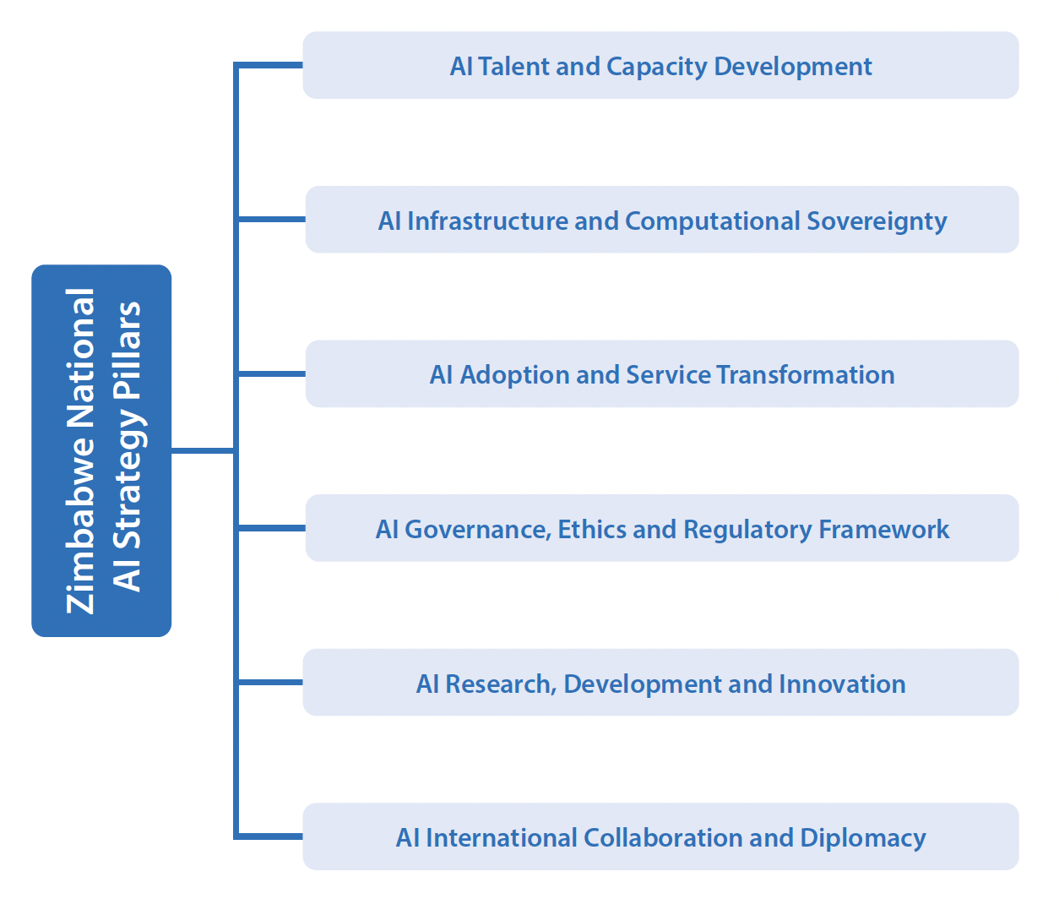

Slide 6









PILLAR 1: AI TALENT & CAPACITY DEVELOPMENT
Guiding Principles
Zimbabwe aims to cultivate, retain and empower a world-class AI talent ecosystem capable of driving innovation, adapting to rapid technological change, and applying AI solutions to national priorities. Building on the country's high literacy rate and the Heritage-Based Education 5.0 framework, this pillar positions human capital as Zimbabwe's greatest AI asset.
Education & AI Literacy
Embedding AI and data literacy at every educational level, from age-appropriate modules in primary schools to mandatory "AI and Society" courses in all tertiary programs.
Tertiary & Research Capacity
Establishing three National AI Centers of Excellence at major universities by 2027, each hosting PhD fellows and specializing in priority AI application domains.
Validation Questions
1.
How should AI concepts be introduced in primary and secondary education curricula?
Workforce Development
2.
What are the most critical AI skills gaps in Zimbabwe's current workforce?
3.
How can Zimbabwe effectively attract and retain AI talent from the diaspora?
Creating Public Sector AI Academies for civil servants and specialized sector-specific academies, complemented by subsidized access to world-class AI education platforms.
Key Enablers: Education, Workforce Development, Talent Cultivation
Implementing fractional appointment programs and Presidential AI Scholarships to harness diaspora expertise and tackle brain drain through competitive incentive packages.
Diaspora Engagement

Slide 7






PILLAR 2: NATIONAL AI INFRASTRUCTURE
Guiding Principles
Zimbabwe will establish sovereign, secure, and sustainable digital infrastructure to support AI development and deployment, focusing on computational capacity, data platforms, and connectivity.
High-Performance Computing
Expanding the Zimbabwe Centre for High Performance Computing (ZCHPC) with specialized AI accelerators and regional compute nodes.
National Data & AI Platform
Creating Project "Pangolin" - a sovereign data platform with foundational datasets and privacy-preserving APIs for researchers.
Connectivity & Digital Inclusion
Expanding broadband access to 85% of the population by 2030, with focus on rural connectivity and affordable data plans.
Validation Questions
1.
Are the infrastructure priorities correctly identified for Zimbabwe's AI needs?
2.
How can we ensure infrastructure reaches rural and underserved areas?
Guiding Principle:
Sovereignty & Self-Determination
Zimbabwe National AI Strategy 2026-2030

Slide 8

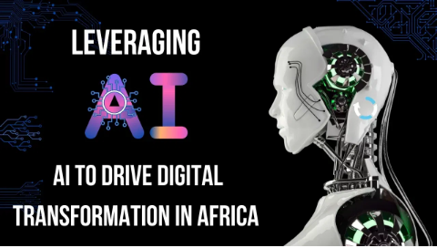
PILLAR 3: AI ADOPTION & SERVICE TRANSFORMATION
Zimbabwe will drive sector-wide AI adoption to improve service delivery, optimize industries, and enhance citizen experiences across key economic sectors while ensuring equitable access.
Agriculture & Food Security
Healthcare System
Education System
Financial Services
• Precision farming with
• Enhanced diagnostic capabilities
• Personalized learning systems
• AI-powered financial inclusion
satellites/drones/IoT
• Telemedicine access expansion
• Intelligent tutoring systems
• Credit scoring & risk assessment
• AI crop disease & pest detection
• Public health monitoring
• Localized educational content
• Mobile banking & digital payments
• Climate-smart agriculture systems
• Supply chain optimization
• Student performance analysis
• Fraud detection & prevention
• Market intelligence & pricing tools
• Mental health support systems
• Administrative efficiency tools
• Investment advisory services
• AI-driven credit scoring & insurance
Mining Sector
Manufacturing & Industry
Transportation & Logistics
Energy Sector
• Predictive maintenance systems
• Smart manufacturing processes
• Traffic flow optimization
• Smart grid optimization
• Geological analysis & resource
• Quality control systems
• Fleet management systems
• Renewable energy integration
assessment
• Supply chain management
• Logistics & supply chain streamlining
• Demand forecasting & planning
• Safety & environmental monitoring
• Predictive maintenance
• Public transport improvement
• Energy efficiency optimization
• Supply chain optimization
• Product design & innovation
• Autonomous vehicle systems
• Grid resilience & maintenance
• Compliance monitoring systems
SMEs Sector
Water, Environment & Tourism
Defence & Security
Public Service Excellence
• Intelligent customer service tools
• Cybersecurity enhancement
• Intelligent service portals
• Predictive analytics for marketing
• Smart water grid management
• Border management systems
• Automated transaction processing
• Automated logistics systems
• Environmental monitoring systems
• Forensic investigation tools
• Citizen engagement platforms
• Support for women/youth enterprises
• Eco-tourism planning tools
• AI-driven threat detection
• Personalized government services
• Digital resilience solutions
• Geospatial intelligence applications
• Smart surveillance systems
• Data-driven decision support
• Climate resilience solutions
Zimbabwe National AI Strategy 2026-2030 | Guiding Principle: Inclusive Development

Slide 9

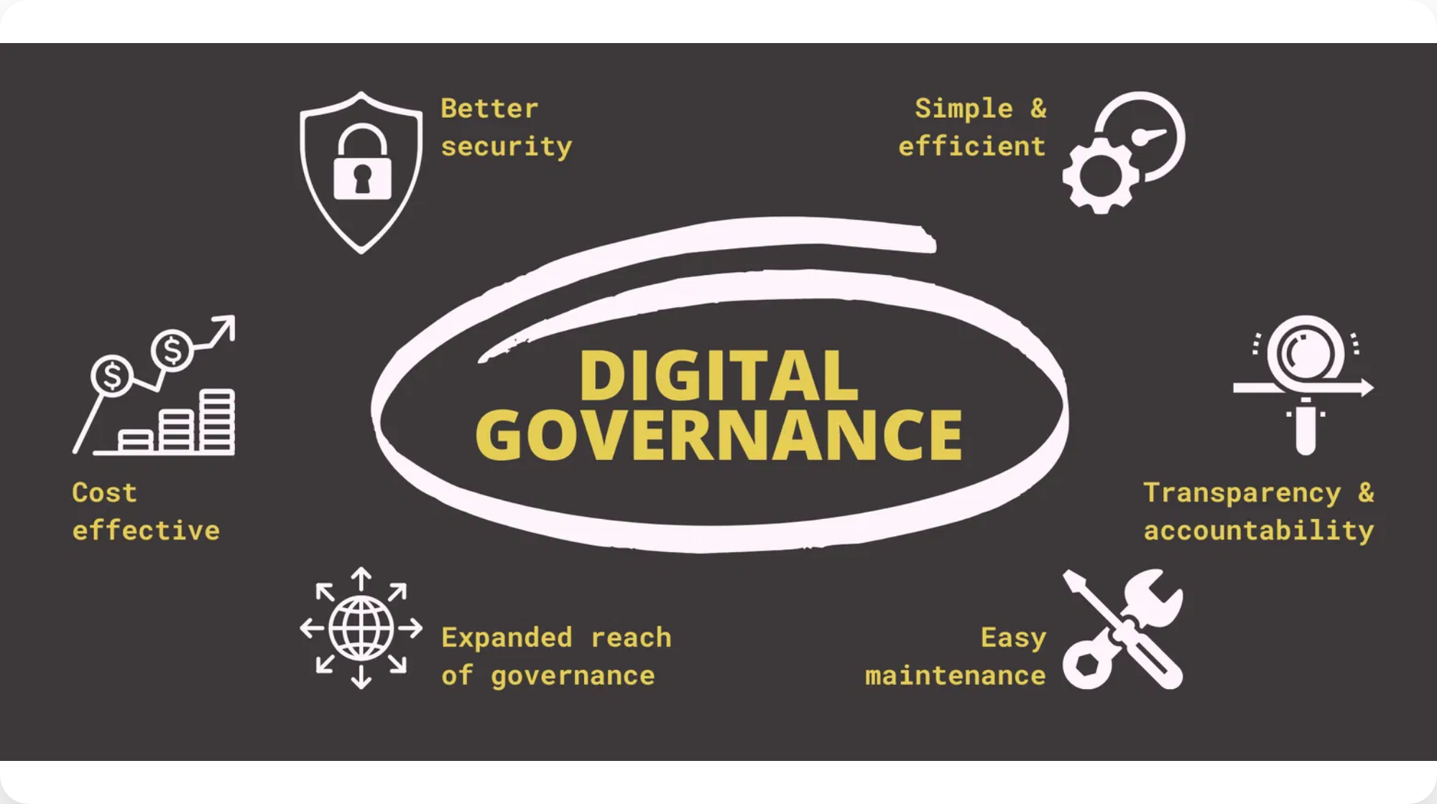




PILLAR 4: GOVERNANCE, ETHICS & REGULATORY FRAMEWORK
Guiding Principles
Zimbabwe will implement an Ubuntu-based governance framework that balances innovation with responsibility, ensuring AI systems uphold human dignity, cultural values, and national sovereignty.
Multi-Level Governance Architecture
Establishing a three-tiered governance system with the National AI Council for strategic oversight, the AI Strategy Implementation Office for coordination, and Technical Working Groups for specialized expertise.
Ethical AI Framework
Developing an Ubuntu-based ethical framework with mandatory impact assessments, algorithmic transparency requirements, and a national AI ethics committee for high-risk applications.
Regulatory Framework
Validation Questions
Creating a risk-based regulatory approach with the AI Regulatory Sandbox ("Innovation Crucible") to test policies and develop harmonized standards for responsible AI deployment.
1.
How can we best incorporate Ubuntu philosophy into AI governance?
2.
What additional safeguards are needed for high-risk AI applications?
3.
How can governance structures remain adaptive to rapid technological change?
Key Enablers: Regulatory Framework, Ethics, Adaptive Governance
Zimbabwe National AI Strategy 2026-2030

Slide 10









CROSS-CUTTING ENABLERS & THEMES
Guiding Principles
Seven cross-cutting enablers work synergistically across all strategic pillars to create a cohesive ecosystem that balances innovation with responsibility and inclusion with excellence.
Education & AI Literacy
Workforce Development
Curriculum reform and teacher training
National upskilling platforms
Talent Cultivation
Regulatory Framework
Research excellence and diaspora engagement
Adaptive governance structures
Ethics & Responsible AI
Strategic Partnerships
Ubuntu-based ethical frameworks
Regional and international cooperation
Integration Themes
Digital Equity & Inclusion
Cultural Preservation
Adaptive Governance
Sectoral Synergies
Validation Questions
1.
Are these enablers comprehensive for Zimbabwe's context?
2.
How can we ensure effective integration across all pillars?
Guiding Principle:
Innovation with Responsibility
Zimbabwe National AI Strategy 2026-2030

Slide 11


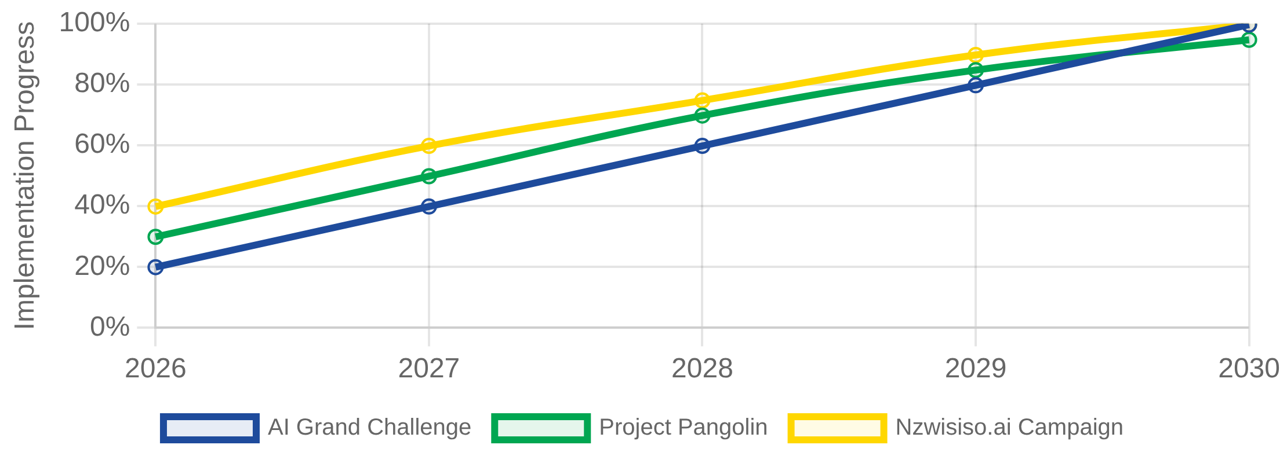
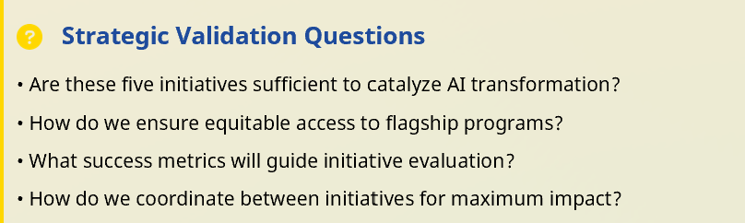




Flagship Initiatives: Igniting the National AI Mission
Initiative Implementation Timeline
1. The Zimbabwean AI Grand Challenge
A national competition to identify and fund innovative AI solutions addressing Zimbabwe's most pressing challenges
Key Components:
• Annual competition with a prize pool • Focus areas: agriculture, healthcare,
education, mining • Public-private partnership model • International expert judging
panel
2. Project "Pangolin" - National AI Platform
A secure, sovereign infrastructure providing computational resources and data services for AI development
4. AI Regulatory Sandbox
Infrastructure:
"Innovation Crucible" - A safe space for testing innovative AI applications under regulatory supervision
• High-performance computing centers • Secure data lakes and APIs • Cloud-native AI
development tools • 24/7 technical support services
3. "Nzwisiso.ai" National Literacy Campaign
Benefits:
A comprehensive program to build AI awareness and skills across all segments of society
• Reduced regulatory barriers • Real-world testing environment • Stakeholder feedback
loops • Policy development insights
Reach:
• 2M citizens trained by 2030 • Multi-language content (Shona, Ndebele, English) •
Mobile-first delivery platform • Community ambassador network
5. "Mugove/Isabelo" Innovation Fund
A mineral wealth-funded sovereign fund to finance AI research, startups, and applications
Investment Focus:
• Early-stage AI startups • Research & development grants • Infrastructure
6
development • Skills development programs

Slide 12

















IMPLEMENTATION & GOVERNANCE
Guiding Principles
Zimbabwe's AI strategy will be implemented through a robust governance architecture and a phased roadmap that balances ambition with pragmatism, ensuring accountability, adaptability, and inclusive participation.
Governance Architecture
National AI Council
AI Strategy Implementation Office
Technical Working Groups
Strategic oversight and policy direction
Operational coordination and monitoring
Specialized expertise and execution
Implementation Roadmap (2026-2030)
Stakeholder Roles
1
Foundation Building
2
Core Engine Building
3
National Transformation
Government:
Visionary architect
Citizenry:
Sovereign and soul
Q1-Q4 2026
Q1 2027 - Q4 2028
Q1 2029 - Q4 2030
Industry:
Engine of creation
Academia:
Fountain of truth
Establish governance structures
Infrastructure development
Ecosystem maturation
Civil Society:
Moral compass
Launch flagship initiatives
Human capital pipeline
Regional leadership
Secure foundational partnerships
Flagship initiative scaling
Global competitiveness
Validation Questions
1.
Is the proposed governance structure appropriate for Zimbabwe's context?
2.
Are the implementation phases realistic and achievable?
3.
How can we ensure effective coordination across stakeholders?
Guiding Principle:
Transparency & Accountability
Zimbabwe National AI Strategy 2026-2030

Slide 13

The AI Skills Gap
Challenges:
Shortage of AI professionals
Limited AI literacy
Lack of infrastructure
Brain drain

Slide 14
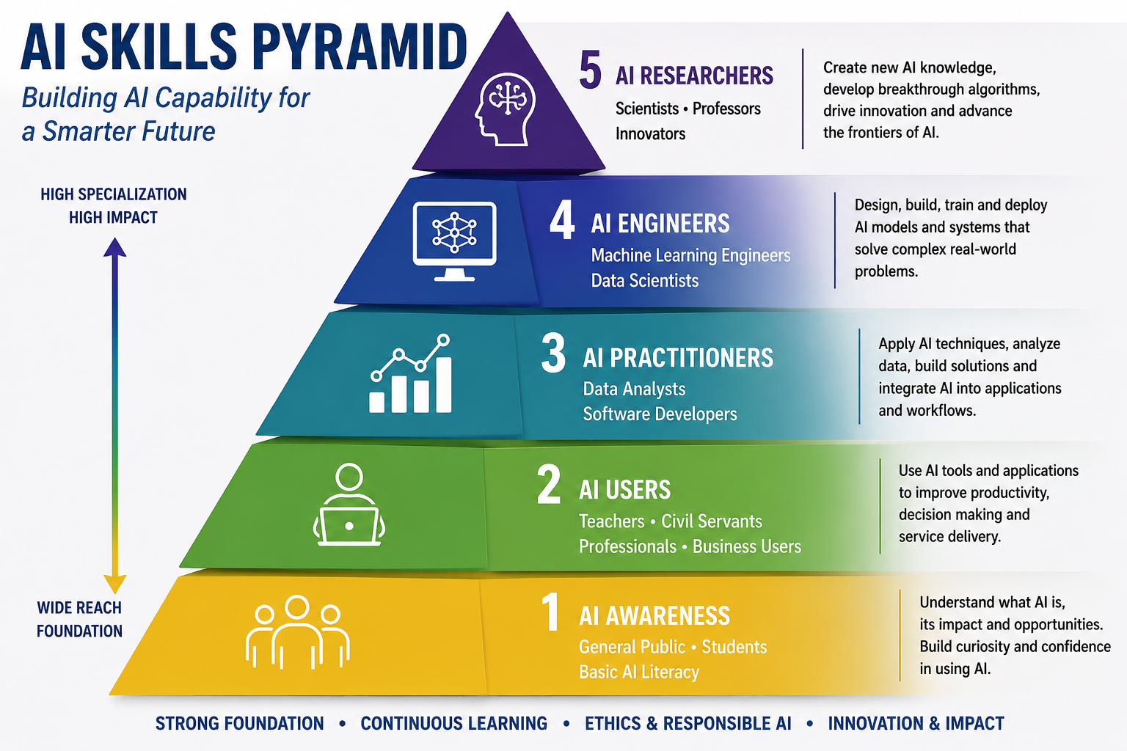
AI Skills Pyramid

Slide 15
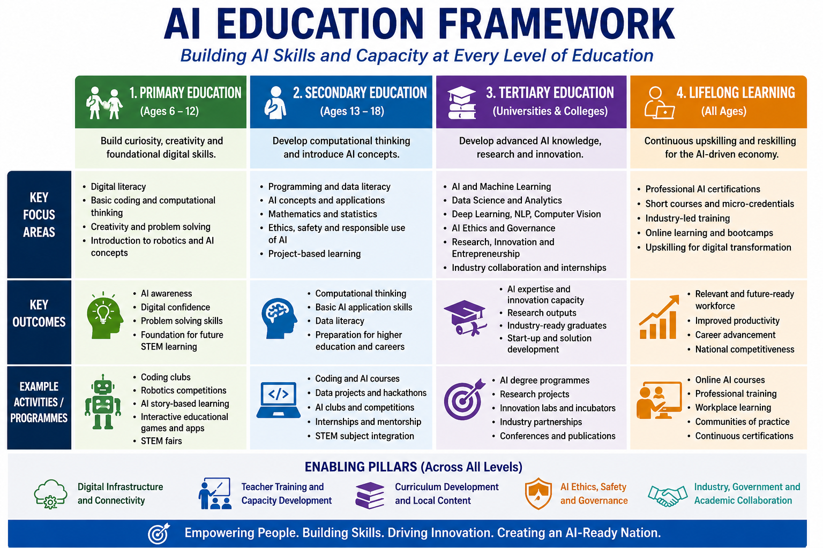

Slide 16
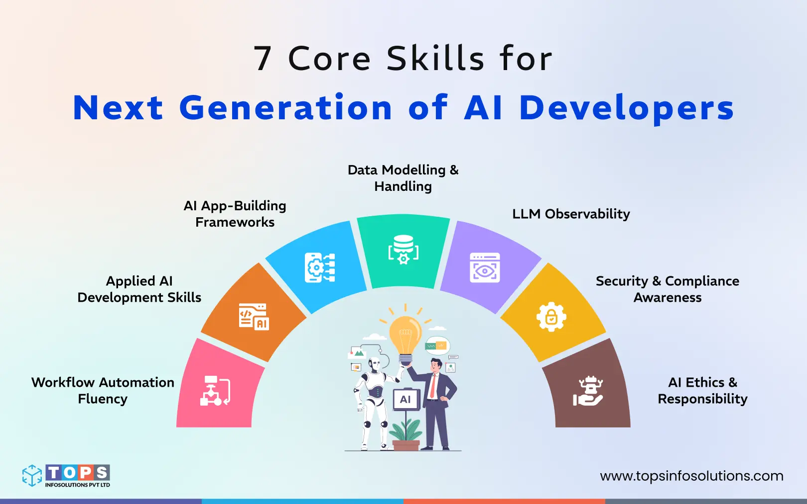
Core AI Skills Required
Programming, Machine Learning, Deep Learning, Data Analytics, Robotics, Cloud Computing

Slide 17
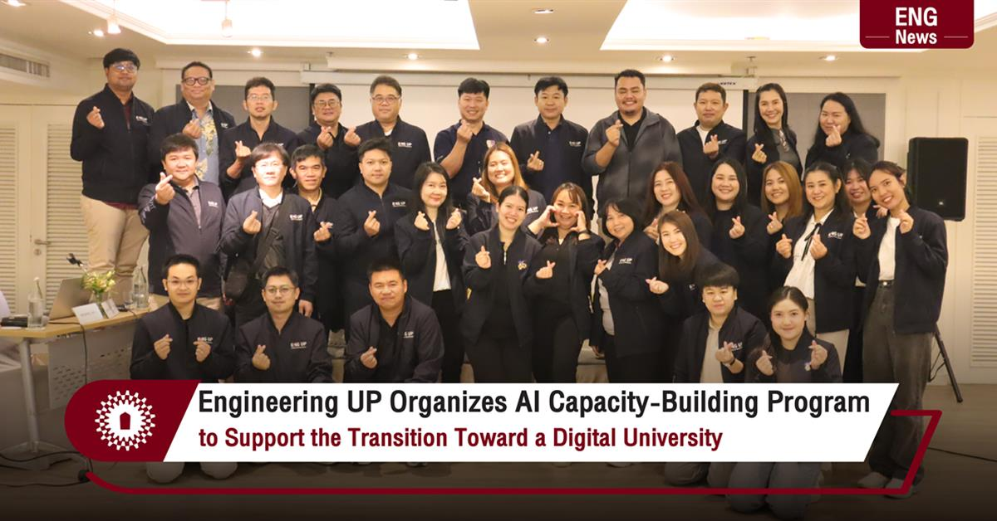
AI Capacity Building for Universities
AI Labs, HPC Infrastructure, Research Grants, Industry Partnerships

Slide 18
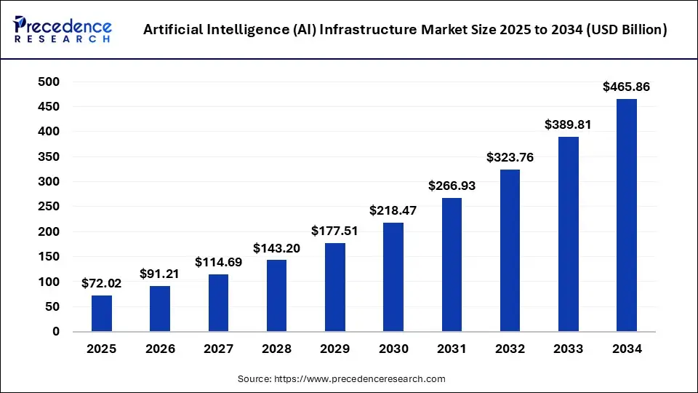
AI Capacity Development for Industry
Digital Transformation, Smart Manufacturing, Predictive Maintenance

Slide 19
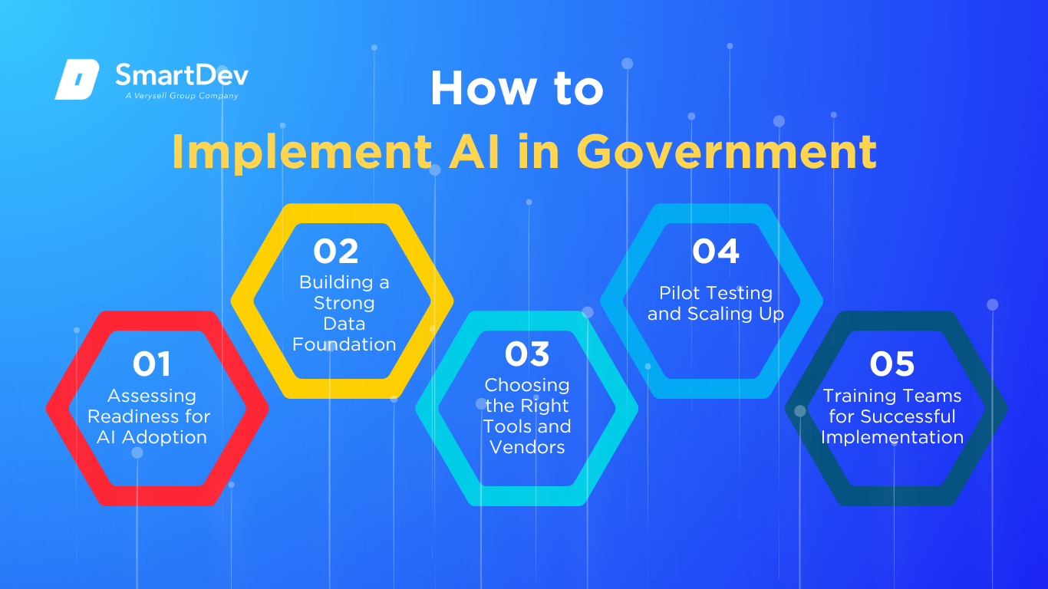
AI Capacity Development for Government
Smart Governance, AI Policy, Cybersecurity, Public Service Delivery

Slide 20
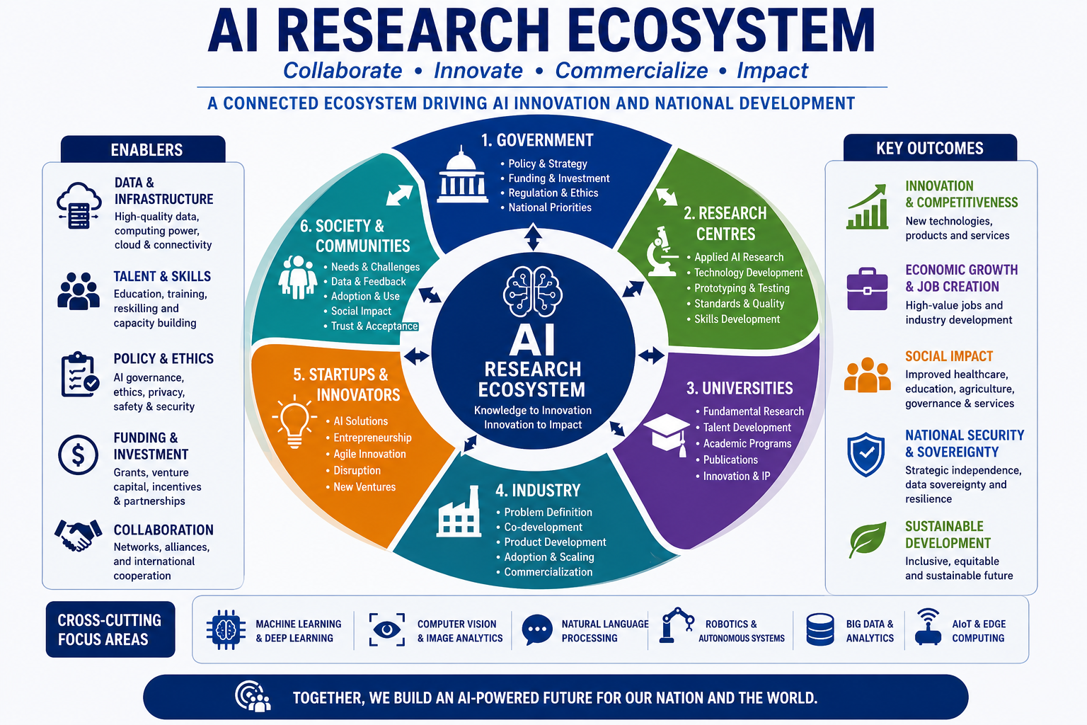
AI Research and Innovation Ecosystem

Slide 21
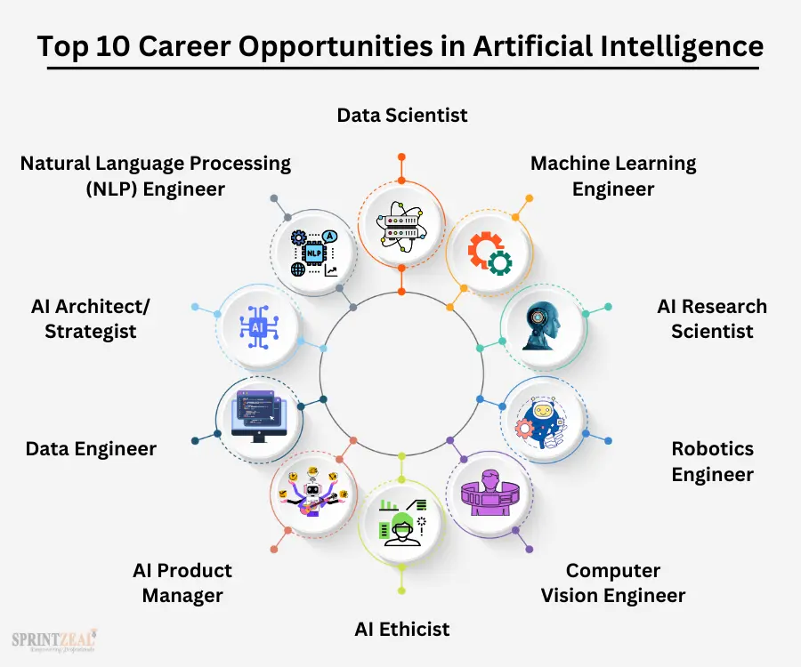
Emerging AI Career Opportunities
AI Engineer, Data Scientist, Robotics Engineer, AI Research Scientist

Slide 22
National AI Capacity Development Strategy
Education, Research, Infrastructure, Innovation, Ethics, Entrepreneurship

Slide 23
Zimbabwe's AI Vision
AI-ready workforce, innovation ecosystems, digital economy, Vision 2030

Slide 24
Recommendations
Short, Medium and Long-Term Actions for National AI Development

Slide 25
Conclusion
AI Education and Skills Development are Strategic National Imperatives.
Thank You

Slide 26
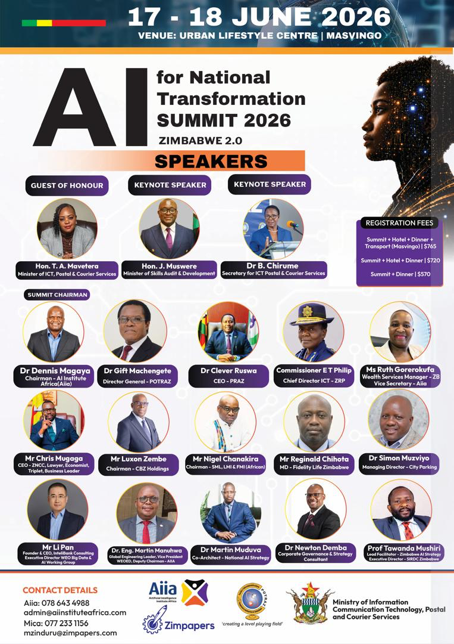
Acknowledgements

