Slide 1


AIIA
AGENTIC AI
NEUROWORKS
From Automation to Agentic Systems
The progression, real use cases, and the NeuroWorks architecture
Theme: Neuroworks & Agentic AI Systems for Enterprise Automation
Table of Contents
The Progression of Automation
What Changes With Agents
How Agentic Systems Work
Real Use Cases
Use Cases by Industry
Introducing NeuroWorks
NeuroWorks Architecture
The Execution Loop & Dual Engines
Key Takeaways & Closing
Presented by Arthur Magaya

Slide 2





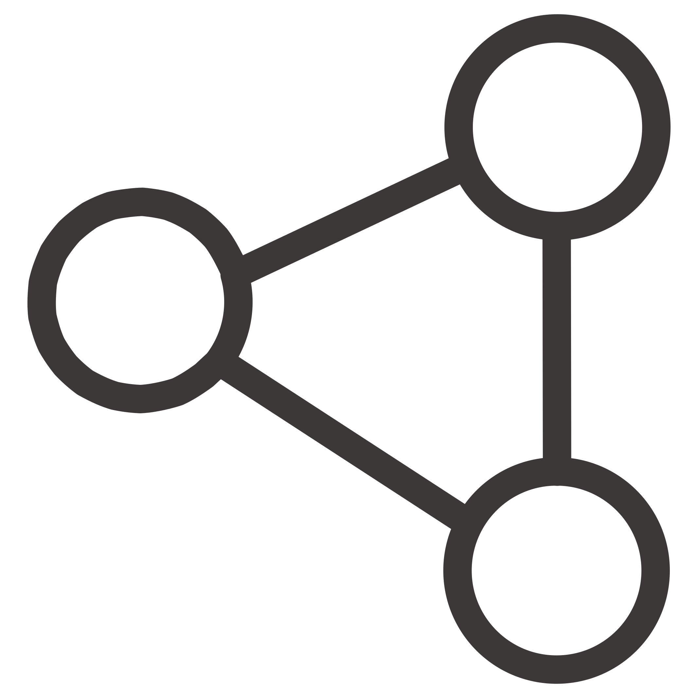
THE JOURNEY
The Progression of Automation
Each wave added more autonomy — from rigid scripts to coordinated, self-correcting agent teams.
Scripted Automation
Macros and scripts — fixed rules, brittle, breaks on change
RPA
Mimics clicks and forms — still rule-bound, no adaptation
Predictive ML
Detects patterns and forecasts — but takes no action
Generative AI & Chatbots
Produces content and answers — responds only to prompts
AI Agents
Understands goals, plans, uses tools, acts, and self-checks
Agentic Systems
Agents coordinate, hand off, and escalate — where NeuroWorks sits

Slide 3
THE SHIFT
What Changes With Agents
Chatbot
Agent
Replies to prompts — then stops
Reacts, never initiates
No memory of prior steps
No access to real tools
Pursues an outcome until done or approval is needed
Plans multi-step work and calls real tools
Remembers context across steps
Self-checks before escalating
Every agent is built on five components: Goal, Context, Tools, Memory, and Guardrails.

Slide 4
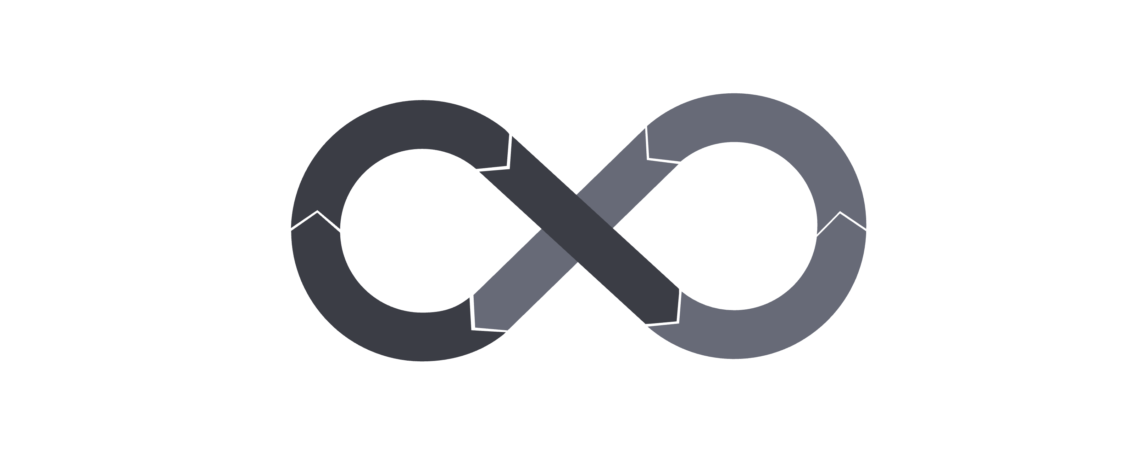
THE LOOP
How Agentic Systems Work
Perceive
Plan
Reflect
Act
This iterative loop lets agents handle complex, multi-step tasks — adapting as conditions change rather than stopping at the first obstacle.

Slide 5
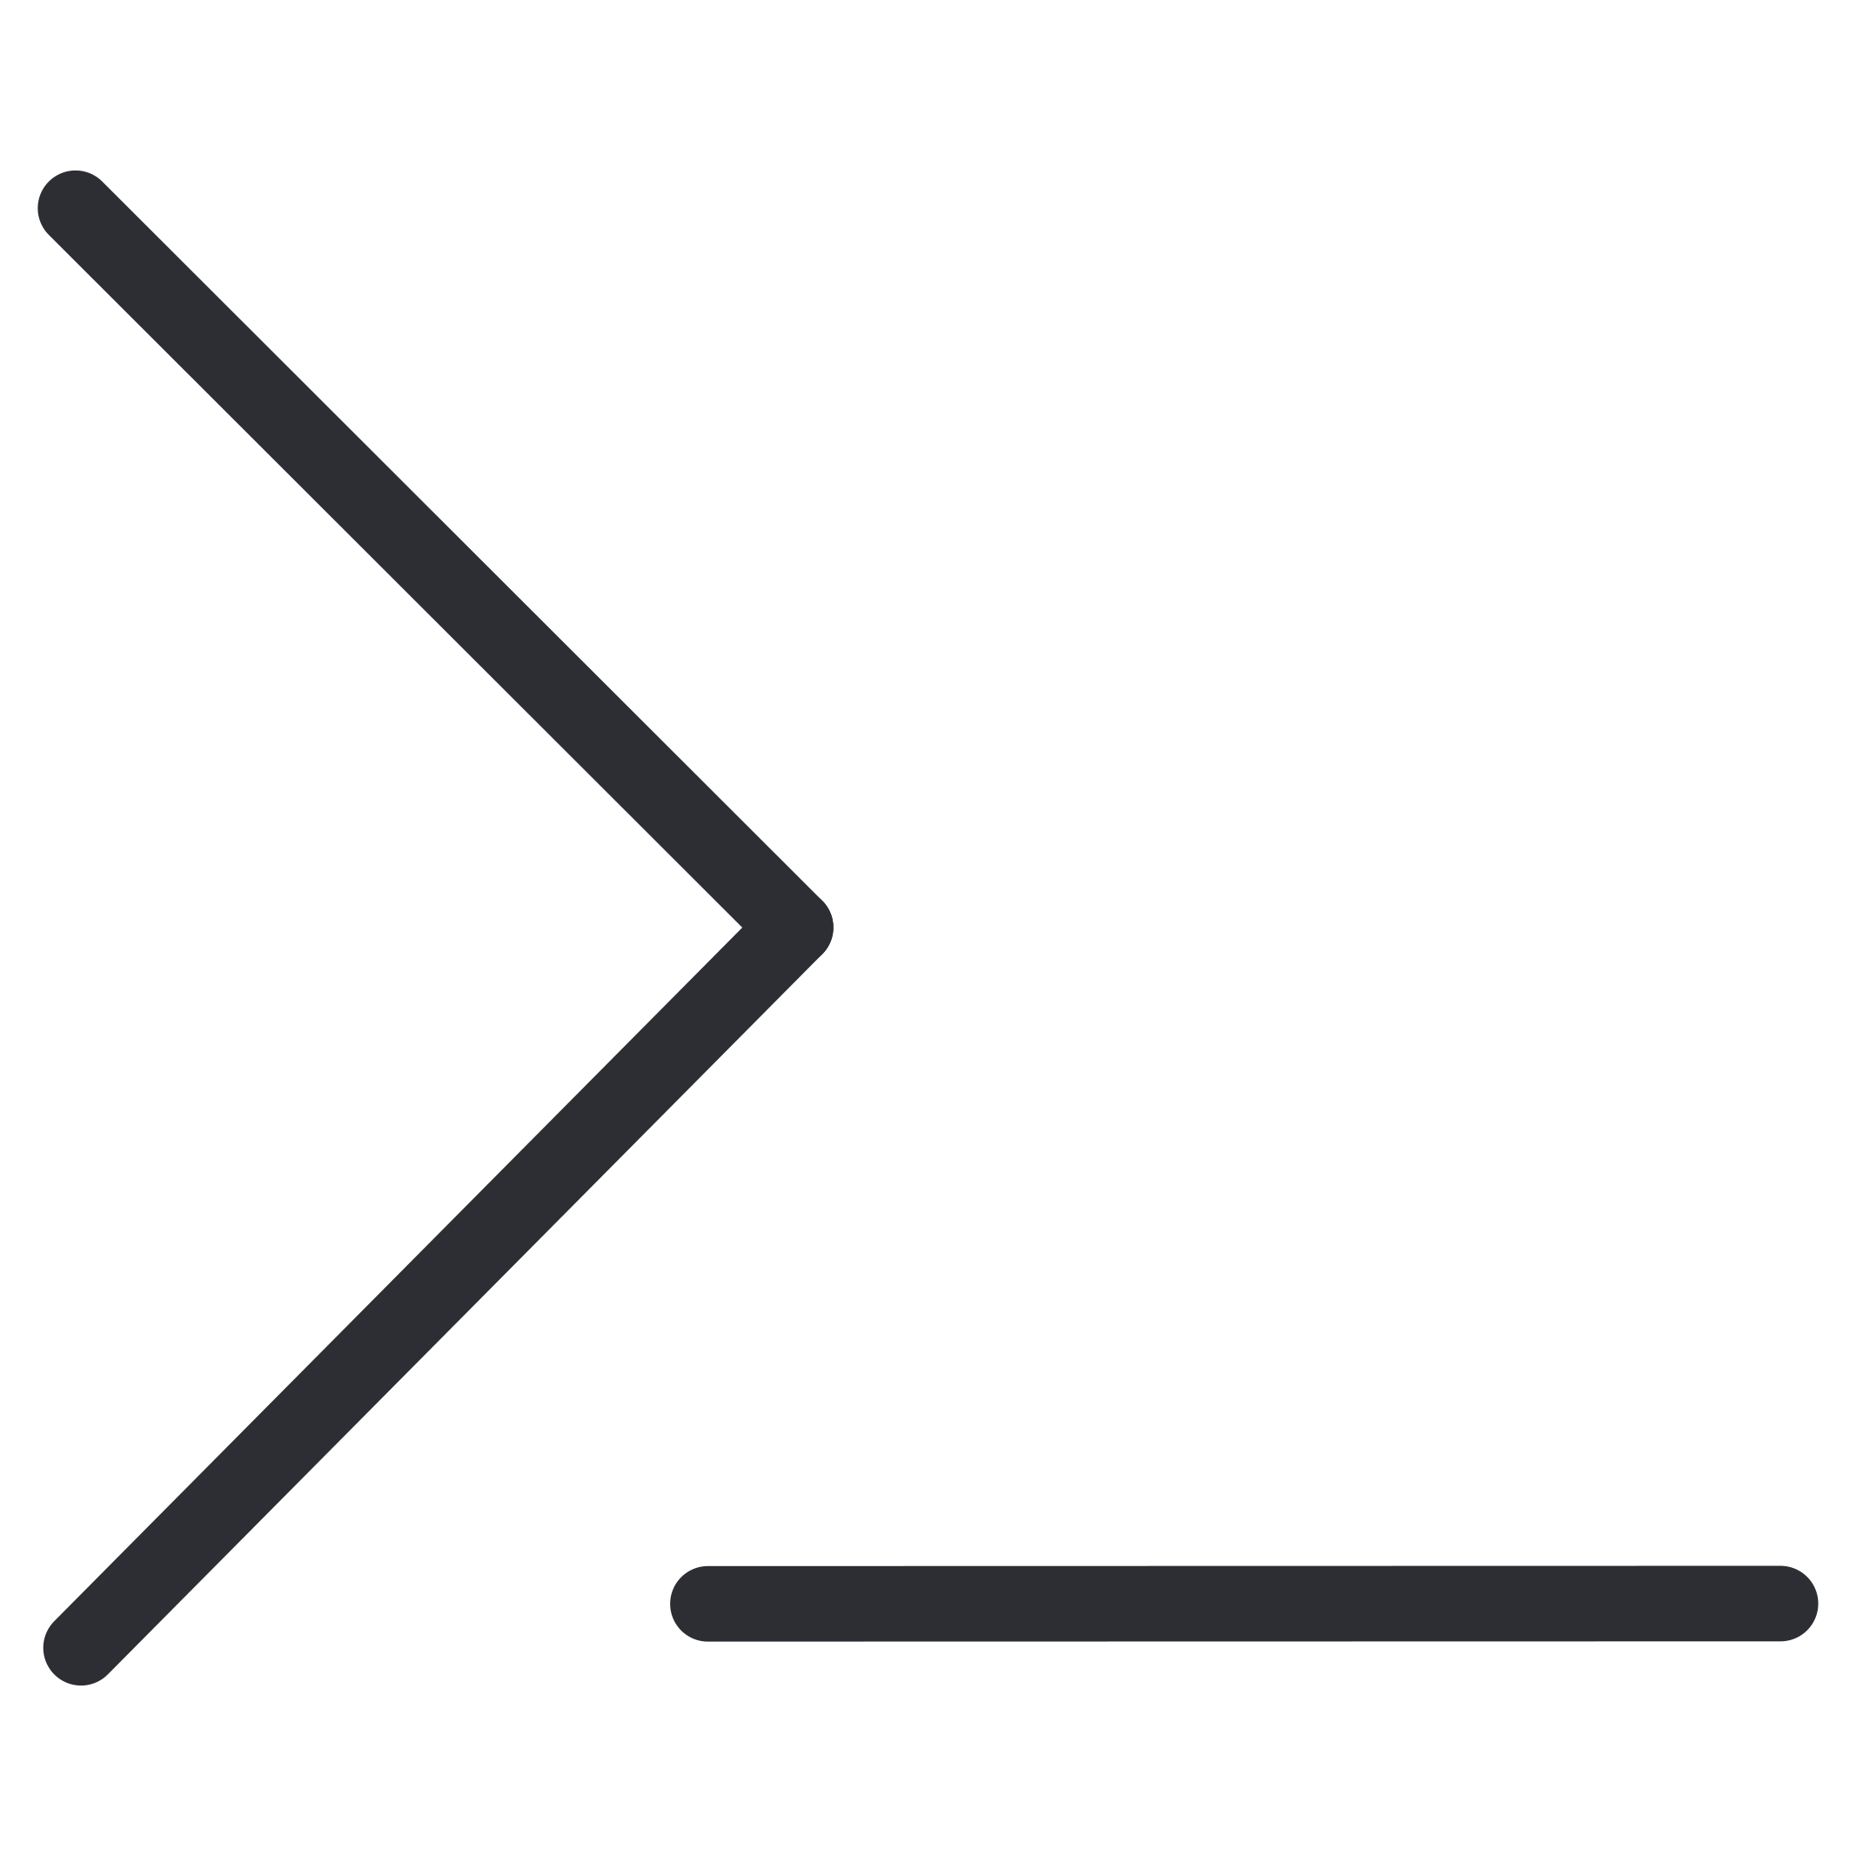





IN PRODUCTION
Real Use Cases of Agentic Systems
How agentic systems could be deployed across enterprise functions — not pilots, but production work.
Software Engineering
Customer Support
Coding agents plan, edit, run tests, and open pull requests
Resolution agents handle tier-1 tickets end-to-end, escalating edge cases
Sales Development
Finance & AP
Research prospects, draft outreach, update the CRM
Intake invoices, check policy, reconcile, flag anomalies
IT & Operations
Research & Analysis
Triage incidents, analyze logs, run approved runbooks
Gather, cross-check sources, and synthesize reports

Slide 6

BY INDUSTRY
Use Cases by Industry
Insurance
Banking
Healthcare Admin
Underwriting support, claims triage, policy-wording checks
KYC-lite onboarding, transaction monitoring, customer servicing
Scheduling, prior-auth prep, records summarization
Legal
Procurement
Contract review, clause extraction, precedent lookup
Supplier comparison, purchase requests, spend approvals

Slide 7
THE PLATFORM
Introducing NeuroWorks
An AI-powered agentic workforce platform that coordinates autonomous agents, shared tools, and governed workflows to complete complex work.
Autonomous Execution
Multi-Agent Orchestration
Real-Time Monitoring
Multi-step task execution without manual hand-holding
Live visibility into jobs, outputs, and system health
Routing, hand-off, and escalation between agents
Governed Access
Persistent Tracking
Approved capabilities only — no uncontrolled tool access
Full logs, artifacts, and state history for audit and recovery

Slide 8
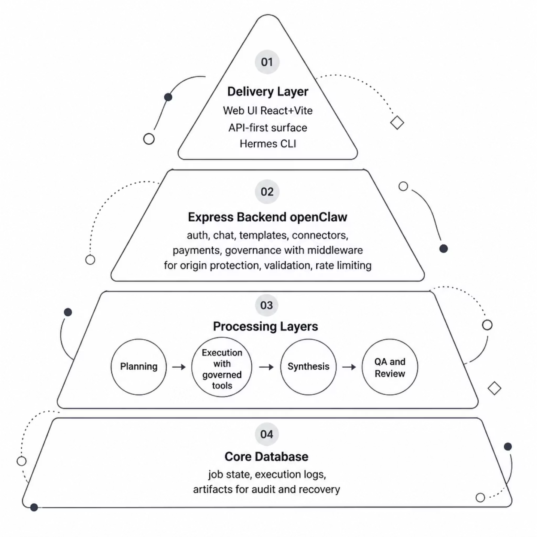
ARCHITECTURE
NeuroWorks Architecture — Layered Platform
A clean, layered pipeline — from delivery surfaces through orchestration and execution to durable storage. Each layer has a defined role, keeping the system auditable and resilient.
Delivery Layer — Web UI (React + Vite), API-first surface, and Hermes CLI
Express Backend — Auth, chat, templates, executor jobs, connectors, payments, governance
Processing Layers — Planning → Execution (governed tools) → Synthesis → QA & Review
Core Database — Job state, execution logs, and artifacts for audit and recovery

Slide 9
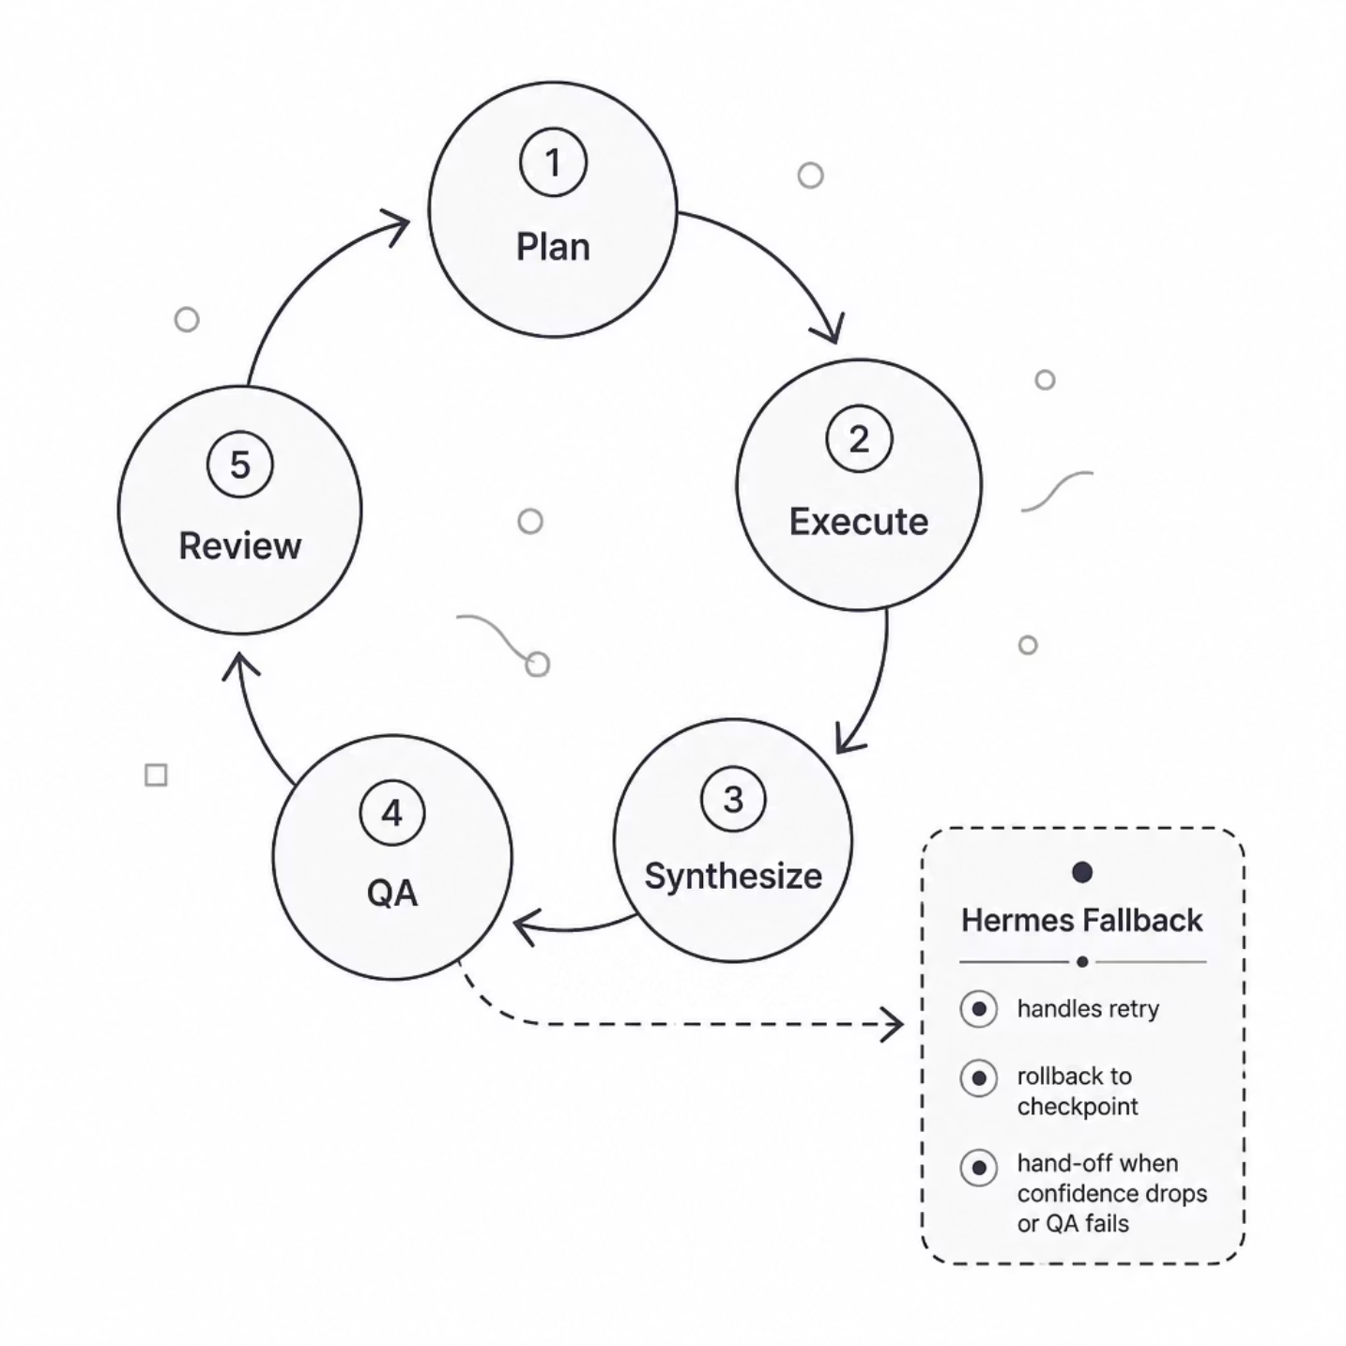
ARCHITECTURE
NeuroWorks — The Execution Loop & Dual Engines
A closed, checkpointed loop: Plan → Execute, Synthesize → QA → Review, then deliver. When confidence drops or QA fails, Hermes — a CLI agent fallback — takes over, retries, or hands off.
Main pipeline runs standard processing
Hermes calls approved capabilities through /api/primitives/call with allowlist-gated dispatch
Resilience: retry locally → roll back to last checkpoint → hand off to Hermes
Primitives layer: Vault, Connectors, Payments, Users/Org, Integrations, Web/Media

Slide 10




KEY TAKEAWAYS
Key Takeaways
Systems Need a Loop, Not a Prompt
Agentic value comes from closed execution cycles — plan, act, verify, and improve — not one-shot generation.
Confidence Must Be Earned
When uncertainty rises, systems should slow down, checkpoint, retry, or escalate rather than guess.
Guardrails Make Scale Possible
Permissions, approvals, and audit trails are not friction; they are the architecture that allows autonomy to grow safely.
Human Judgment Still Matters Most Where It Hurts
Payments, legal decisions, and customer-impacting actions should remain human-reviewed, even in highly automated workflows.
The Future Belongs to Composable Agents
NeuroWorks becomes powerful by orchestrating trusted primitives and fallback intelligence into a resilient operating model.
“The future won’t be defined by AI that acts alone, but by systems that know when to proceed, when to pause, and when to ask for help.”

Slide 11
AIIA
AGENTIC INTELLIGENCE
The coming wave of agentic intelligence will not merely augment our capabilities; it will redefine the very canvas of human endeavor, empowering us to build futures we once only dreamed possible.
— Arthur Magaya
0781253091

