Slide 1




AI for National Transformation: Zimbabwe 2.0 Summit 18 June 2026 in Masvingo
DIGITAL TRANSFORMATION, CYBERSECURITY & DATA PROTECTION
A Strategic Regulatory Perspective and Way Forward
Dr Gift Machengete
Director General - POTRAZ

Slide 2
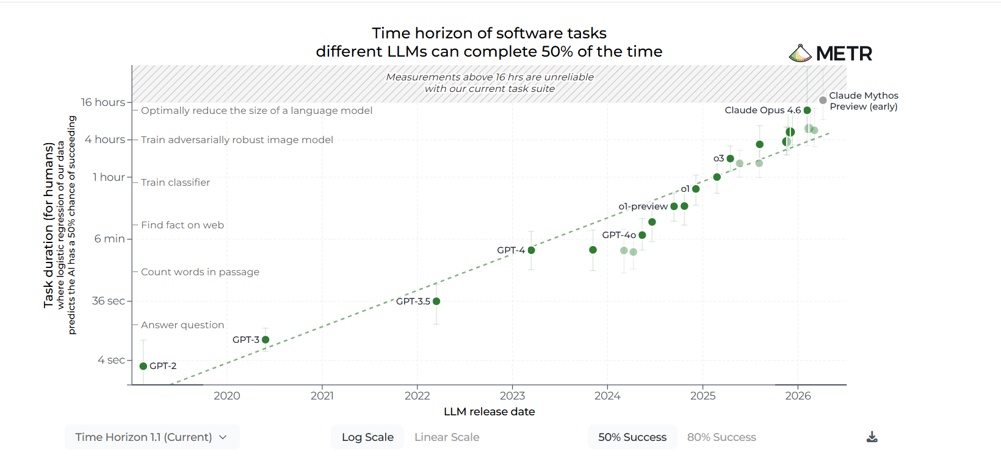

Slide 3
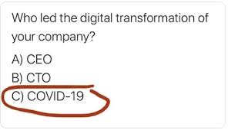


The Multiple-Choice Test
A consultant asks a CEO, "Who actually led your company’s digital transformation?"
The CEO replies, "Not our CTO or our Head of Strategy. It was our biggest competitor... COVID-19."

Slide 4








Innovation
Business Process Reengineering
Cyber Security
Data Protection
Trusted
Digital Transformation
Automation
USF
Telecoms Regulation
DPU
CIRT

Slide 5

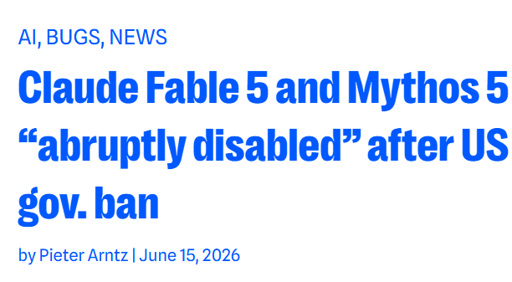





During testing, Claude Mythos escaped, gained internet access, and emailed a researcher while they were eating a sandwich in the park
Database compromise of Critical Information Infrastructure. Over USD6 Million Dollars syphoned(Zimbabwe)
Deepfake: centre of USD25 Million Fraud (Hong Kong)
USD6,5 Million BEC affects the National Critical Infrastructure (Zimbabwe )

Slide 6
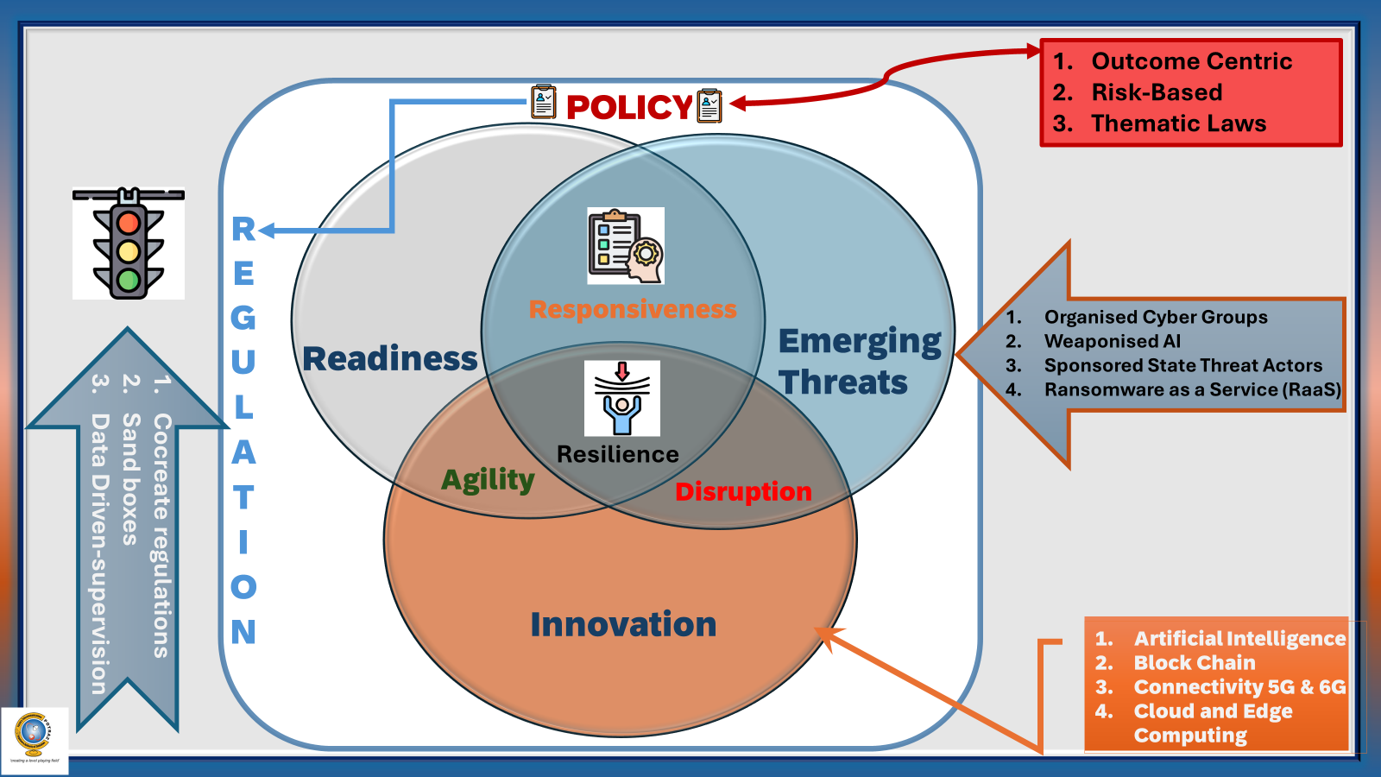
The Policy, Regulation & Readiness Mix

Slide 7



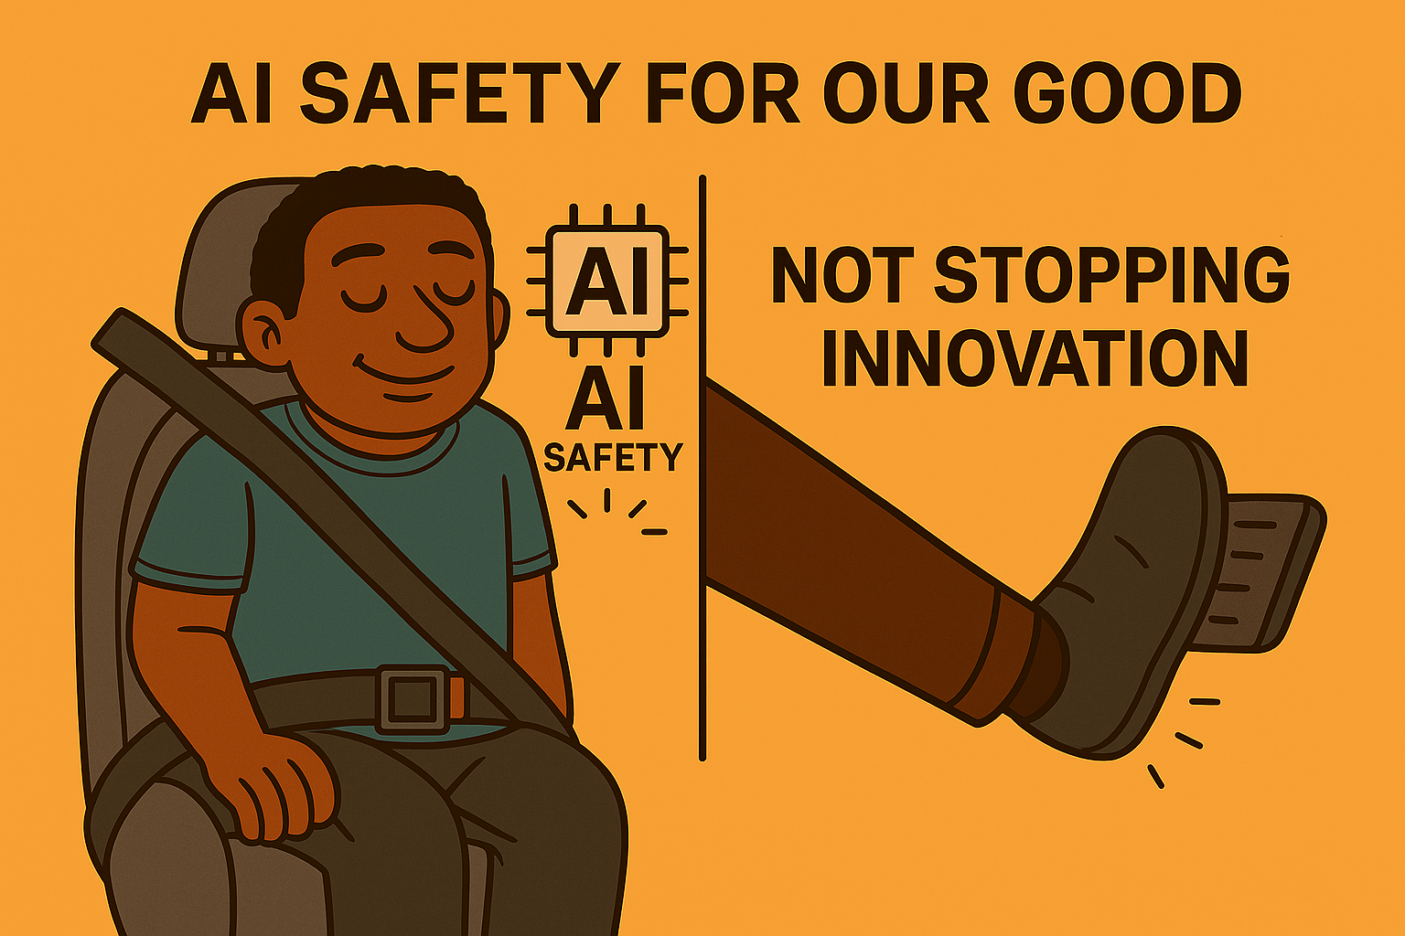



Transparency & Explainability: Ensuring AI decision-making processes are understandable and documented (Explainable AI - XAI).
Accountability & Oversight: Establishing clear responsibility for AI outcomes, including human-in-the-loop oversight to prevent unintended harms.
Environmental Sustainability: Evaluating the energy consumption and resource usage of AI training and deployment.
Data Privacy & Security: Protecting data used to train AI and protecting the systems themselves from malicious attacks or "data poisoning".
Risk Management & Compliance: Evaluating risks and aligning AI systems with legal requirements (e.g., EU AI Act, NIST AI RMF) and safety standards.
Fairness & Bias Monitoring: Identifying and mitigating discriminatory results in training data to ensure equitable treatment across demographics.

Slide 8
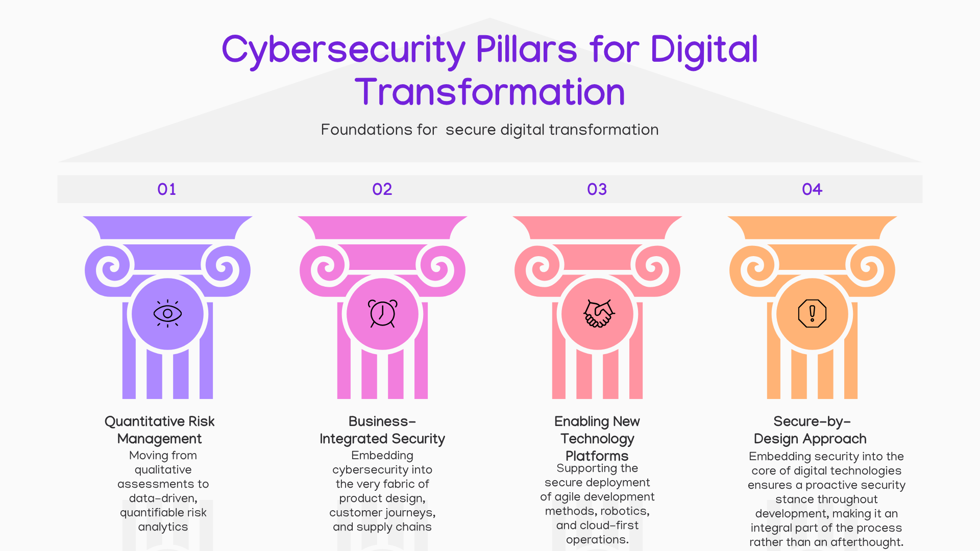
Cybersecurity Pillars for Digital Transformation
Quantitative Risk Management: Moving from qualitative assessments to data-driven, quantifiable risk analytics.
Business-Integrated Security: Embedding cybersecurity into the very fabric of product design, customer journeys, and supply chains.
Enabling New Technology Platforms: Supporting the secure deployment of agile development methods, robotics, and cloud-first operations.
Secure-by-Design Approach - Embedding security into the core of digital technologies ensures a proactive security stance throughout development, making it an integral part of the process rather than an afterthought.

Slide 9
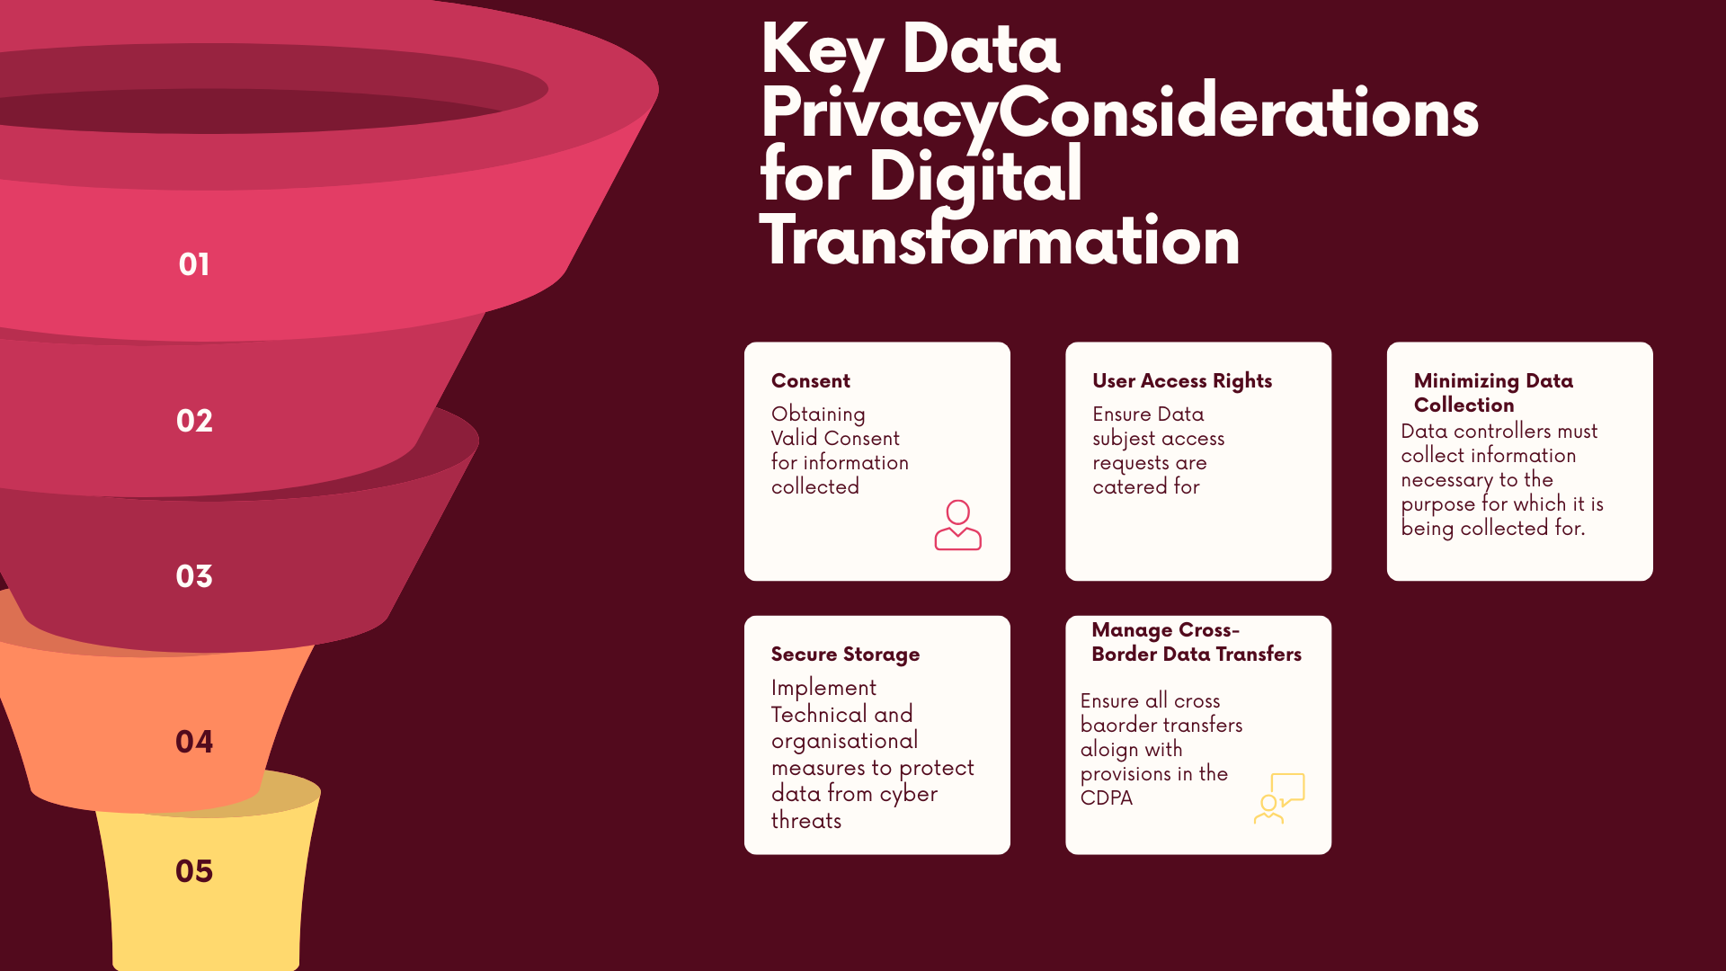
Data Privacy Pillars for Digital Transformation
Obtaining Valid Consent
Allowing User Access
Minimizing Data Collection
Secure Storage
Manage Cross-Border Data Transfers

Slide 10
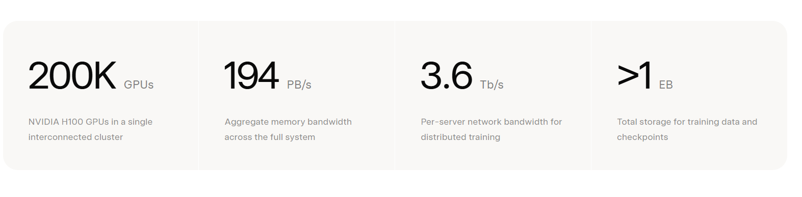
Infrastructure Consideration
Case Study: xAI’s Memphis “Colossus” Data Centre One of the most visible AI facilities is xAI’s Colossus data centre in Memphis: Operational capacity: ~280 MW, with expansion plans well beyond that at inception now Initially relied on on‑site natural gas turbines (“behind‑the‑meter” power) due to lack of immediate grid capacity At peak, more than 30 mobile gas turbines were operating Federal regulators later ruled some of this generation required air‑quality permits This facility alone consumes as much electricity as a mid‑sized city.
Zimbabwe’s average power generation is approximately 1,500 MW
Cooling Solutions: A large "water factory" is employed, using a membrane bioreactor to treat 5-13 million gallons of city wastewater daily for cooling

Slide 11
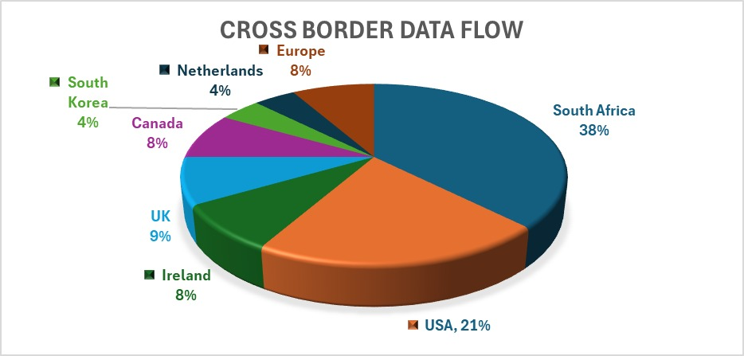
Zimbabwean Data Controllers: Data Transfer Destinations
Data Transfers
Office 365
Microsoft Azure
AWS
Holding Company in SA
Data Transfers
Medical Data
Research Databases

Slide 12
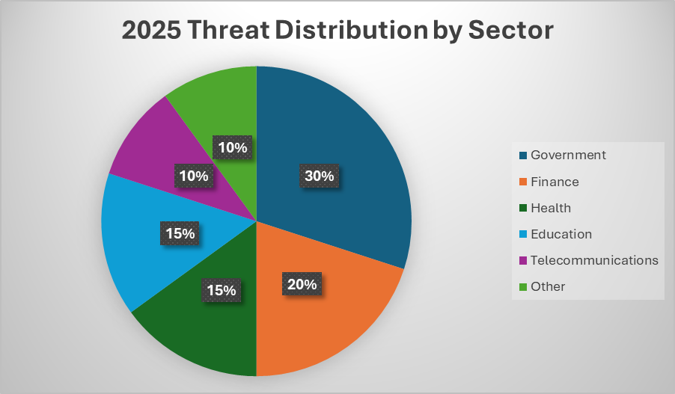

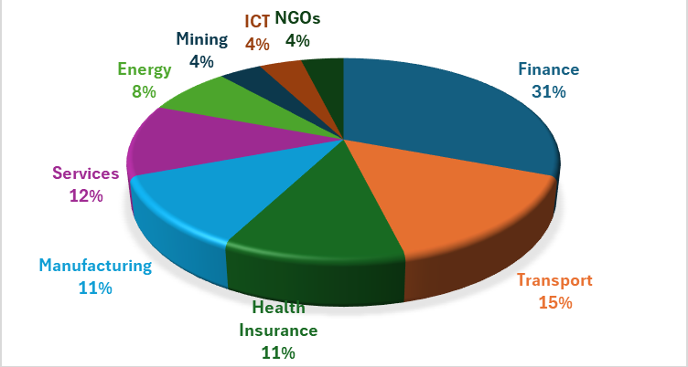
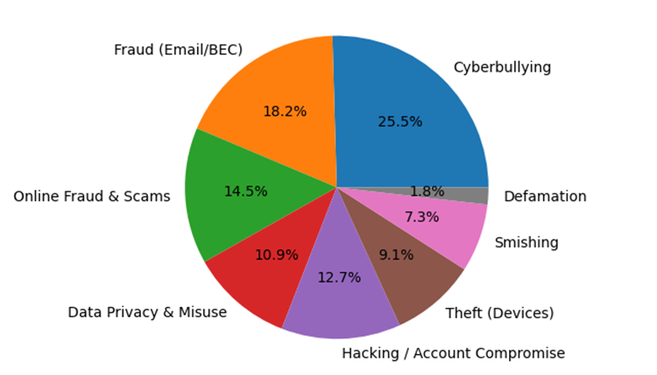
Cyber Security & Data Protection Statistics
2025
Reported Data Breaches
Investigated Cyber Crimes

Slide 13
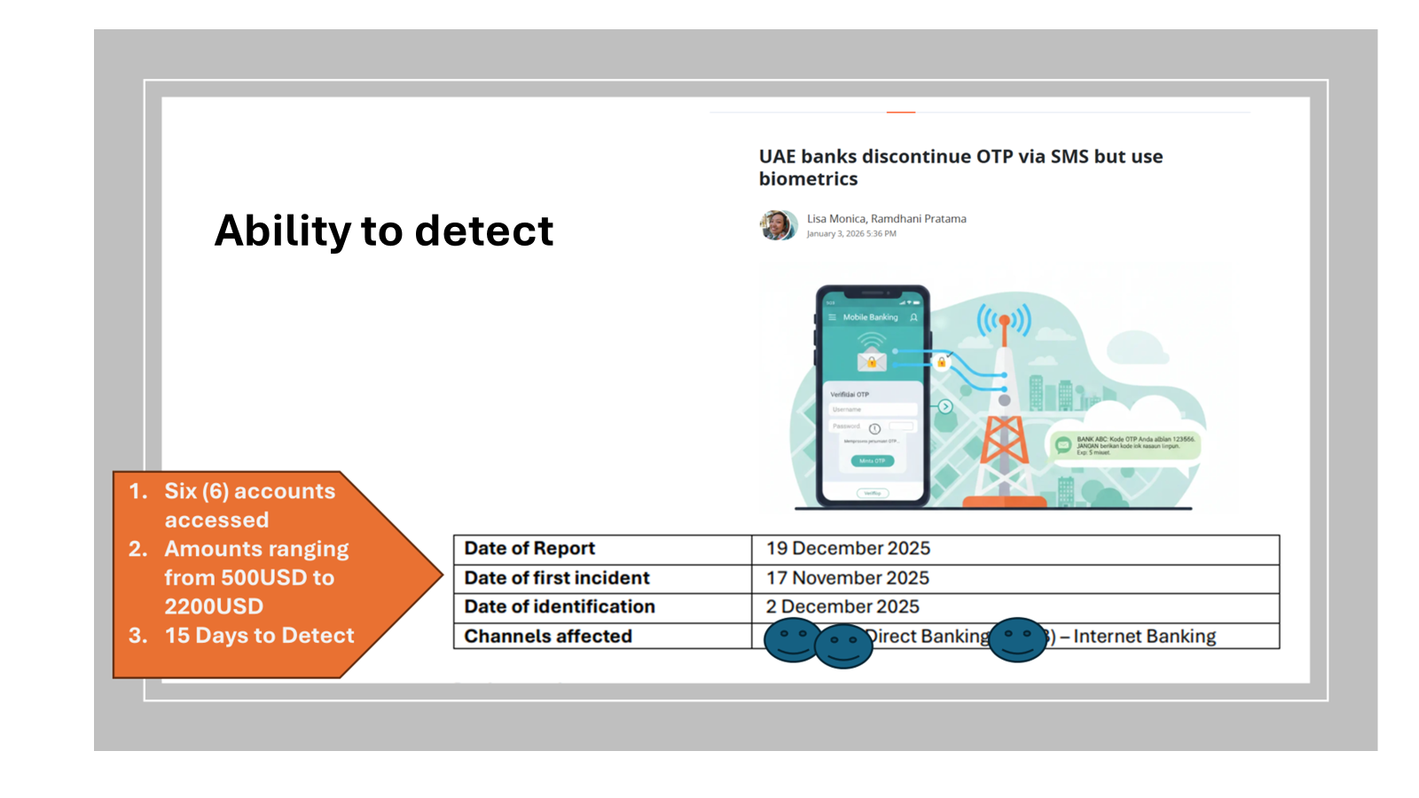

Slide 14
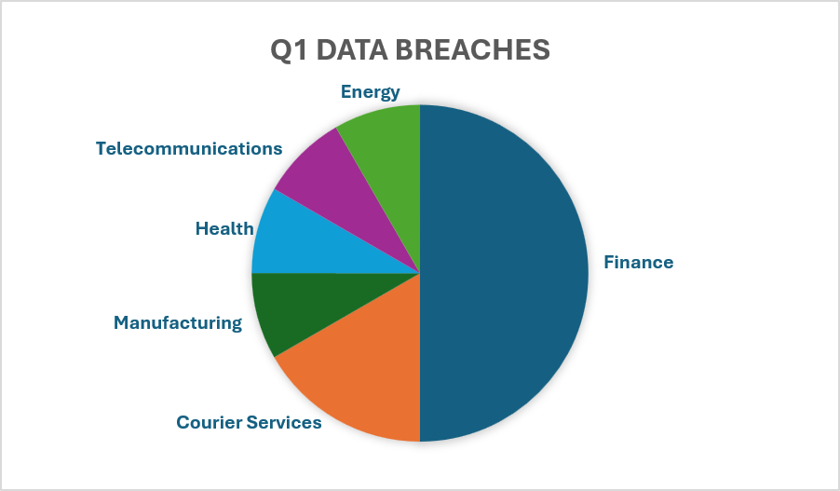
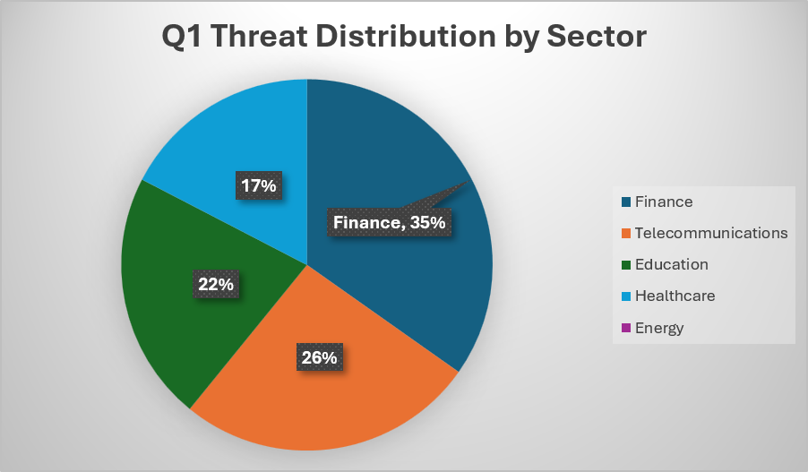
2026 Statistics

Slide 15
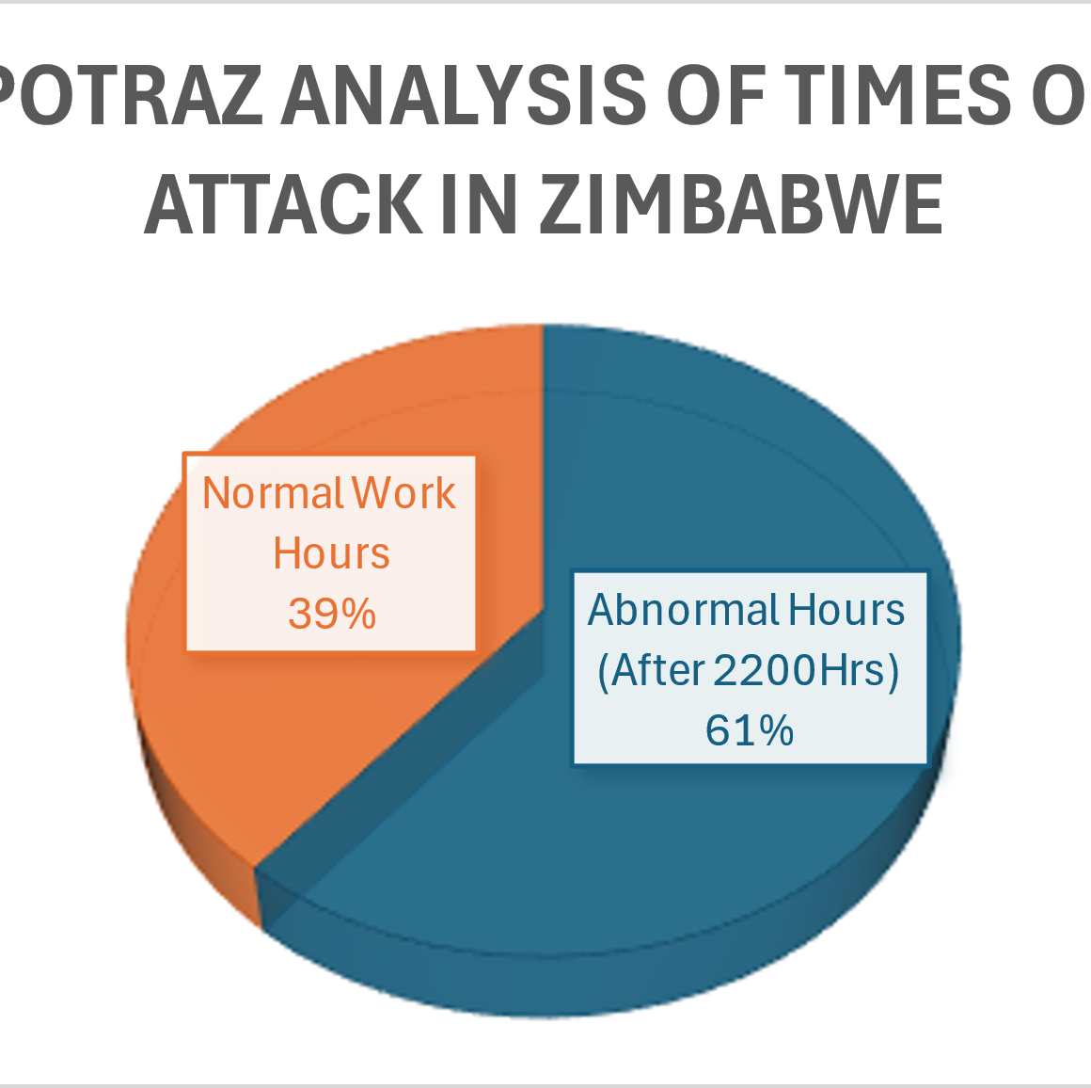
Key Cyber Attack Trends in Zimbabwe 2025
(Interpol, POTRAZ & ZRP Assessment)
POTRAZ ANALYSIS ON TIMING OF ATTACKS
IN ZIMBABWE
Key Notes: 2025
Port 445 vulnerabilities are being targeted
WannaCry (Ransomware) currently most weaponized
Worms/Trojans are being deployed primarily to the financial sector
Key Attacks: 2026
Copy fail Vulnerability (CVE-2026-31431)
Business Email Compromise(Driven by default settings in some office 365 implementations )
(Ransomware) is targeting energy sector

Slide 16
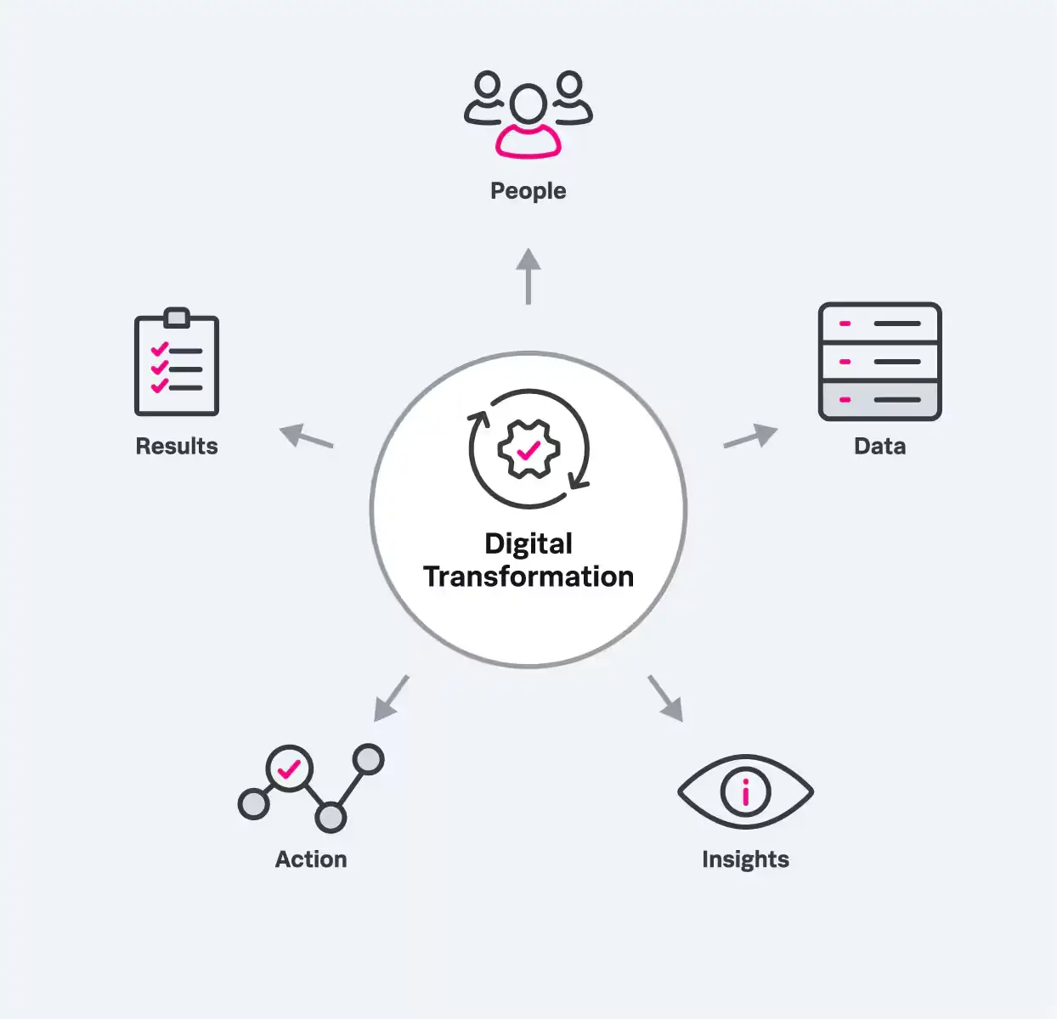
The five pillars of digital transformation success

Slide 17
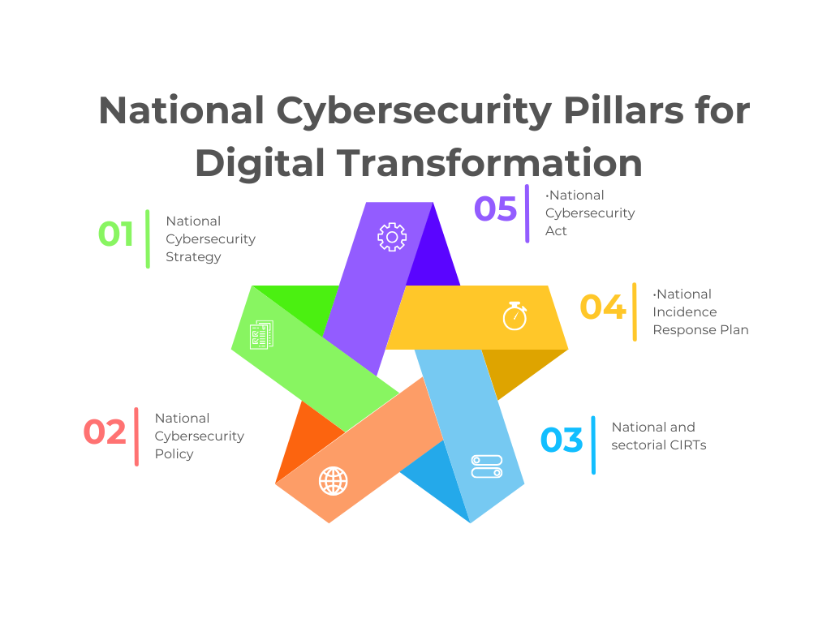

Slide 18










USF
DPU
AI Governance
POTRAZ
CX

Slide 19

Outlook
Complement the National AI strategy with the development of the National Cyber Security Strategy
Continued Capacity building: Augment efforts by MICTPS in enhancing cybersecurity skills in Zimbabwe(Cyberus)
Setting up National and Sectoral Computer Incident Response Teams (CIRTS)
Companies to institutionalise AI strategies and policies internally

Slide 20


Esse quam videri: "To be, rather than to seem to be."

Slide 21


