Slide 1


AI DATA READINESS
Building Clean and
Sovereign Data Systems
The data foundation that decides which nations
and enterprises win the AI decade.
Dr Panashe Chiurunge · Chief AI Scientist
Keynote · AI & Data Sovereignty
Notes:
Open (0:00–1:30). Hook: 'Every leader in this room is being sold a model. Almost nobody is being sold the thing that actually decides whether that model works — the data underneath it.' Set up the two words that frame the whole talk: CLEAN and SOVEREIGN. State the promise: by the end you'll have a shared definition, a way to benchmark yourselves, a reference architecture, and concrete actions for both the engineers and the policymakers in the room.

Slide 2
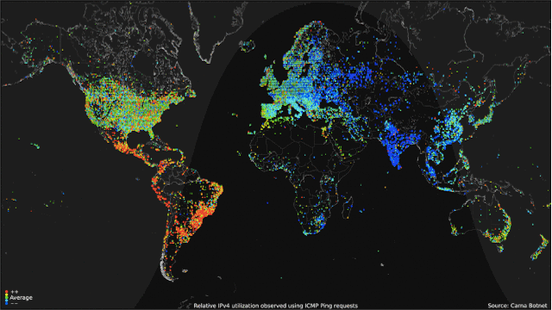
Online Data Processing every 60 secs

Slide 3
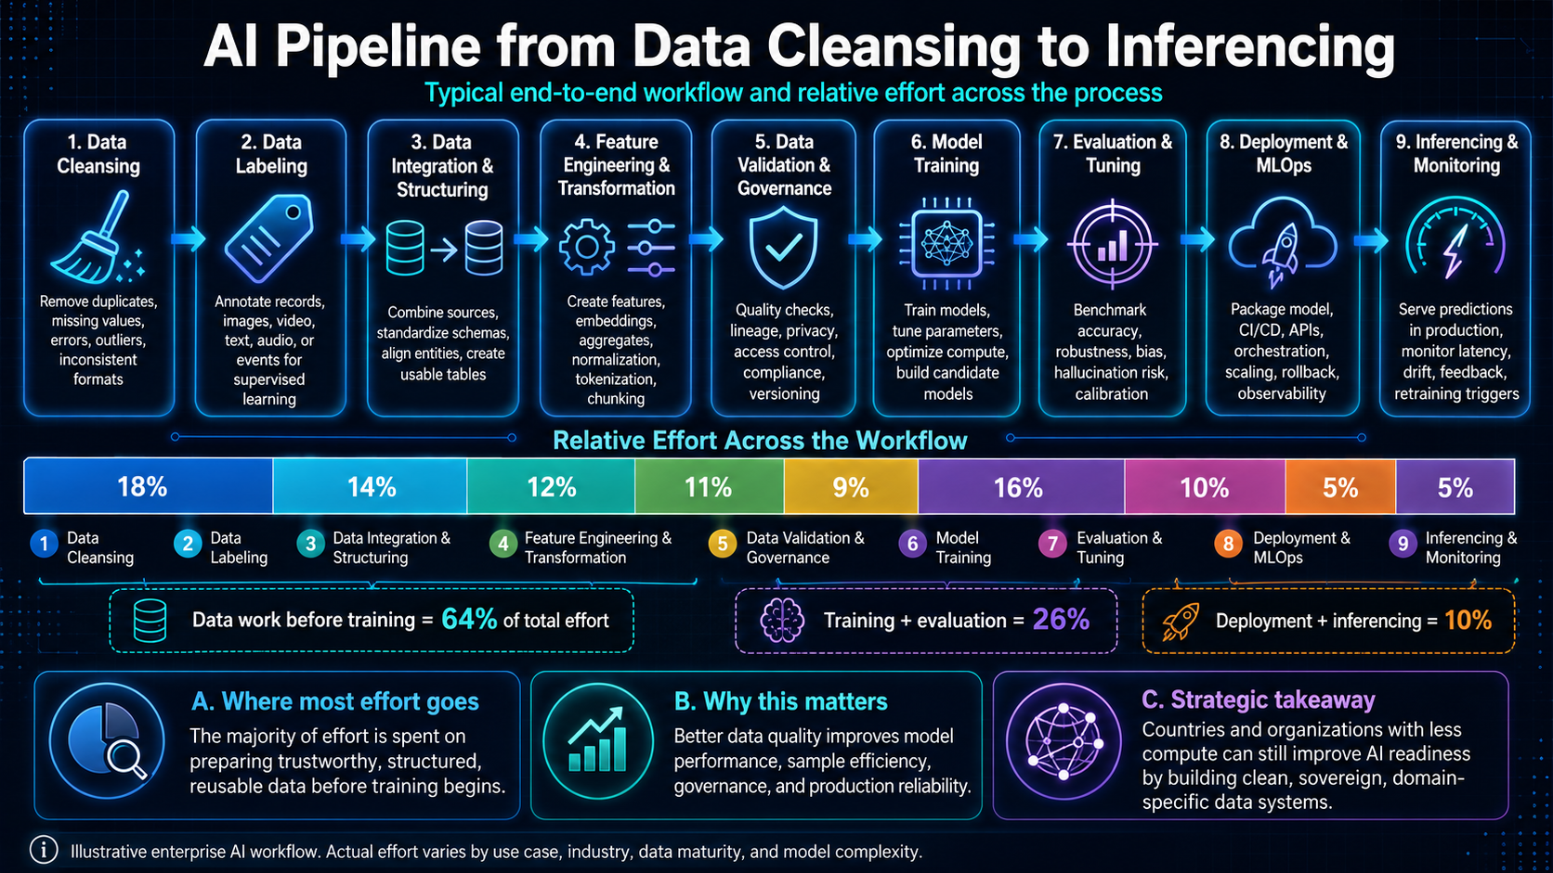
THE INFLECTION
Notes:
1:30–3:30. The strategic premise. Compute and models are racing toward commodity; the durable advantage is the data layer. Land the 181 ZB number — the volume is exploding, but volume is not value. Pivot: more data without readiness just means more liability, faster. That sets up the definition.

Slide 4
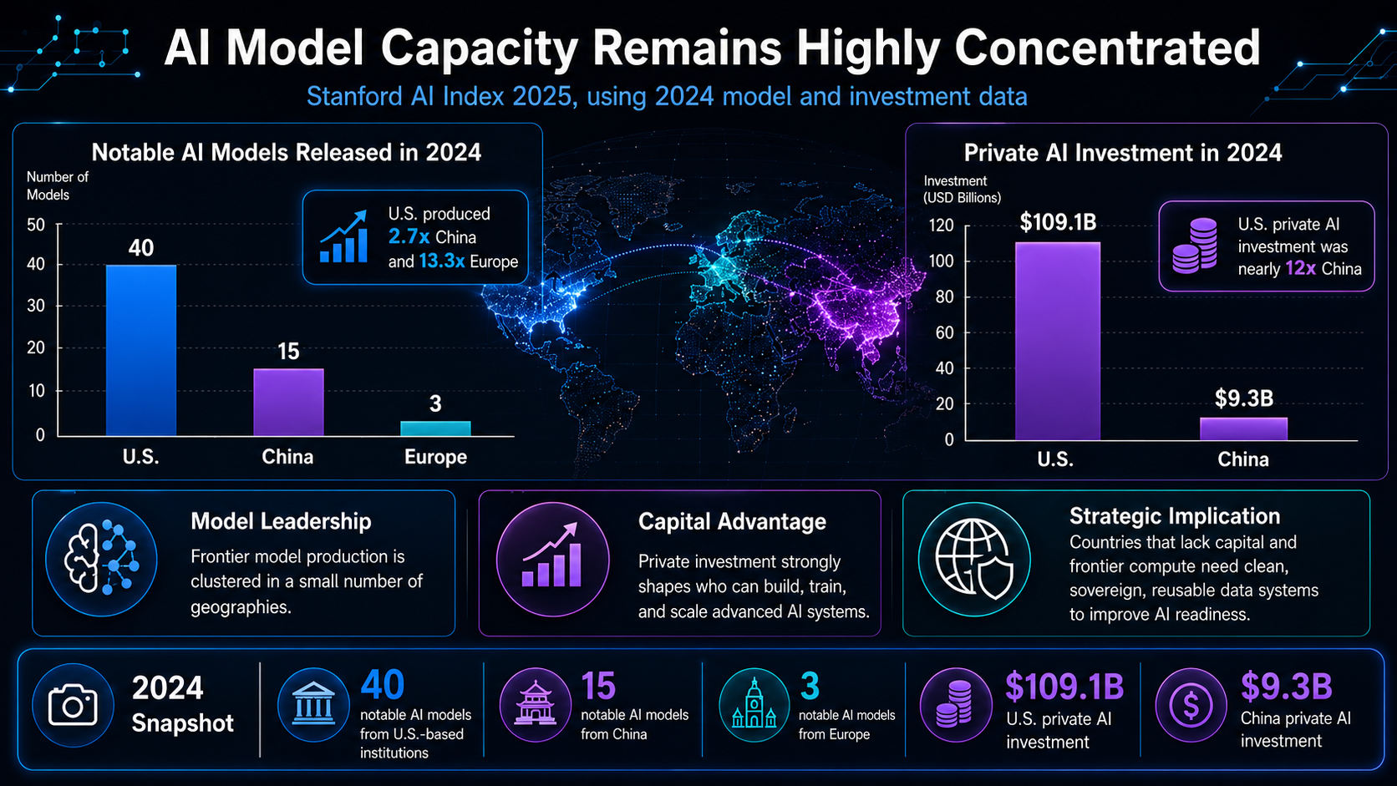
THE INFLECTION
Notes:
1:30–3:30. The strategic premise. Compute and models are racing toward commodity; the durable advantage is the data layer. Land the 181 ZB number — the volume is exploding, but volume is not value. Pivot: more data without readiness just means more liability, faster. That sets up the definition.

Slide 5
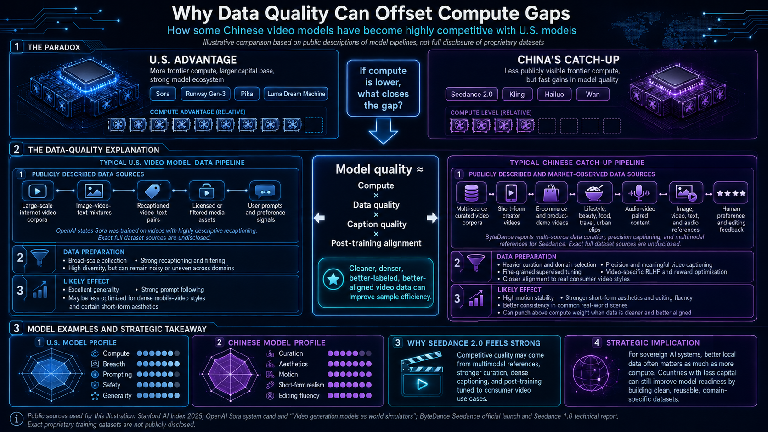
Notes:
1:30–3:30. The strategic premise. Compute and models are racing toward commodity; the durable advantage is the data layer. Land the 181 ZB number — the volume is exploding, but volume is not value. Pivot: more data without readiness just means more liability, faster. That sets up the definition.

Slide 6



THE INFLECTION
The model is no longer the goat.
The data is.
Compute is abundant. Frontier models are converging and commoditising. What remains scarce, defensible and jurisdiction-bound is high-quality, well-governed data — and the right to use it.
The global datasphere
Data created, captured & replicated worldwide — zettabytes / year (IDC)
Compute is rented
GPUs are a commodity you can buy by the hour.
Models converge
Open Models now trail the frontier by a few months, not years.
Data is the moat
Proprietary, clean, sovereign data cannot be downloaded.
181 ZB by 2025 — a ~5.5× rise in seven years.
AI Data Readiness · Clean & Sovereign Data Systems
2
Notes:
1:30–3:30. The strategic premise. Compute and models are racing toward commodity; the durable advantage is the data layer. Land the 181 ZB number — the volume is exploding, but volume is not value. Pivot: more data without readiness just means more liability, faster. That sets up the definition.

Slide 7

DEFINITION
What “AI Data Readiness” actually means
Two independent tests. Data must be clean accurate, complete, governed, fit for a use cases and sovereign under your jurisdiction, your keys, your control.
AI-ready data is data that is…
Locked, but useless
AI-Ready & Sovereign
Aligned to a specific, validated use case
Controlled yet dirty, sovereignty over noise.
Clean and controlled. The only place AI compounds.
Governed at the asset level, with clear ownership
SOVEREIGN → control & jurisdiction
Fed by automated pipelines with quality gates
Liability
Exposed asset
Described by live, machine-readable metadata
Dirty and exposed the default state.
Clean but ungoverned, value that leaks away.
Continuously quality-assured, not checked once
Adapted from Gartner's 2025 definition of AI-ready data
CLEAN → data quality & fitness
AI Data Readiness · Clean & Sovereign Data Systems
3
Notes:
3:30–6:00. The conceptual spine of the talk. Walk the 2x2: most organisations live in the bottom-left 'Liability' quadrant by default. Clean-but-exposed (bottom-right) is where many Western firms sit — great data hygiene, weak control. Locked-but-useless (top-left) is the trap of crude data-localisation mandates. Only the top-right compounds. Right panel: this is not hand-waving — it's the working definition the industry has converged on. Note 'governed at the asset level' and 'continuously assured' — those two kill most projects.

Slide 8




THE STAKES
Most AI failure is data failure
The failure rate is not a model problem. Across every major study, the root cause traces upstream to data that was never ready.
>90%
60%
$12.9M
5%
of enterprise AI projects fail to deliver value, about twice the rate of conventional IT.
of AI projects will be abandoned through 2026 for lack of AI-ready data.
average annual cost of poor data quality, per organisation.
of enterprise generative-AI pilots produce measurable financial value.
RAND, 2025
Gartner
Gartner
MIT, 2025
AI Data Readiness · Clean & Sovereign Data Systems
4
Notes:
6:00–8:30. The burning platform. These four numbers are independent studies, different methods, same verdict. Pause on $12.9M — that is the steady-state cost of doing nothing, before a single AI project. The S&P data point if asked: abandonment jumped from 17% of companies in 2024 to 42% in 2025. The diagnosis is consistent: organisations are scaling adoption faster than they are fixing the data foundation. Everything after this slide is the fix.

Slide 9
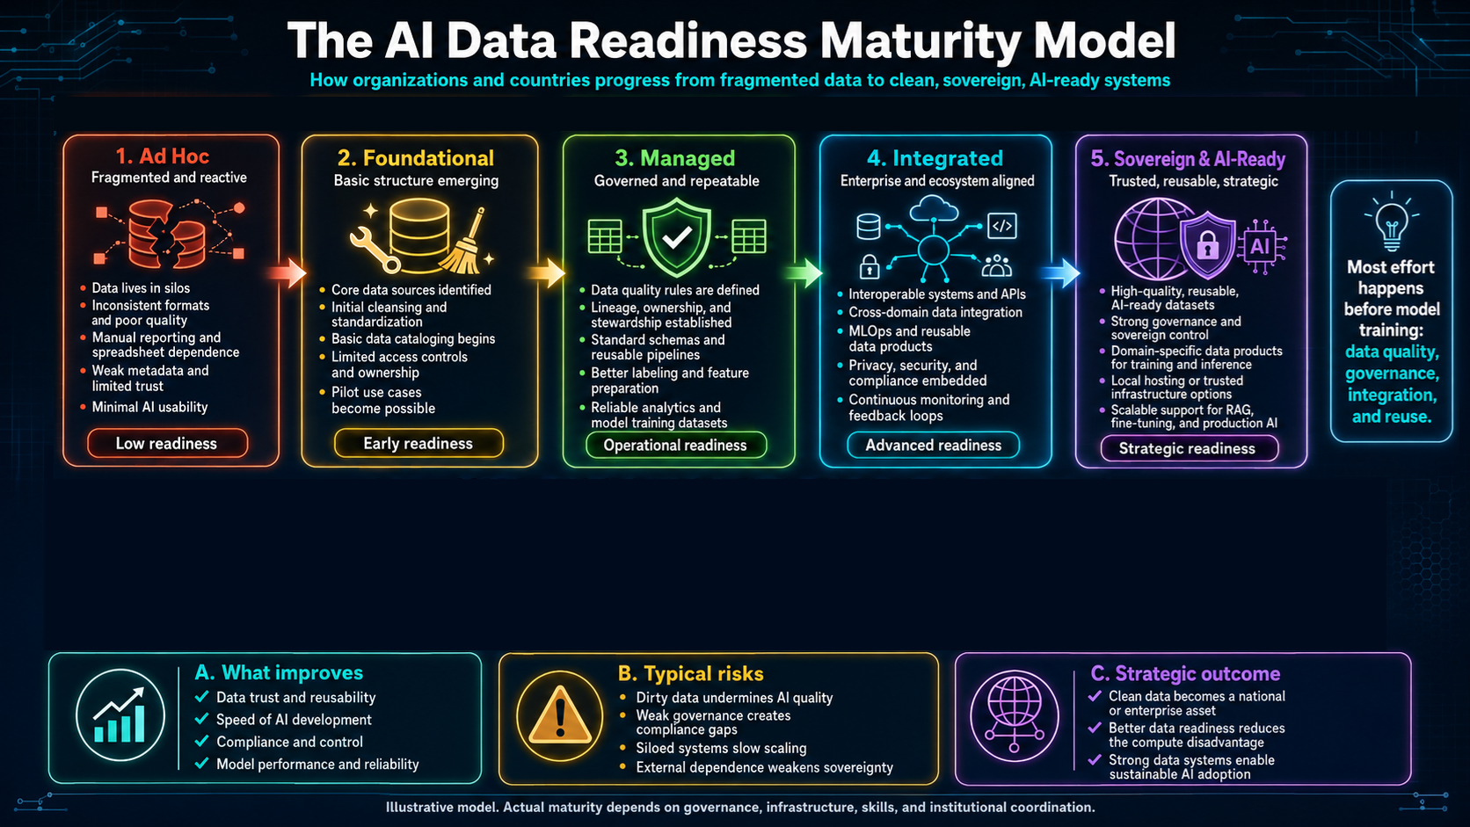
Notes:
1:30–3:30. The strategic premise. Compute and models are racing toward commodity; the durable advantage is the data layer. Land the 181 ZB number — the volume is exploding, but volume is not value. Pivot: more data without readiness just means more liability, faster. That sets up the definition.

Slide 10






PILLAR I — CLEAN
The six dimensions of clean data
“Clean” is not a vibe it is measurable. Each dimension has rules, thresholds and an owner.
Accuracy
Completeness
Consistency
Values reflect the real world entity they describe.
No missing records or required fields.
Same fact agrees across every system.
Timeliness
Validity
Uniqueness
Fresh enough for the decision at hand.
Conforms to type, format and business rules.
One entity, one record no duplicates.
AI Data Readiness · Clean & Sovereign Data Systems
5
Notes:
8:30–10:30. Make 'clean' concrete. The key message for the executives: each of these six is auditable and ownable — you can put a number and a name against it. The key message for the engineers: these become your test assertions and quality-gate rules. Tie back: 59% of organisations don't measure data quality at all (Gartner) — you can't improve what you never instrument.

Slide 11









PILLAR I — CLEAN
Quality is engineered, not inspected
Move quality “left” into the pipeline. Every stage carries a gate that bad data cannot pass.
1
2
3
4
5
Ingest
Profile & validate
Cleanse & standardise
Govern & catalog
Serve
Batch & stream, with contracts
Schema, rules, anomalies
Dedupe, normalise, enrich
Lineage, classify, document
Features, vectors, models
Quality gates Pipelines fail closed on rule breach
Observability Freshness, volume & drift monitored
Data contracts Producers commit to a schema & SLA
AI Data Readiness · Clean & Sovereign Data Systems
6
Notes:
10:30–12:30. The engineering answer. Old world: a data-quality team inspects data after the fact. New world: quality is a property of the pipeline. 'Fail closed' is the phrase to land — a broken contract stops the pipeline rather than silently poisoning the model. The bottom band is what separates a demo from production: gates, observability, contracts.

Slide 12




PILLAR II — SOVEREIGN
Data sovereignty is more than data residency
Residency asks “where does the data sit?” Sovereignty asks” who truly controls it — and under whose law?” Three layers must come together.
Legal sovereignty
Technical sovereignty
Operational sovereignty
Data falls under your jurisdiction's law — and is shielded from foreign extraterritorial reach (e.g. compelled disclosure).
You hold the encryption keys, the access controls and the operational runbook — not just the postal address of the server.
Local skills, processes and vendor independence, so control survives the exit of any single provider.
Residency ≠ sovereignty. A server in-country, but operated under a foreign provider's keys and a foreign government's subpoena power, is not sovereign.
AI Data Readiness · Clean & Sovereign Data Systems
8
Notes:
14:30–17:00. This is the slide for the government officials, but the engineers need it too. The most common and most dangerous mistake is equating data localisation with sovereignty. Localising a copy onto a hyperscaler region you don't control, with keys you don't hold, under a CLOUD-Act-style regime, gives you the cost of localisation with none of the protection. Sovereignty is the AND of all three layers. Technical sovereignty (keys) is the one most often skipped.

Slide 13


THE TRADE-OFF
Sovereignty without utility is just isolation
Hard localisation has measurable economic cost. The goal is not to wall data in — it is to keep control while keeping it useful.
Cost of over-localisation
The balanced doctrine
Control the sensitive, free the rest, and engineer trust into the flow.
A 1-point rise in data restrictiveness is associated with:
Classify data by sensitivity, not by reflex most data is not sovereign-critical.
−7%
gross trade output
Localise and key-protect the crown jewels; permit trusted flows for the rest.
−2.9%
productivity
Balance
Use adequacy regimes, contractual safeguards and PETs to move data safely.
+1.5%
downstream prices
Invest in domestic capacity so control is real, not just regulated on paper.
Over five years (ITIF econometric model)
AI Data Readiness · Clean & Sovereign Data Systems
10
Notes:
19:00–21:00. The nuance that earns credibility with both camps. To the sovereignty hawks: isolation has a price tag, and ITIF has quantified it. To the open-data crowd: unrestricted flow ignores real risk and real power asymmetry. The doctrine on the right is the synthesis — classify, protect the few, free the many, and use technology (next slide) to move the rest safely. This is the slide that says you understand the politics, not just the tech.

Slide 14







BLUEPRINT
A reference architecture for sovereign, AI-ready data
Serving
Feature store · vector DB · ML & LLM endpoints · BI
CROSS-CUTTING
Quality & Observability
Quality gates · profiling · freshness & drift monitoring
Security & IAM
Governance & Catalog
Lineage · classification · access control · policy-as-code
Privacy (PETs)
Lakehouse Storage
Open table formats · bronze / silver / gold zones
Ingestion & Integration
Batch · streaming · change-data-capture · contracts
Audit & lineage
Sovereign Infrastructure
In-jurisdiction region · confidential compute · your keys
Compliance
AI Data Readiness · Clean & Sovereign Data Systems
11
Notes:
21:00–23:30. The 'how' for the architects. Read bottom-up: sovereignty starts at the infrastructure layer — in-jurisdiction region, confidential compute, customer-managed keys (the two amber layers are where sovereignty is won or lost). Then open formats so you're not locked in, governance and quality as first-class layers, and serving on top. The right-hand column is the point that security, privacy and audit are not a layer — they cut across all of them. Keep this slide as the architectural anchor for follow-up conversations.

Slide 15




OPERATING MODEL
Governance is people and policy, not just tooling
Tools enforce rules; they don't decide them. Sovereign, clean data needs clear accountability across four roles.
Governance Council
Data Owners
Data Stewards
Data Custodians
Sets policy, classifies data, owns sovereignty posture & risk appetite.
Accountable business leaders for each domain's data and its use.
Define quality rules, metadata and standards; arbitrate disputes.
Operate the platform, keys and controls that enforce the policy.
Policy-as-code is the multiplier. Encode classification, residency and access rules as version-controlled policy that the platform enforces automatically — governance that scales with data, not headcount.
AI Data Readiness · Clean & Sovereign Data Systems
12
Notes:
23:30–25:00. For the officials especially: governance fails when it's a document nobody owns. These four roles create a chain of accountability — council decides, owners are answerable, stewards define, custodians operate. The bottom band is the modern twist: encode the rules as code so they're enforced consistently and audibly. This is also how a small team in a resource-constrained ministry can govern at scale.

Slide 16



ENABLERS
Use the data without surrendering it
Privacy-enhancing technologies dissolve the false choice between sovereignty and utility — they let data create value where it cannot, or should not, move.
Federated learning
Differential privacy
Synthetic data
Confidential computing
Train across sites; the model travels, the raw data stays home.
Add calibrated noise so outputs reveal patterns, never individuals.
Generate statistically faithful stand-ins for restricted records.
Process encrypted data inside hardware-isolated enclaves.
AI Data Readiness · Clean & Sovereign Data Systems
13
Notes:
25:00–26:30. The optimistic turn. This is where the engineers lean in and the officials realise sovereignty doesn't mean economic isolation. Federated learning is the headline — e.g. multiple hospitals or central banks training a shared model without pooling raw records. Differential privacy and synthetic data let you publish and share safely; confidential computing protects data even in use. Together they make the 'balanced doctrine' from slide 10 technically real.

Slide 17





MEASUREMENT
You cannot govern what you do not measure
A readiness scorecard turns an abstract goal into a tracked program. Baseline today, set targets, review quarterly.
Lead indicators worth tracking
% data assets cataloged & classified
Quality score by domain (the six dimensions)
% pipelines with automated quality gates
% sensitive data under customer-managed keys
% datasets with end-to-end lineage
Reminder: 59% of organisations don't measure data quality at all.
AI Data Readiness · Clean & Sovereign Data Systems
15
Notes:
28:00–29:00. Make it operational. The radar is illustrative — the shape is what matters: most organisations are strong on security, weak on sovereignty and governance. The KPI list is what you actually instrument. Land the closing fact: 59% don't measure quality at all, so simply standing up this scorecard puts you ahead of most. Then move to the roadmap.

Slide 18
THE ROADMAP
From ad hoc to AI-ready in four phases
A sequence, not a big bang. Each phase ships value and de-risks the next.
01
0–3 months
02
3–9 months
03
9–18 months
04
18 months +
Assess & baseline
Build the foundation
Govern & secure
Scale & sustain
Inventory & classify data
Gap analysis vs. maturity model
Pick 1–2 lighthouse use cases
Quick-win cleanups
Lakehouse on sovereign infra
Catalog & metadata
First quality gates
Residency & key decisions
Policy-as-code & access control
End-to-end lineage
Deploy PETs where needed
Stand up governance council
Ship AI use cases to production
Continuous QA & observability
Sovereign operations & skills
Quarterly scorecard reviews
AI Data Readiness · Clean & Sovereign Data Systems
16
Notes:
29:00–29:45. The 'so what do I do Monday' for the program owner. Stress the sequencing logic: you cannot govern data you haven't cataloged, and you shouldn't deploy AI on a foundation you haven't secured. Lighthouse use cases in phase 1 fund the rest politically. Most organisations try to start at phase 4 and that's exactly why 60% get abandoned.

Slide 19
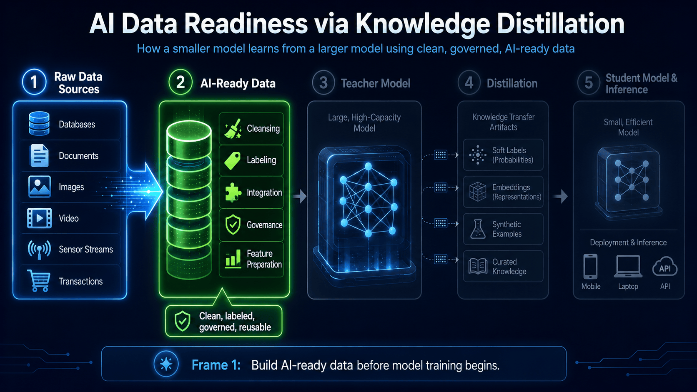
Notes:
1:30–3:30. The strategic premise. Compute and models are racing toward commodity; the durable advantage is the data layer. Land the 181 ZB number — the volume is exploding, but volume is not value. Pivot: more data without readiness just means more liability, faster. That sets up the definition.

Slide 20

THE TAKEAWAY
Clean. Sovereign. Ready.
Clean is engineered
Quality lives in the pipeline, measured against six dimensions.
Sovereign is layered
Legal, technical and operational control — not just residency.
Readiness is a program
Benchmark, build, govern, measure — and start now.
Whoever owns clean, sovereign data owns their AI future.
Thank you · Panashe Chiurunge, Chief AI Scientist
Notes:
Close (30:15–30:45). Three things to remember, then the one line: 'Whoever owns clean, sovereign data owns their AI future.' Pause. Thank the audience. Invite the two camps to find each other in the room — the builders and the governors — because that's the only way the foundation gets built. Take questions.

