Slide 1
PRAGMATIC FINANCING OF
AI DEVELOPMENT
IN ZIMBABWE @Aiia Masvingo
Leveraging the landscape
by Nigel MK Chanakira +263772223777
June 2026
NATIONAL AI STRATEGY 2026 – 2030

Slide 2
Executive Summary
The core financing thesis
THE OPPORTUNITY
Zimbabwe's National AI Strategy (2026–2030) creates a structured policy anchor for mobilising $500M+ in AI infrastructure capital.
THE CATALYST
The Econet–Nvidia partnership to build sovereign AI factories provides a bankable anchor asset around which a multi-layered financing stack can be constructed.
THE GAP
The strategy articulates the financing framework but carries no attached budget figures. A pragmatic architecture — blended, phased, and risk-tranched — is urgently required.
OUR THESIS
Combining DFI/multilateral first-loss capital, infrastructure bonds, listed equity (VFEX), revenue-share agreements, and the Mugove Co-Investment Fund produces a de-risked, executable pathway.
2 / 14

Slide 3
AI is no longer a future trend. It is an execution question.
The old question
The real question now
"What is AI?"
Awareness. Curiosity. Exploration. This phase is over for competitive markets.
"How do we use AI to improve productivity, decisions, services and growth?"
This is the conversation that separates leading organisations from the rest.
AI is now a competitiveness issue, not only a technology issue. The organisations that act with clarity and speed will build an advantage that is very difficult to close.

Slide 4
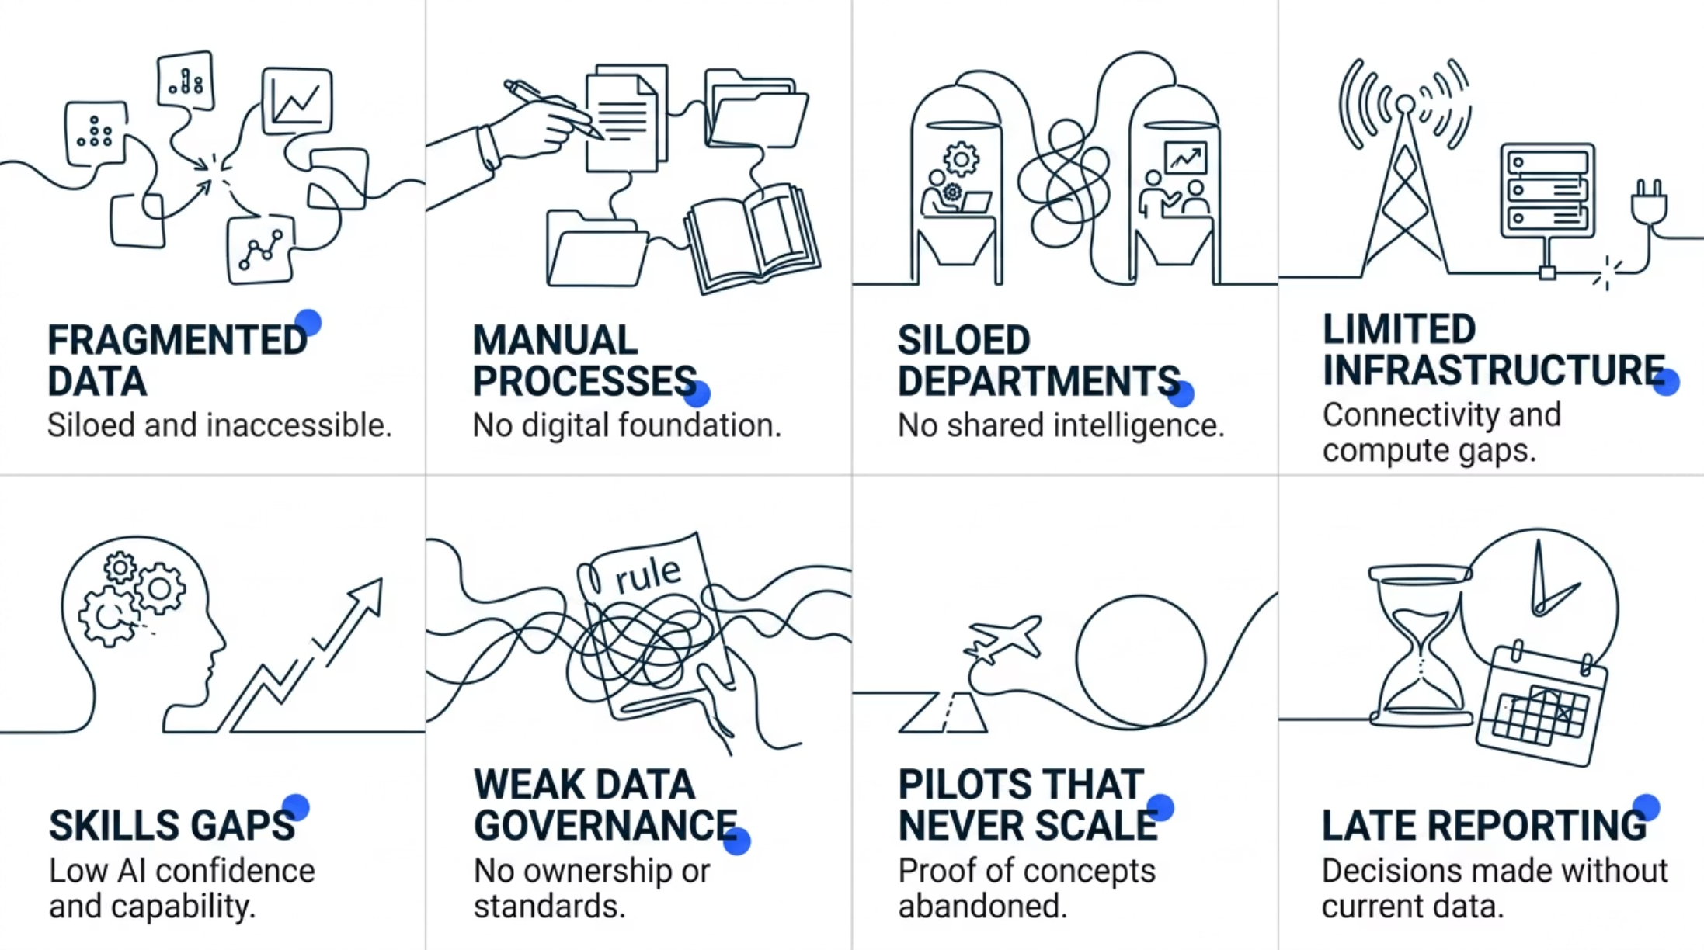

COMPLEMENTARY ACCENT
Zimbabwe's AI challenge is not ambition. It is execution.
Across African markets, the barriers are not political will or strategic intent. They are operational realities that prevent AI from delivering at scale.
AI cannot create intelligence from organisational chaos. The foundation must be built deliberately, before the technology is deployed.

Slide 5
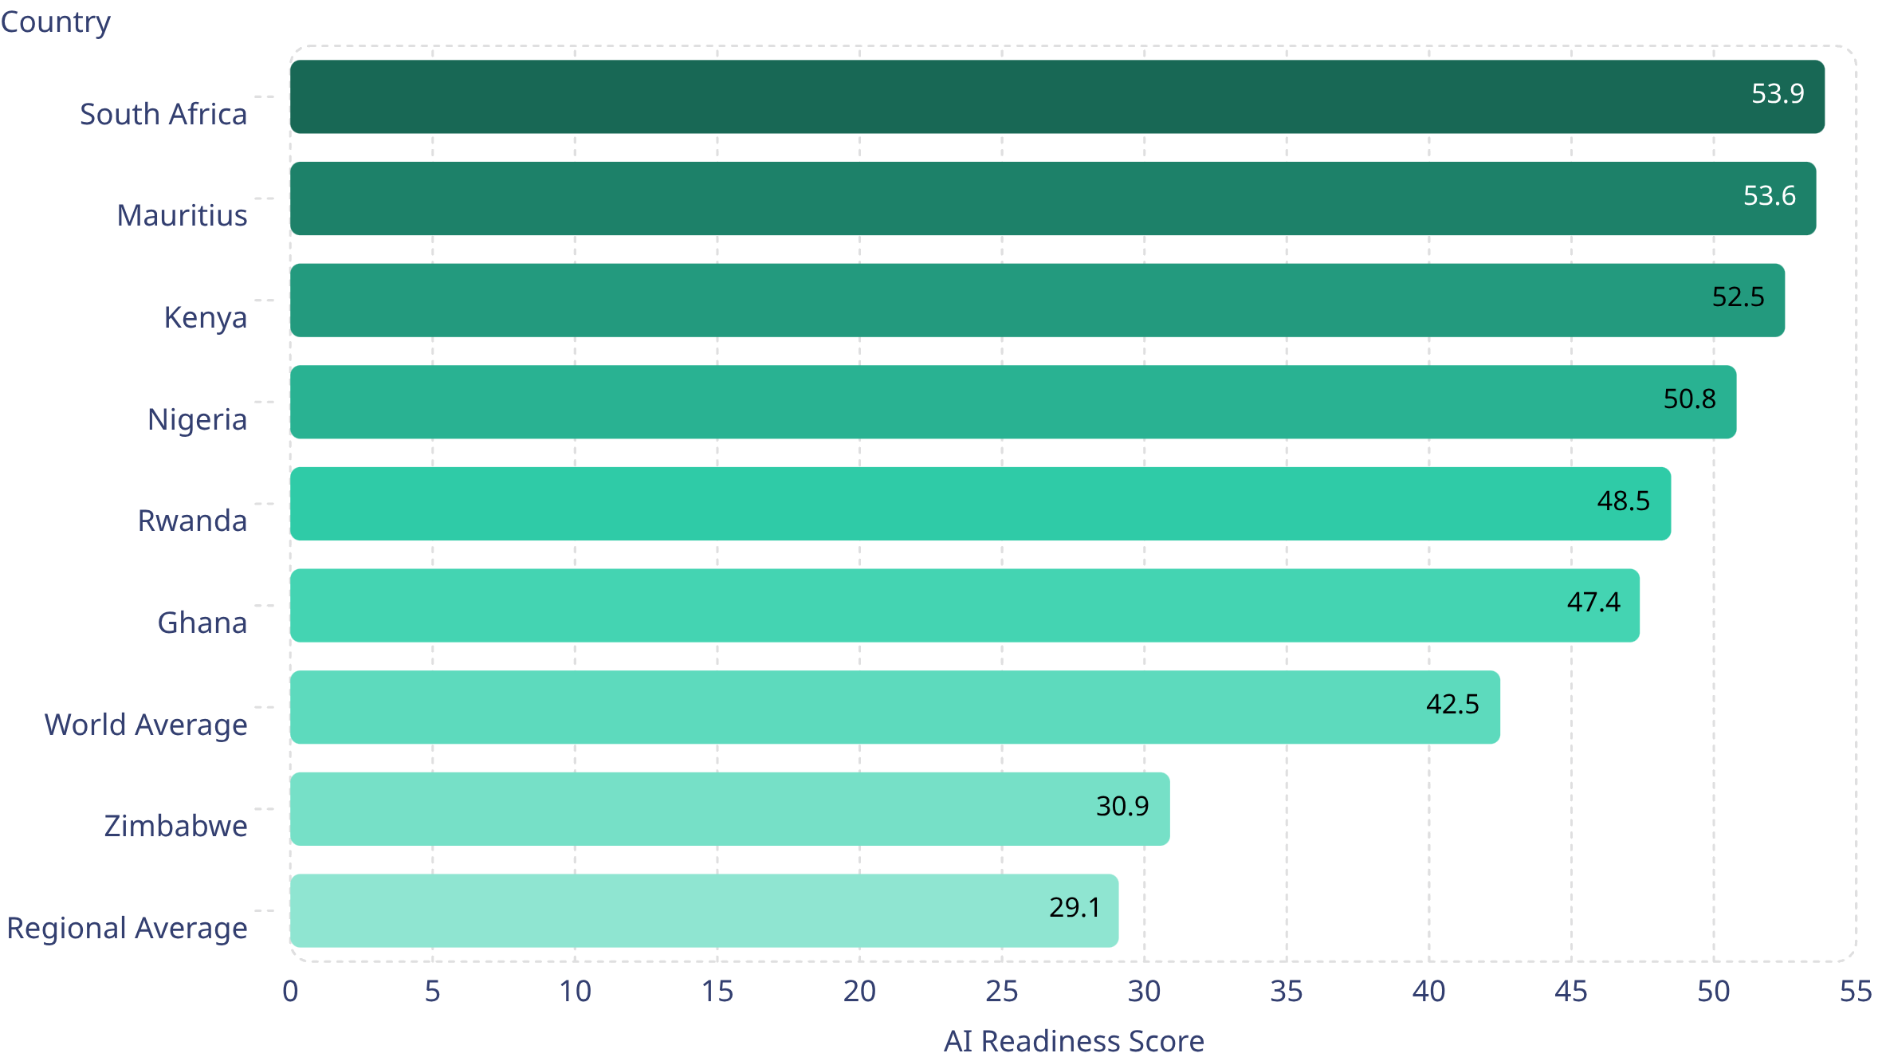
Zimbabwe's AI readiness gap is also its opportunity.
OXFORD INSIGHTS · 2025 GOVERNMENT AI READINESS INDEX
Zimbabwe sits above the regional average of 29.1 but remains materially below the world average of 42.5. This gap is not a verdict — it is a starting point. The countries above Zimbabwe did not arrive there by accident. They built momentum through targeted execution. Zimbabwe can do the same.

Slide 6
The gap is not the problem. The response is the opportunity.
Zimbabwe does not need to copy Silicon Valley. Zimbabwe needs AI that solves African problems — practical, contextual and commercially grounded.
Leapfrog potential
Practical use cases win
Execution is the differentiator
Stronger African markets are building momentum. Zimbabwe can accelerate through targeted, high-impact adoption rather than broad-based investment.
The biggest gains will come from solving real business problems — not from technology theatre or pilot programmes that never reach scale.
Business leaders must convert AI interest into operational capability. Speed, clarity and leadership commitment separate winners from watchers.
The question is not: "Are we behind?" The question is: "Where do we start, and how fast can we execute?"

Slide 7

Zimbabwe is not starting from zero.
The National AI Strategy 2026–2030 provides a credible national framework. The direction is set. The work is implementation.
Talent & Capacity
Infrastructure
AI skills development at every level
Computational sovereignty and digital backbone
Sector Adoption
Governance & Ethics
Service transformation across key industries
Responsible AI with strong oversight
R&D & Innovation
Global Collaboration
Local research and development capacity
Strategic international partnerships
The strategy creates direction. Execution will create value.

Slide 8
AI must solve real Zimbabwean business problems.
The winning use cases will be practical, measurable and directly connected to business performance. Below are the highest-priority sectors for Zimbabwe's AI adoption agenda.
Customer Intelligence & Sales
Agriculture Productivity
Smarter lead conversion, retention analytics and revenue growth through AI-driven customer insight.
Yield optimisation, early warning systems and supply chain intelligence for Zimbabwe's agricultural sector.
Mining & Operations
Fraud & Risk Detection
Predictive maintenance, safety monitoring and operational efficiency at scale.
Real-time anomaly detection and automated risk scoring for financial services and public sector.
Healthcare & Public Services
SME Productivity
Improved access, triage efficiency and AI-assisted diagnostics across under-resourced facilities.
Automated reporting, cash flow intelligence and growth tools purpose-built for African entrepreneurs.

Slide 9
POLICY ANCHOR
Zimbabwe National AI Strategy 2026–2030
AI Talent & Capacity
Infrastructure & Sovereignty
AI literacy, research hubs, sector-specific academies, diaspora engagement.
High-performance compute, sovereign data platforms, world-class data centres, inclusive connectivity.
AI Adoption & Services
Governance & Ethics
Sector-wide adoption across agriculture, health, mining, and smart cities.
Ubuntu-based governance, National AI Council, AI Act, Data Protection Act revision.
Phase 1: Foundation Building (2025–2026)
Phase 2: Scaling Core Applications (2027–2028)
Phase 3: Ecosystem Maturation (2029–2030)
3 / 14
Source: Zimbabwe National AI Strategy (veritaszim.net, Jan 2026) · zimaistrategy.net

Slide 10

A practical 90-day AI adoption sprint.
Transformation does not require a three-year masterplan before results appear. A focused 90-day sprint can prove value, build confidence and create the organisational momentum needed to scale.
Days 1–15
1
Define
Identify one priority business use case with a clear, measurable outcome.
2
Days 16–30
Audit
Map data sources, workflow gaps and key decision points in scope.
Days 31–60
3
Build
Develop a focused pilot solution with a dedicated, cross-functional team.
4
Days 61–75
Govern
Train users, test outputs, validate governance and manage change.
Days 76–90
5
Scale
Measure ROI, capture lessons and build the investment case to expand.
Start small. Prove value. Build confidence. Then scale. The organisations that win with AI do not attempt everything at once — they sequence with discipline.

Slide 11
STRATEGY PILLARS
Five Flagship Initiatives
01
AI Grand Challenge
Annual national competition: winners receive funding, government pilot contracts, and international exposure. Target: 50+ qualified teams.
02
Project Pangolin
National AI & Data Platform — sovereign compute, privacy-preserving access to national datasets for researchers and developers.
03
Nzwisiso.ai Campaign
"AI for Every Zimbabwean" — public literacy in local languages, Community Digital Ambassadors.
04
Innovation Crucible
National AI Regulatory Sandbox — temporary regulatory flexibility for monitored testing of fintech, telecom, and AI pilots.
05
Mugove / Isabelo Fund
National AI Innovation Fund — co-invests government capital alongside private investors in certified AI startups.
4 / 14
Source: Zimbabwe National AI Strategy (2026) · zimaistrategy.net · iafrica.com

Slide 12
The Econet–Nvidia AI Factory
Anchor Asset
PARTNERSHIP
Econet / Cassava Technologies × Nvidia
FIRST FACTORY
Cassava AI Factory, Cape Town — first sovereign AI factory on the continent
ZIMBABWE BUILD
Planned within Econet Tech City (800-acre hub near Robert Mugabe International Airport, Harare)
POWER BASE
100 MW captive solar-powered industrial park — addresses Zimbabwe's chronic power deficit
SOVEREIGN CLOUD
Sovereign cloud solutions for African governments; data and compute kept on-continent
CONNECTIVITY
Econet–Ericsson 5G MOU (MWC 2026); Africa Data Centres infrastructure spanning the continent
5 / 14
Source: billionaires.africa (Apr 2026) · mobileeurope.co.uk · thezimbabwemail.com · myzimbabwe.co.zw

Slide 13
CAPITAL MARKETS
Econet InfraCo: Infrastructure Financialisation
$1B
INFR.VX
800 acres
20,000+
InfraCo Valuation
(VFEX Listing, Mar 2026)
VFEX Ticker
(USD-denominated)
Econet Tech City
Near Harare Airport
Jobs Target
From Tech City
Structure
Financing Implications
• Listing by introduction — no new capital raised; separates valuation unlock from fundraise.
• USD-denominated VFEX exchange insulates investors from ZiG currency risk.
• Assets: telecoms towers, fibre, data centres, renewable energy systems, strategic real estate.
• Creates an investable, liquid vehicle for pension funds, regional DFIs, and offshore institutional capital.
• At least 30% public float required under VFEX Listings Requirements.
• Infrastructure financialisation model unlocks asset value without dilutive equity issuances.
• Mirrors MTN, Vodacom, Airtel, and Orange MEA tower securitisation precedents across Africa.
• Platform for infrastructure bonds: towers and data centres as project finance collateral.
6 / 14
Source: africa.businessinsider.com · developingtelecoms.com · zse.co.zw · mobileeurope.co.uk

Slide 14
The Financing Gap: Risk vs. Opportunity
Gap Analysis
CHALLENGES
OPPORTUNITIES
No Budget Attached
Sovereign Policy Mandate
The National AI Strategy articulates the financing framework but carries no specific budget allocations or quantum.
Government-backed strategy provides concessional financing eligibility with DFIs (IFC, Afreximbank, DFC, BII, Proparco).
Macroeconomic Fragility
Anchor Private Investor
Zimbabwe's fiscal space is constrained; the government balance sheet cannot anchor large-scale AI capital deployment alone.
Masiyiwa / Econet InfraCo provides a credible, bankable private counterpart with proven capital markets execution.
Access Cost Barriers
Continental Capital Pools
Developers are charged tens of thousands of dollars for HPC access at the University of Zimbabwe — allocated in blocks, not pay-as-you-go.
The $60B Africa AI Fund commitment and $200M Africa AI Governance Capacity Fund create accessible grant and equity pools.
7 / 14
Source: Zimbabwe National AI Strategy (2026) · mobileeurope.co.uk · africadca.org · lawyershub.org (AFD, May 2026)

Slide 15
CORE FRAMEWORK
A Pragmatic Financing Architecture
TRANCHE 1
Sovereign & Multilateral Grants
10–15%
GoZ budget, UNDP, Africa AI Fund, G20 AI for Africa. First-loss capital that de-risks all commercial layers above.
TRANCHE 2
DFI Concessional Debt
20–25%
IFC, Afreximbank, DFC, BII, Proparco, AFD. Long-tenor loans (10–15 yr), low coupon, conditioned on governance milestones.
TRANCHE 3
Infrastructure Bonds (VFEX)
25–30%
USD-denominated bonds backed by Econet InfraCo assets (towers, data centres, fibre). Targets pension funds and sovereign wealth vehicles.
TRANCHE 4
Listed Equity & Revenue-Share
20–25%
Econet InfraCo VFEX equity; revenue-share on Nvidia compute access fees; Cassava AiCloud subscription revenues.
TRANCHE 5
Mugove Fund & VC Co-Investment
10–15%
Government co-investment alongside private VC in certified AI startups. CBZ–UNDP blended finance model. Target: $100M+ unicorn by 2030.
8 / 14
Source: Zimbabwe National AI Strategy · africadca.org · lawyershub.org (AFD) · unesco.org · UNDP AI Week 2025

Slide 16
DFI ACCESS
DFI Landscape & Zimbabwe's Eligibility
DFI / Fund
Mandate & Track Record
Instrument
Fit
IFC (World Bank Group)
Backs data centres and AI infrastructure across Africa. Track record includes Africa Data Centres and Raxio Group.
Equity + senior debt
High
Afreximbank
Pan-African trade and project finance. Provided $4.4M to fund a Zimbabwe power feasibility study in 2025.
Long-tenor project loans
High
US DFC
Supported Africa Data Centres. Zimbabwe eligible under AGOA and the US–Africa digital strategy framework.
Loans + guarantees
Medium
BII / Proparco / DEG / FMO
UK, French, German, Dutch DFIs — all active in African digital infrastructure. Require ESG and governance compliance.
Equity + mezzanine
Medium
Africa AI Fund ($60B)
Endorsed by African states under the Africa Declaration on AI. Blended finance mandate for infrastructure and startup scale-up.
Grants + equity
High
UNDP / CBZ Blended Finance
UNDP milestone-based awards plus CBZ seed capital. Validated model from Zimbabwe AI Innovation Week 2025.
Grants + seed equity
High
9 / 14
Source: africadca.org · lawyershub.org (AFD, May 2026) · technomag.co.zw · youtube.com (UNDP AI Week 2025)

Slide 17
Infrastructure Bonds & VFEX Capital Markets
Debt Instruments
AI Infrastructure Bond Structure
Enabling Conditions
Issuer
Econet InfraCo (INFR.VX) / GoZ AI Infrastructure Fund
USD-Denominated Exchange
VFEX provides currency stability that conventional ZiG instruments cannot offer institutional investors.
Currency
USD (VFEX-listed)
Asset-Backed Security
Tenor
10–15 years
InfraCo's $1B valuation of tangible assets (towers, fibre, data centres) provides robust collateral cover.
Collateral
Tower portfolio, fibre network, data centres, Tech City real estate.
Government Offtake
Use of Proceeds
AI factory construction, sovereign compute, 5G-AI grid.
GoZ commitment to Project Pangolin creates predictable sovereign revenue to service bond obligations.
Coupon
Fixed / step-up; DFI guarantee blended to lower yield to investment grade.
DFI First-Loss Guarantee
A 15–20% first-loss guarantee from IFC or Afreximbank compresses bond yields to investment-grade levels.
Target Investors
ZIM & regional pension funds, sovereign wealth, institutional offshore.
Revenue-Share Mechanism
Precedent
MTN, Vodacom, Airtel tower securitisations across Africa.
Nvidia compute fees and Cassava AiCloud subscription revenues diversify debt service income streams.
10 / 14
Source: africa.businessinsider.com · africadca.org · developingtelecoms.com · zse.co.zw

Slide 18
VENTURE LAYER
The Mugove Fund: Startup & Innovation Capital
Fund Mechanics
African Venture Context
Structure:
Government co-investment fund alongside private VC — independently managed.
$575M
Mandate:
Invest in certified AI startups; provide mentorship, legal aid, accelerator support.
African startup funding in Q1 2026 — up 44% year-on-year
• SoftBank deployed $40B for a single OpenAI investment — Africa's entire sector raised $575M.
Match:
Matches private investment dollar-for-dollar — reduces private risk and crowding-out.
• Logistics and transport led with $119.6M; AI infrastructure financing remains undercapitalised.
Target:
At least one Zimbabwean AI unicorn (>$100M valuation) by 2030.
Precedent:
CBZ + UNDP blended finance model validated at AI Innovation Week 2025 ($40K prizes, milestone-based awards).
• Mistral (Europe) raised $830M for AI chips in the same period — illustrating the global capital race.
Pipeline:
AI Grand Challenge winners feed directly into the Mugove Fund as assessed deal flow.
• The Mugove Fund positions Zimbabwe to capture Africa-dedicated AI capital before regional peers.
11 / 14
Source: youtube.com (Econet InfraCo, Apr 2026) · iafrica.com · youtube.com (UNDP AI Week 2025) · zimaistrategy.net

Slide 19
Phased Implementation Roadmap
Execution Plan
2025 – 2026
2027 – 2028
2029 – 2030
Phase 1: Foundation Sprint
Phase 2: Infrastructure Build
Phase 3: Scale & Maturity
• Establish National AI Council & AI Strategy Office
• Issue first AI Infrastructure Bonds on VFEX
• Tech City operational: 300 businesses, 20,000+ jobs
• Gazette National AI Act; revise Data Protection Act
• Begin construction — Econet Tech City data centre & AI factory
• First AI Infrastructure Bond maturity / refinancing round
• List Econet InfraCo on VFEX (done, March 2026)
• Commission 100 MW solar power base
• Nzwisiso.ai: nationwide AI literacy campaign complete
• Launch Project Pangolin — sovereign compute access
• AI Grand Challenge first cohort; Mugove Fund first investments
• Target unicorn AI startup (>$100M) from Mugove Fund portfolio
• DFI engagement: IFC, Afreximbank term sheets
• Cassava AiCloud: extend from South Africa to Zimbabwe on-shore
• Zimbabwe established as regional AI governance leader
• Mugove Fund: establish & appoint independent manager
• Innovation Crucible: first regulatory sandbox cohorts live
• Review and rebalance financing architecture for next decade
12 / 14
Source: Zimbabwe National AI Strategy (2026) · billionaires.africa · thezimbabwemail.com · zimaistrategy.net

Slide 20
RISK MANAGEMENT
Key Risk Factors & Mitigants
Risk Factor
Description
Mitigant
Severity
Policy / Execution
Strategy lacks budget lines; implementation of governance bodies is lagging.
Tie DFI disbursements to milestone-based conditions (National AI Council formation, AI Act gazette).
High
Currency & FX
ZiG volatility; local investors face USD-denominated instrument mismatch.
VFEX USD structure and DFI hard-currency loans insulate the stack. InfraCo revenues are largely USD.
Medium
Energy Infrastructure
Zimbabwe's power deficit could impair AI factory operations and uptime.
100 MW captive solar base at Tech City. Afreximbank-backed feasibility study already funded ($4.4M, 2025).
Medium
Governance & Fiduciary
Mugove Fund requires robust fiduciary controls to attract DFI co-investment.
Co-governance with international LP (IFC, UNDP) and independent fund administrator; Ubuntu governance charter.
Medium
Technology Partner
Concentration risk on Nvidia hardware and Cassava AiCloud platform.
Diversify with Google Gemini (underway), Ericsson 5G, and expanded open-access university HPC.
Low
13 / 14
Source: mobileeurope.co.uk · youtube.com (Africa Tech Kin, Mar 2026) · veritaszim.net · africadca.org

Slide 21
CONCLUSION
From Strategy to Bankable Reality
1
Anchor on policy
2
Leverage Econet InfraCo
3
Tranche the risk
The National AI Strategy 2026–2030 provides sovereign legitimacy — essential for DFI eligibility and investor confidence.
The $1B VFEX-listed vehicle is the most bankable asset in the ecosystem. Build the financing stack around it.
First-loss grants → DFI debt → infra bonds → listed equity → VC. Each layer widens the investor universe.
4
Activate Mugove now
5
Governance is the key
The co-investment model is de-risked and validated. Delay cedes deal flow to faster-moving regional peers.
Ubuntu-based, independently audited governance is not just ethical — it is the pre-condition for accessing most international capital.
Zimbabwe has the policy framework, the anchor private investor, and the continental context to execute. The financing architecture exists. The question is execution speed.

