Slide 1

From the President, His Excellency CDE, Dr. Emmerson Dambudzo Mnangagwa; “We stand at the dawn of a new era, a time of unprecedented technological advancement that will reshape our world, where the 21st century is defined by the rapid pace of technological change and at its heart lies Artificial Intelligence (AI). “
Unpacking the Zimbabwe National
Artificial Intelligence Strategy
2026 – 2030
AI for national transformation
by
Martin Muduva (PhD, MBL (ongoing),MSc, MSc, MLC, MSc, B. Tech (hons), PGD, Certified DPO)

Slide 2

Presentation Roadmap
#
Section
#
Section
01
Strategic Context & Vision
07
Governance Framework & NAIC
02
Situational Analysis: Zimbabwe's AI Readiness
08
Implementation Roadmap
03
Guiding Principles
09
Monitoring, Evaluation & KPIs
04
Six Strategic Pillars
10
Funding & Investment Strategy
05
Five Flagship Initiatives
11
Risks & Mitigation
06
Sectoral Applications
12
Way Forward & Call to Action
Zimbabwe National AI Strategy 2026-2030
2

Slide 3




The Strategic Imperative
Zimbabwe at the Crossroads of the Fourth Industrial Revolution
The Global Shift
The Zimbabwe Opportunity
The National Pledge
Artificial Intelligence is not merely another technological shift but a fundamental reordering of societies and economies worldwide. Nations that lead in AI will define the rules of the 21st century economy, while those that lag risk becoming passive consumers of imported technologies.
Zimbabwe will not be a passive consumer of imported technologies, but a creator of context-driven solutions that reflect its identity and aspirations. This strategy is a bold declaration to actively shape the future and harness the powerful currents of the Fourth Industrial Revolution.
For Zimbabwe, a nation defined by its unwavering spirit of innovation, AI represents a profound opportunity to leapfrog its development agenda — transitioning from a resource-dependent economy to a competitive, knowledge-driven nation aligned with Vision 2030.
"We will build a future where Zimbabwe is not just a participant in this AI revolution, but a leader."
— His Excellency CDE, Dr. Emmerson Dambudzo Mnangagwa, President of Zimbabwe
Zimbabwe National AI Strategy 2026-2030
3

Slide 4

Strategic Vision & Alignment
"AI for Development" (AI4D)
"Establish Zimbabwe as a beacon of 'AI for Development' in Southern Africa, where home-grown ingenuity converges with global excellence to create prosperity for 2030 and beyond."
Strategic Alignment
Strategic Framework
Alignment & Contribution
Vision 2030
Upper-middle income economy, inclusive growth and technological advancement
National Development Strategy 1 & 2
Economic diversification, productivity enhancement, and digital economy growth
Heritage-Based Education 5.0
Innovation, research, industrialization, and commercialization of knowledge
African Union AI Strategy
Continental AI4D leadership and unified African approach to emerging tech
AfCFTA
Regional digital economy integration and cross-border data flows
"Nyika inovakwa nevene vayo" / "Ilizwe lakhiwa ngabanikazi balo"
A nation is built by its own citizens — rooted in the philosophy of national culture
Zimbabwe National AI Strategy 2026-2030
4

Slide 5
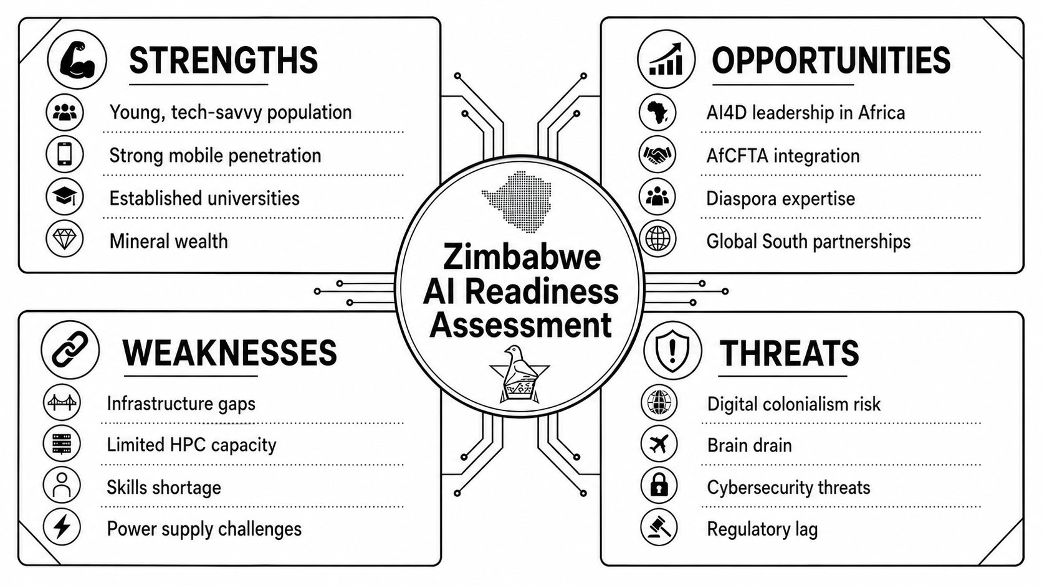
Situational Analysis: Zimbabwe's AI Readiness
Assessment Context: The AI Readiness Assessment Methodology (RAM) report, produced with UNESCO's leadership, identified key action points that directly informed this National AI Strategy. The assessment revealed both significant assets (youth demographic, universities) and critical gaps (HPC capacity, power infrastructure, skills) that the strategy is designed to address.
Zimbabwe National AI Strategy 2026-2030
5

Slide 6
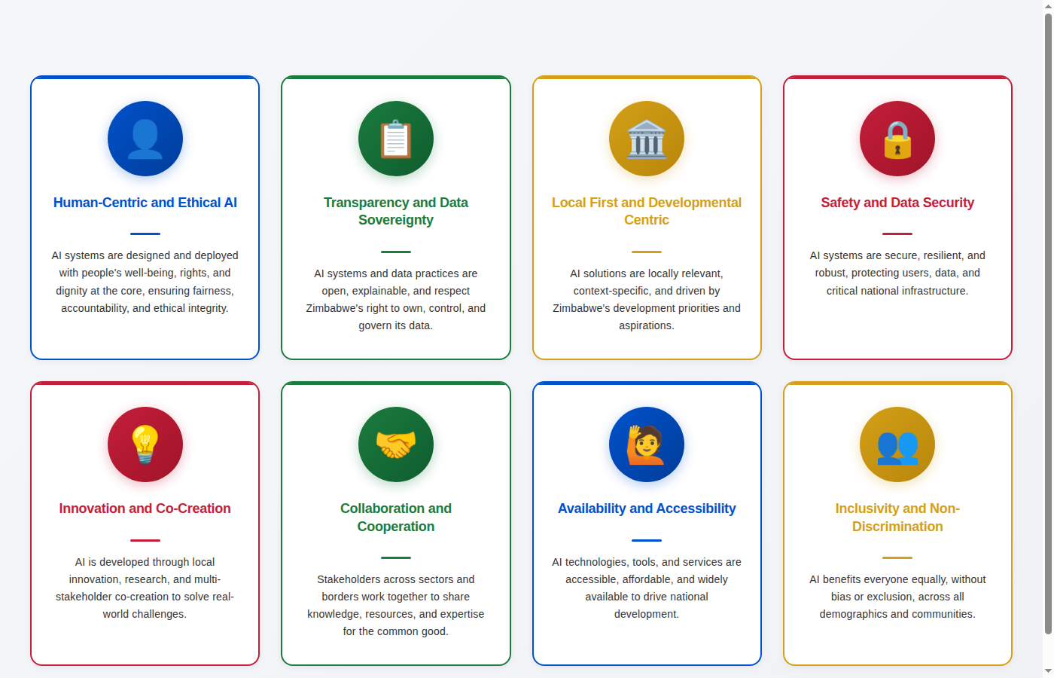
Guiding Principles
The Principles That Anchor Our AI Journey
Zimbabwe National AI Strategy 2026-2030
6

Slide 7
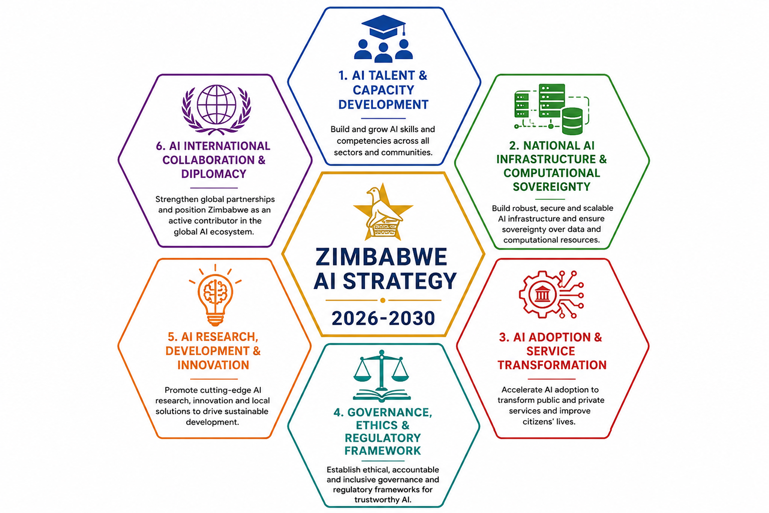
Six Strategic Pillars: Overview
The Foundations of Zimbabwe's AI Transformation
The six pillars are not independent silos but an interconnected ecosystem. Progress in one pillar reinforces and accelerates progress in others. Together, they form a comprehensive framework for transforming Zimbabwe into the continental hub of AI for Development.
Zimbabwe National AI Strategy 2026-2030
7

Slide 8

Pillar 1: AI Talent and Capacity Development
Cultivating a Skilled, Innovative Workforce
Mission: Cultivate a skilled, innovative workforce through AI literacy programs, research hubs, sector-specific academies and diaspora engagement — building the human capital that will drive Zimbabwe's AI transformation.
Key Initiative
Description
Talent Pathway
National AI Literacy Programs
Foundational AI awareness for all Zimbabweans
AI Literacy
Sector-Specific Academies
AgriTech, MiningTech, and Public Sector AI academies
"Skills for New Zimbabwe"
National upskilling and reskilling platform
Application Developer
National AI Research Fellowship
Advanced research programs and PhD support
AI Researcher
Diaspora Engagement
Fractional appointments and mentorship programs
Microcredentials & Certifications
Industry-recognized AI qualifications
Commercialization Expert
Zimbabwe National AI Strategy 2026-2030
8

Slide 9



Pillar 2: AI Infrastructure & Computational Sovereignty
Building the Digital Backbone of Zimbabwe's AI Future
Mission: Establish high-performance computing infrastructure, sovereign data platforms, world-class data centres and secure, inclusive connectivity — ensuring Zimbabwe owns and controls its critical AI infrastructure.
Compute & Data
Connectivity & Energy
Expanding the Zimbabwe Centre for High Performance Computing (ZCHPC)
Reliable broadband access nationwide, prioritizing rural areas
■
■
National data infrastructure under Zimbabwean control
Solar, wind, kinetic, nuclear hybrid systems for AI facilities
■
■
Secure, resilient, redundant facilities meeting global standards
Strict Power Usage Effectiveness (PUE) standards
■
■
USSD and mobile-first access for underserved communities
■
Project "Pangolin" (Flagship Initiative)
■
Critical Enabler: Power infrastructure is a strategic priority — reliable, abundant, renewable energy is non-negotiable for AI data centres and HPC facilities.
Zimbabwe National AI Strategy 2026-2030
9

Slide 10
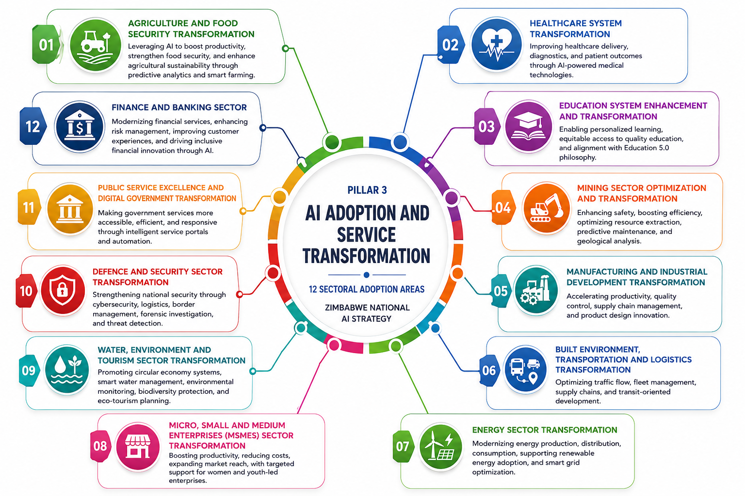
Pillar 3: AI Adoption and Service Transformation
Driving Sector-Wide Adoption for Inclusive Growth
This pillar drives sector-wide AI adoption to improve service delivery, optimise industries, and enhance citizen experiences while ensuring equitable access. Technical Working Groups (TWGs) co-chaired by government and private sector leaders lead implementation in Agriculture, Health, Mining, Finance, and Education.
Zimbabwe National AI Strategy 2026-2030
10

Slide 11

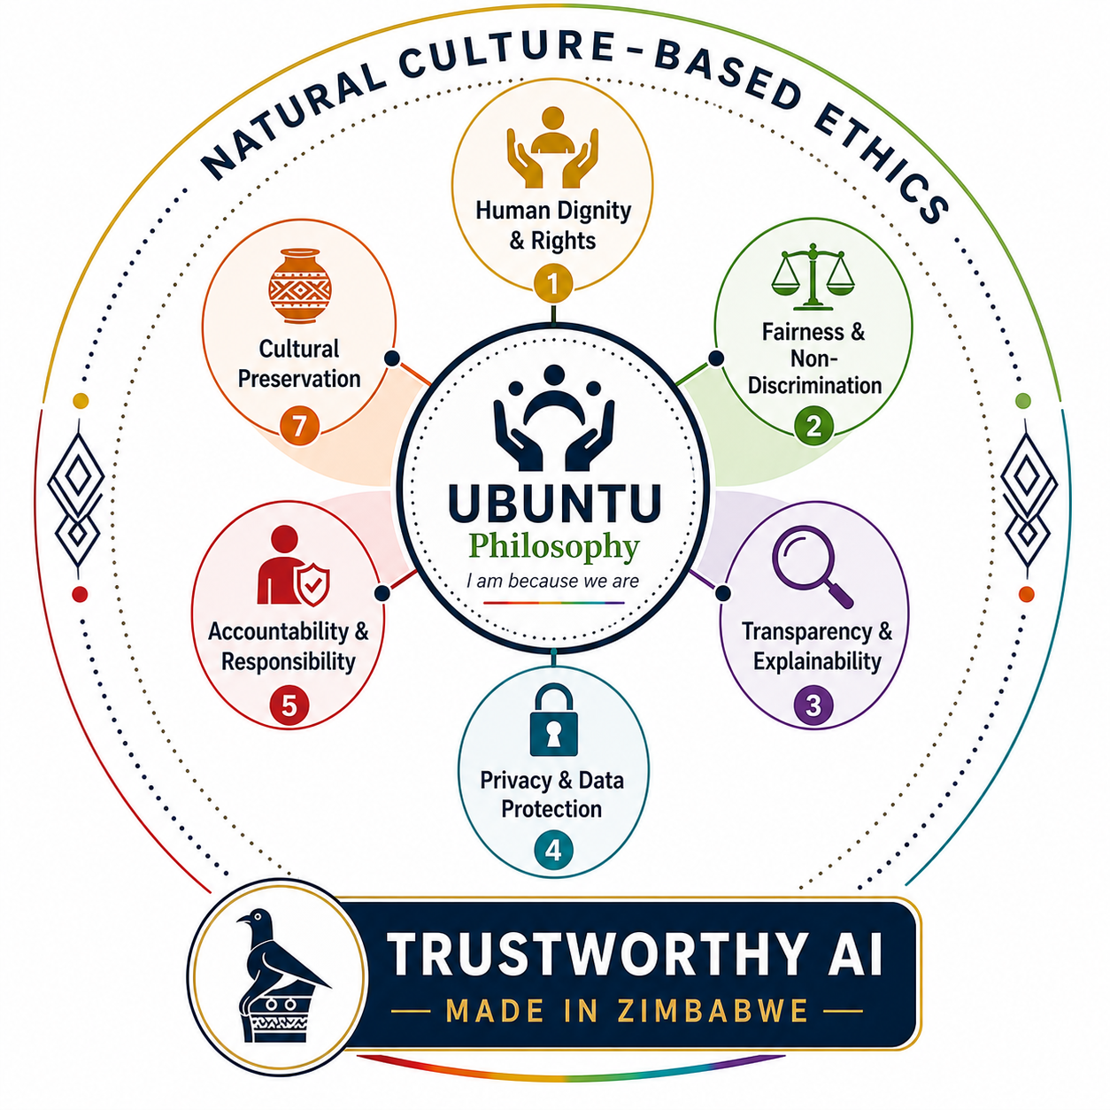
Pillar 4: Governance, Ethics & Regulatory Framework
Responsible AI Rooted in Ubuntu Philosophy
Location
Regulatory Architecture
AI Strategy Implementation Office (AISIO)
Operational execution and M&E
Lead Ministry (MICTPCS)
National Digital Regulatory Committee (ZNDC)
Independent regulatory oversight
Hosted within POTRAZ
Technical Working Groups (TWGs)
Sector-specific implementation
Cross-ministerial
National AI Ethics Committee
Independent ethical oversight
Independent
Zimbabwe National AI Strategy 2026-2030
11

Slide 12




Pillar 5: AI Research, Development & Innovation
Advancing Scientific Discovery and Home-Grown IP
Mission: Promote scientific discovery, technological innovation and locally tailored intellectual property that meets national priorities and enriches global AI knowledge positioning Zimbabwe as a contributor to, not merely a consumer of, global AI advancement.
Research Excellence
Innovation Pipeline
IP & Knowledge
Specialized research focus areas at universities aligned with national priorities
Research-to-commercialization pathways
Locally-tailored Intellectual Property (IP) reflecting Zimbabwean context
■
■
■
Joint Innovation Labs between government and private sector
"Data for Development" agreements with private companies
■
■
National AI Research Fellowship program
■
AI Regulatory Sandbox ("Innovation Crucible")
Publication and knowledge-sharing platforms
Advanced AI research projects and PhD programs
■
■
■
International research partnerships and exchanges
Support infrastructure for AI start-ups and SMEs
Indigenous knowledge integration in AI systems
■
■
■
Zimbabwe National AI Strategy 2026-2030
12

Slide 13


Pillar 6: AI International Collaboration and Diplomacy
Global Engagement While Protecting Digital Sovereignty
Mission: Enhance Zimbabwe's role in the global AI landscape, amplify its influence in global AI governance, and secure technology transfer while protecting digital sovereignty — positioning Zimbabwe as a continental leader and Global South voice in AI governance.
Regional Leadership
Global Engagement
Lead African AI governance through regional bodies
Participate in ITU, UNESCO, and OECD AI standards development
■
■
Host the annual "Harare Declaration on Ethical AI for Development"
Secure agreements with global technology partners
■
■
Build alliances with other "AI Sprinter" nations
Establish strategic agreements with private companies
■
■
Contribute to African AI standards and frameworks
Support for allied nations and diaspora AI experts
■
■
Strategic Positioning: Zimbabwe as the continental hub of "AI for Development" — where home-grown ingenuity meets global excellence.
Zimbabwe National AI Strategy 2026-2030
13

Slide 14
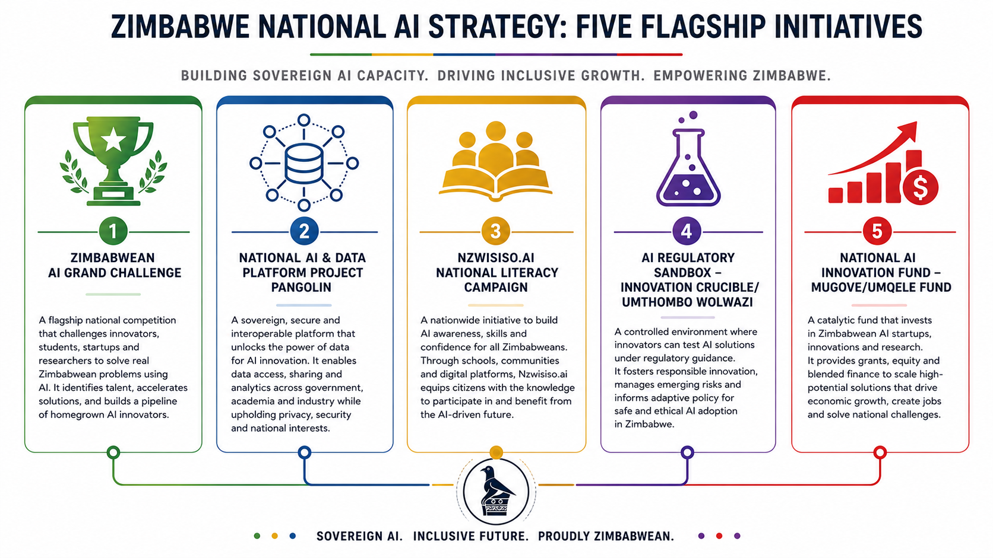
Five Flagship Initiatives: Overview
Igniting the National AI Mission
Five transformative flagship initiatives have been designed to generate immediate momentum, demonstrate AI's tangible value, and build the foundational infrastructure for Zimbabwe's AI ecosystem. Each initiative is cross-cutting, supporting multiple strategic pillars simultaneously.
Zimbabwe National AI Strategy 2026-2030
14

Slide 15



Flagship 1: Zimbabwean AI Grand Challenge
Catalyzing Home-Grown Innovation
Objective: An annual national competition designed to crowdsource AI solutions for Zimbabwe's most pressing socio-economic challenges, driving local innovation and identifying top talent.
AgriTech Track
HealthTech Track
MiningTech Track
Precision farming optimization
AI-assisted diagnostic tools
Mineral exploration optimization
■
■
■
Early crop disease detection
Medical resource allocation
Worker safety monitoring
■
■
■
Climate-resilient yield prediction
Telemedicine enhancements
Equipment predictive maintenance
■
■
■
Supply chain logistics
Epidemic outbreak prediction
Environmental impact reduction
■
■
■
The Prize: Winning teams receive seed funding from the National AI Innovation Fund, expert mentorship and fast-tracked access to the AI Regulatory Sandbox.
Zimbabwe National AI Strategy 2026-2030
15

Slide 16




Flagship 2: Project Pangolin
Sovereign Data Infrastructure for the Nation
Sovereign Data Lake
API Gateway
Curated, high-quality datasets spanning health, agriculture, climate, and public services, securely hosted within Zimbabwe's borders.
Standardized, secure APIs enabling developers and startups to seamlessly integrate national data into their AI applications and services.
A centralized, secure national platform providing researchers, startups, and government agencies access to anonymized national datasets and computing resources to build context-relevant AI solutions.
ZCHPC Integration
Privacy & Security
Direct linkage with the Zimbabwe Centre for High Performance Computing, providing the necessary computational muscle for model training.
Strict access controls, robust anonymization protocols, and compliance with national data protection laws to ensure citizen trust.
Zimbabwe National AI Strategy 2026-2030
16

Slide 17




Flagship 3: Nzwisiso.ai National Literacy Campaign
AI for Every Zimbabwean
Demystifying AI
Multilingual Content
Mobile-First Learning
Educational materials and resources translated into Shona, Ndebele, and all 16 official national languages to ensure cultural resonance and accessibility.
USSD and WhatsApp-based micro-learning modules designed specifically for low-bandwidth environments and basic mobile devices.
"Nzwisiso" (Understanding) is a nationwide, inclusive campaign designed to demystify Artificial Intelligence, build foundational digital skills, and ensure equitable participation in the digital economy.
Community AI Hubs
Public Broadcasting
It transforms AI from an abstract concept into an accessible tool for everyday problem-solving.
Leveraging existing schools, public libraries, and rural telecenters as local learning nodes equipped with basic AI demonstration tools.
Dedicated radio and television programming to reach remote and offline populations, featuring local AI success stories and practical use cases.
Target Audience
Students, informal sector workers, rural communities, SMEs, and the general public.
Zimbabwe National AI Strategy 2026-2030
17

Slide 18



Flagship 4: AI Regulatory Sandbox
The "Innovation Crucible" - Safe Space for Bold Ideas
The Innovation Crucible: A controlled regulatory environment allowing startups, researchers, and enterprises to test high-impact AI solutions under regulatory supervision. It fosters rapid innovation while ensuring public safety, ethical compliance, and alignment with national values.
Safe Testing
Policy Co-Creation
Fast-Track Deployment
Deploy and test bold AI applications in real-world scenarios with controlled risks and temporary regulatory relief, removing immediate compliance barriers for early-stage innovations.
Regulators and innovators collaborate closely within the sandbox, allowing national policy and governance frameworks to evolve dynamically alongside rapid technological advancement.
Successful sandbox graduates receive accelerated regulatory approvals, certification, and pathways for national deployment, ensuring the best solutions reach the market quickly.
Target Sectors: FinTech | HealthTech | AgriTech | GovTech
Zimbabwe National AI Strategy 2026-2030
18

Slide 19




Flagship 5: National AI Innovation Fund
"Mugove/Umqele Fund" — Capital for Creation
The Objective: A dedicated sovereign investment vehicle designed to provide patient capital, de-risk early-stage AI innovation, and accelerate the commercialization of home-grown AI solutions aligned with national priorities.
Seed & Pre-Seed
Capital
Commercialization
Matching Grants
Scale-Up
Funding
Target: Ideation, prototyping, and university spin-offs.
Providing crucial early-stage funding to transform academic research and bold ideas into viable minimum viable products (MVPs).
Target: Industry-academia joint ventures and SME AI adoption.
Co-funding mechanisms to incentivize traditional industries to adopt AI and partner with local AI developers.
Target: Proven AI startups expanding regionally.
Growth capital to help successful Zimbabwean AI companies scale their operations across the SADC region and the continent.
Management Model: Structured as a Public-Private Partnership (PPP), leveraging government seed funding to crowd-in private equity, venture capital, and international development finance.
Zimbabwe National AI Strategy 2026-2030
19

Slide 20
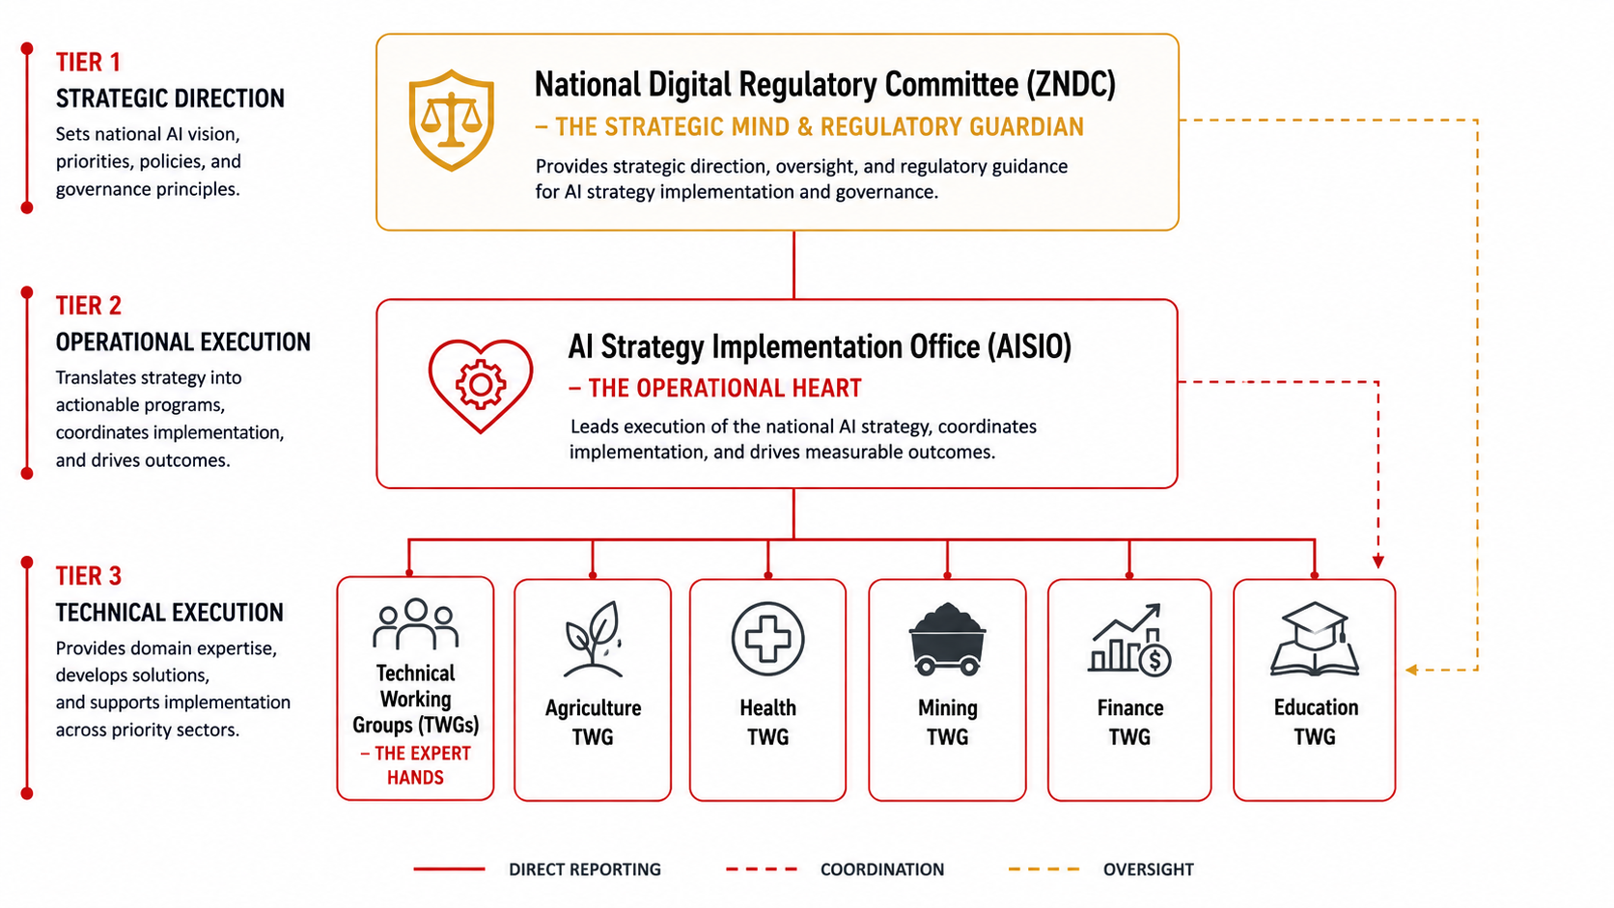
Governance Framework: The Three-Pillar Structure
Implementation Governance: The Strategic Mind, Operational Heart, and Expert Hands
Zimbabwe National AI Strategy 2026-2030
20

Slide 21
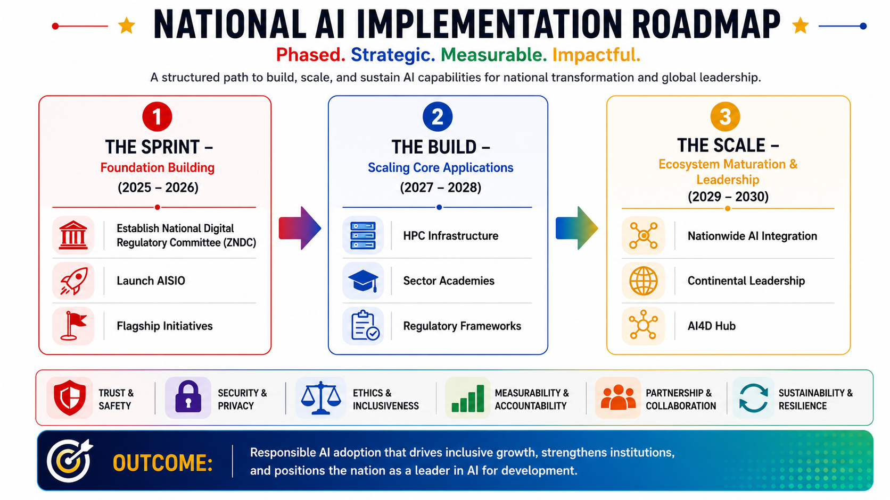
Implementation Roadmap: Three Phases
The Sprint, The Build, The Scale (2026-2030)
The strategy unfolds across three distinct phases: Phase 1: The Sprint (First 100 Days) focuses on rapid institutional setup; Phase 2: The Build (2026-2027) establishes core infrastructure and pilots; and Phase 3: The Scale (2028-2030) drives nationwide adoption and regional leadership.
Zimbabwe National AI Strategy 2026-2030
21

Slide 22




Phase 1: The Sprint - First 100 Days (Q1-Q2 2026)
Llaying the Foundation for AI Transformation
1
2
3
4
Governance
Activation
Flagship
Launch
Infrastructure
Audit
Sandbox
Setup
Formally establish the National Digital Regulatory Committee (NDRC) and operationalize the AI Strategy Implementation Office (AISIO).
Announce and open applications for the inaugural Zimbabwean AI Grand Challenge to catalyze immediate innovation.
Conduct a comprehensive national audit of compute capabilities, data center readiness, and high-value public datasets.
Draft and publish the initial operational guidelines for the AI Regulatory Sandbox (The Innovation Crucible).
Strategic Objective: The Sprint phase is designed to generate immediate momentum, signal government commitment and establish the critical institutional structures required for long-term success.
Zimbabwe National AI Strategy 2026-2030
22

Slide 23

Monitoring and Evaluation Framework
Measuring What Matters
Accountability & Agility: A robust, data-driven Monitoring and Evaluation (M&E) framework led by the AI Strategy Implementation Office (AISIO) to ensure accountability, track progress against Vision 2030, and enable agile course correction.
Strategic Pillar
Key Performance Indicators (KPIs)
1. Talent & Capacity
National AI literacy rate; Number of specialized AI graduates; Diaspora engagements
2. Infrastructure
HPC utilization rate; Sovereign data lake volume; Renewable energy integration (PUE)
3. Adoption & Services
Sectoral AI adoption rate (Agri, Health, Mining); Public service AI integration index
4. Governance & Ethics
Regulatory Sandbox throughput; Ethics committee reviews; Compliance rate
5. R&D and Innovation
AI patents/IP registered; Startups funded via Mugove Fund; Grand Challenge solutions deployed
6. International Diplomacy
Strategic international partnerships signed; Regional leadership roles assumed
Transparency Mechanism: Publication of the "Annual State of AI in Zimbabwe Report" to keep all stakeholders informed.
Zimbabwe National AI Strategy 2026-2030
23

Slide 24





Funding and Investment Strategy
Mobilizing Resources for AI Transformation
1. Government Seed Funding
Blended Finance Model
Dedicated national budget allocations for core infrastructure and the National AI Innovation Fund.
Realizing the National AI Strategy requires significant, sustained investment. Zimbabwe will employ a Blended Finance Model, leveraging public funds to de-risk investments and crowd-in private and international capital.
2. Public-Private Partnerships (PPPs)
Joint ventures with telecom operators and tech firms for data centres and connectivity.
3. International Development Finance
Grants and concessional loans from multilateral institutions (AfDB, World Bank, UN agencies).
This approach ensures financial sustainability while maintaining national sovereignty over critical AI infrastructure.
4. Venture Capital & Private Equity
Tax incentives and Special Economic Zones to attract local and foreign direct investment.
5. "Data for Development" Agreements
"Investment in AI is not a cost; it is the most critical capital allocation for Zimbabwe's future economic competitiveness."
Monetizing sovereign data access through strategic, secure agreements with global tech entities.
Zimbabwe National AI Strategy 2026-2030
24

Slide 25
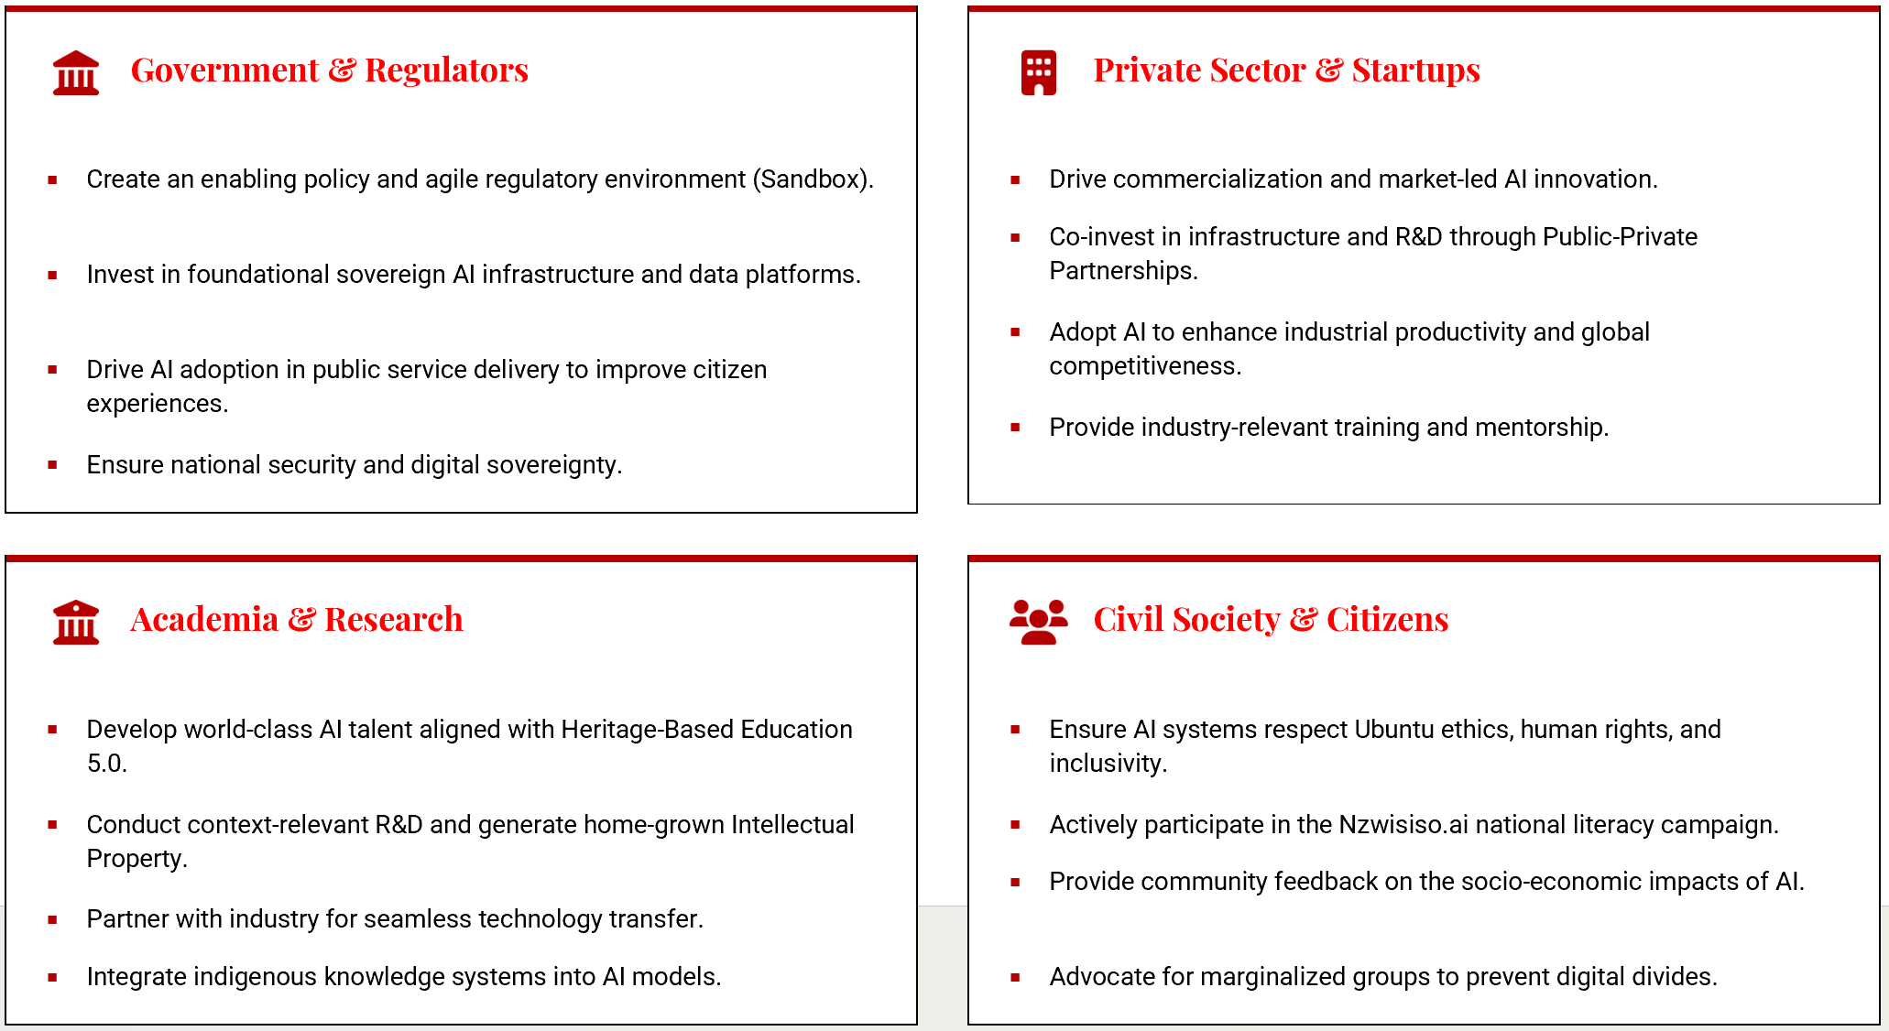
Stakeholder Roles and Responsibilities
Collective Action for National AI Transformation
■
■
■
■
■
■
■
■
■
■
■
■

Slide 26





Cross-Cutting Themes
Strengthening All Six Pillars
Certain strategic imperatives transcend individual pillars and must be integrated into every aspect of Zimbabwe's AI ecosystem to ensure holistic and sustainable development.
Gender & Inclusion
Environmental Sustainability
Equitable Participation: Ensuring women, youth, and marginalized communities actively participate in AI development. Actively mitigating algorithmic bias to prevent the amplification of existing societal inequalities.
Green AI: Mandating energy-efficient computing practices and renewable energy use for data centres. Leveraging AI specifically to address climate change, resource management, and conservation efforts.
Cybersecurity & Resilience
Public Trust & Transparency
Secure Infrastructure: Protecting critical AI systems and sovereign data from cyber threats. Building robust, resilient architectures that can withstand disruptions and ensure continuous service delivery.
Explainable AI: Fostering citizen confidence through transparent AI decision-making processes. Maintaining open communication regarding how AI is deployed in public services and its impact on society.
Zimbabwe National AI Strategy 2026-2030
26

Slide 27



Risk Management and Mitigation
Identifying and Mitigating Key Challenges
Infrastructure & Resource Risks
Ethical & Social Risks
Identified Risk:
Identified Risk:
Power instability and limited high-performance computing capacity hindering AI development.
Algorithmic bias against local populations and potential workforce displacement due to automation.
Mitigation Strategy:
Mitigation Strategy:
Mandate hybrid renewable energy systems for all AI facilities; leverage Public-Private Partnerships (PPPs) to accelerate data centre investments.
Enforce Ubuntu-based ethics guidelines via the National AI Ethics Committee; launch "Skills for New Zimbabwe" reskilling initiatives.
Data & Security Risks
Execution & Talent Risks
Identified Risk:
Identified Risk:
Cyber threats, data breaches, and the loss of national data sovereignty to foreign entities.
Brain drain of top AI talent and potential funding shortfalls for strategy implementation.
Mitigation Strategy:
Mitigation Strategy:
Implement Project Pangolin's strict security protocols; mandate local hosting for critical national datasets; enforce strict data protection laws.
Establish Diaspora fractional appointments to retain expertise; deploy the Blended Finance Model to ensure sustainable, diversified funding.

Slide 28




International Positioning and Diplomacy
Zimbabwe's Global AI Leadership: Diplomacy and Sovereignty
Regional Hub (SADC & AU)
Championing the African Union AI Strategy and leading regional frameworks for cross-border data flows, shared infrastructure, and ethical AI governance.
Global South Voice
A Bridge to the Future
Amplifying the perspectives of developing nations in international forums (ITU, UNESCO) to ensure global AI standards are inclusive and equitable.
Zimbabwe seeks to position itself not merely as a consumer of global technologies, but as a sovereign creator and a vital bridge between home-grown African innovation and global technological excellence.
Sovereign Engagement
Forging strategic bilateral and multilateral partnerships for technology transfer while fiercely protecting national data, intellectual property, and cultural identity.
"Diplomacy in the AI era is about securing our place in the future economy without compromising our heritage or sovereignty."
Zimbabwe National AI Strategy 2026-2030
28

Slide 29






National AI Strategy: Key Performance Indicators Dashboard
1. AI Talent and Capacity Development
2. National AI Infrastructure and Computational Sovereignty
3. AI Adoption and Service Transformation
LAGGING INDICATORS (NORTH STAR)
LAGGING INDICATORS (NORTH STAR)
LAGGING INDICATORS (NORTH STAR)
GDP Contribution: % increase in target sectors by 2030.
National Compute Capacity: Total petaflops of sovereign HPC.
Global Talent Index: Overall ranking and "Skills" sub-pillar.
■
■
■
National Food Security Index: Measurable improvement globally.
STEM Graduates: % increase from Zimbabwean universities.
■
■
Global AI Index: Ranking on the compute sub-index.
■
High-Value Job Creation: Direct jobs created in the AI sector.
Carbon Footprint: CO2 emissions per petaflop of ZIM-HPC.
Brain Gain Ratio: Net flow of AI talent into/out of Zimbabwe.
■
■
■
LEADING INDICATORS (DASHBOARD)
LEADING INDICATORS (DASHBOARD)
ZCHPC Utilization Rate: % compute time actively used.
LEADING INDICATORS (DASHBOARD)
■
Adoption Rate: Commercial farms/MSMEs using local AI.
Curriculum Rollout: % of schools using "Digital Mhuri".
■
Platform Onboarding: Entities integrated with "Pangolin" Data Trust.
■
■
Productivity Metrics: % increase in average maize yield.
■
Certifications Issued: Micro-credentials via "Skills for a New Zim".
Startup Formation: New AI start-ups and 3-year survival rate.
Dataset Completion: % digitization of Health/Agri datasets.
■
■
■
Diaspora Engagement: Experts acting as fractional faculty.
■
4. Governance, Ethics and Regulatory Framework
5. AI Research, Development and Innovation
6. AI International Collaboration and Diplomacy
LAGGING INDICATORS (NORTH STAR)
LAGGING INDICATORS (NORTH STAR)
LAGGING INDICATORS (NORTH STAR)
Rule of Law Index: Score in "Regulatory Enforcement".
Total AI Investment: Annual investment as a % of GDP.
Regional Leadership: Leadership roles in SADC/AU AI Working Groups.
■
■
■
Public Trust in AI: % of citizens trusting AI systems to be fair.
FDI in Tech Sector: Total Foreign Direct Investment flowing in.
■
■
Policy Export: Adoption of Zimbabwean ethical frameworks globally.
■
Ease of Doing Business: Ranking in "Starting a Business".
Global Influence Score: Shaping AI policy at SADC and AU.
■
■
IP Licensing: Local AI patents licensed internationally.
LEADING INDICATORS (DASHBOARD)
LEADING INDICATORS (DASHBOARD)
■
Trustworthy AI Mark: Companies with voluntary certification.
Fund Leverage Ratio: Private capital mobilized per public dollar.
LEADING INDICATORS (DASHBOARD)
■
■
High-Level Engagements: Joint R&D projects with global entities.
■
Sandbox Throughput: Startups graduating from the AI Sandbox.
PPP Pipeline: Value of Joint Innovation Labs & Data Agreements.
■
Bilateral Tech Agreements: Sovereign technology transfer deals.
■
■
Time to Market: Average time for graduates to receive licenses.
Conference Leadership: Experts keynoting international forums.
Global Forum Participation: Speaking roles at UN AI summits.
■
■
■

Slide 30





Way Forward: Call to Action
The Path Forward: Collective Transformation
The time to act is now. Zimbabwe's AI transformation requires immediate, coordinated action from all stakeholders—government, private sector, academia, and civil society.
Government
Private Sector
Academia
Citizens
Approve and resource the National AI Strategy immediately. Operationalize the NAIC and AISIO within the first 100 days.
Commit to Public-Private Partnership investments and drive commercial AI innovation through the Regulatory Sandbox.
Launch dedicated AI programs and research initiatives aligned with the National AI Strategy and Heritage-Based Education 5.0.
Actively engage in Nzwisiso.ai national literacy campaign and support the inclusive, ethical transformation of Zimbabwe.
Together, we will build an AI-powered Zimbabwe that serves all citizens, respects our heritage, and positions our nation as a beacon of innovation across Africa and the Global South.
Zimbabwe National AI Strategy 2026-2030
29

Slide 31



Conclusion: Zimbabwe's AI Future
A Beacon for Africa and the Global South
By 2030, Zimbabwe will be recognized as a sovereign, ethical AI innovator—a beacon of inclusive, human-centered AI development for Africa and the Global South.
Vision
Mission
Impact
Sovereign AI leadership rooted in Ubuntu ethics, African values, and indigenous knowledge systems.
Transform Zimbabwe through inclusive, responsible AI innovation that creates shared prosperity and opportunity.
Create lasting prosperity, dignity, and opportunity for all Zimbabweans while protecting our sovereignty and heritage.
The future is not something that happens to us. It is something we build together—with vision, courage, and collective action.
Zimbabwe National AI Strategy 2026-2030
30

