Slide 1
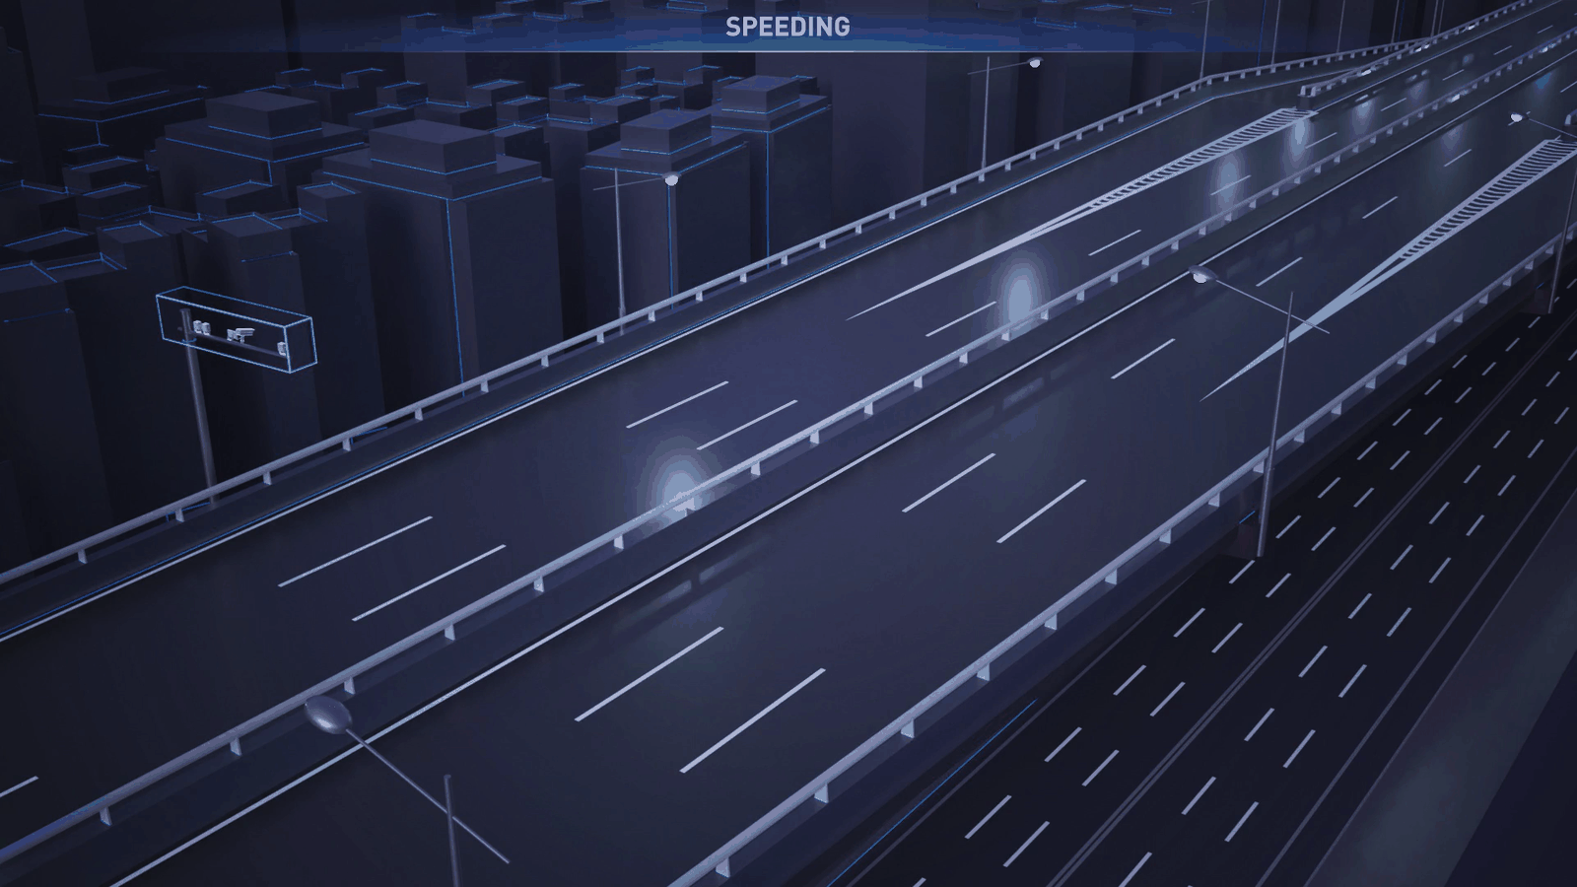
AI-POWERED ANALYTICS
Leveraging AI for Real-Time Traffic Optimization, Congestion Reduction, and Safer Roads
Transforming Zimbabwe's transportation infrastructure through intelligent automation, predictive analytics, and data-driven decision making for a smarter, safer future.
Presented By: Dr Simon Muzviyo - Managing Director, City Parking Pvt Ltd
AI Analytics
Smart Infrastructure
Safety Enhancement
Real-time processing and predictive modelling
Adaptive signals and road management systems
Incident detection and emergency response
Zimbabwe Traffic Intelligence Roadmap

Slide 2
//
PRESENTATION ROADMAP
Presentation Highlights
A sequenced view of the problem, AI opportunity, global cases and recommended implementation path.
01
Real Cost
02
Ecosystem
03
Challenges
04
Safety Crisis
Congestion as an economic drain
Who must coordinate
Infrastructure, behaviour and technology
Accident trends and hotspots
05
AI Strategy
06
Digitalization
07
Enforcement
08
AI Opportunity
National framework alignment
Current infrastructure projects
AI-powered compliance lifecycle
What more AI can do
09
Case Studies
10
Missing Pieces
11
Recommendations
12
Call to Action
Nairobi and Pune lessons
Data, integration and scope gaps
Five practical interventions
Implementation priorities
AI-Powered Traffic Analytics
02

Slide 3

$
01 / ECONOMIC IMPACT
The Real Cost of Traffic in Zimbabwe
Traffic congestion is not just an inconvenience; it is an economic drain.
Congestion affects cross-border trade, SME productivity and daily commutes. The costs extend beyond fuel to lost working time, delayed freight and increased maintenance.
Economic Loss
Border Gridlock
Productivity
Freight Delays
Fuel consumption and wasted man-hours affect traders, commuters and SMEs.
Heavy truck traffic at Beitbridge and Forbes can create extended delays.
Parliamentary Concern
Infrastructure Gap
Weak Systems
Capacity Lag
Concerns include decaying infrastructure, weak enforcement and coordination gaps.
Vehicle growth has outpaced urban road and parking capacity expansion.
KEY INSIGHT
Traffic congestion costs Zimbabwe approximately $2.5 billion annually in lost productivity.
AI-Powered Traffic Analytics
03

Slide 4
◎
02 / COORDINATION
● Multi-agency delivery
The Stakeholder Ecosystem
AI traffic management is not only a technology project; it is an institutional coordination project.
Enforcement & Admin
Local Authorities
ZRP
ZINARA
VID
TSCZ
City Councils
Municipalities
Rural District Councils
Government Regulators
Ministry of Transport
Ministry of ICT
Ministry of Home Affairs
Cabinet Committee
Traffic
Data Hub
Tech Partners
ISPs
Technology Providers
POTRAZ
Academic & Civil Society
Universities
Transport Associations
Civil Society
AI-Powered Traffic Analytics
04

Slide 5
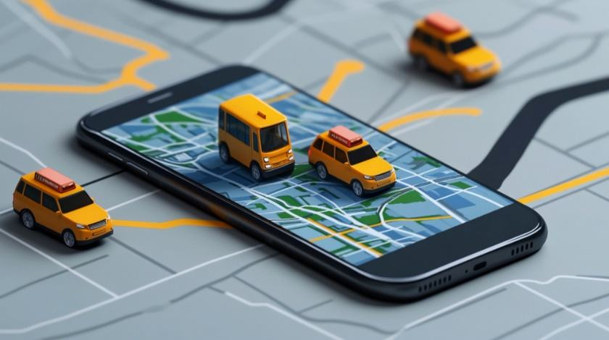
!
03 / CURRENT CHALLENGES
Infrastructure & Volume
Problem 1: Inadequate infrastructure to support modern traffic flow.
Parking mismatch
Dilapidated roads
8,000 vs 200,000
Potholes, faded markings and broken traffic lights reduce network reliability.
Harare CBD has limited parking capacity against a far larger daily vehicle volume.
Narrow roads
Drainage issues
Capacity is not matching demand
Rush-hour lanes are easily overwhelmed, especially in corridors with mixed traffic.
Heavy rains trigger flooding, stranded commuters and cascading route delays.
AI helps only when supported by basics: reliable intersections, visible markings, functioning signals, sensors and credible data.
AI-Powered Traffic Analytics
05

Slide 6
⚠
03 / CURRENT CHALLENGES
Human & Enforcement
Problem 2: behavioural issues and corruption undermine existing traffic systems.
1
Driver indiscipline
2
Corruption
Risk Pattern
Red-light running, illegal stops and poor lane discipline increase congestion and crash risk.
Informal settlements of offences weaken trust and reduce compliance incentives.
Higher impact
Mushikashika
Corruption
Weak enforcement
3
Weak enforcement
4
Mushikashika chaos
Indiscipline
Low certainty of detection allows repeat violations and inconsistent penalties.
Unregulated public transport loading patterns disrupt intersections and kerbsides.
Higher frequency
AI enforcement must be transparent, auditable and appealable
AI-Powered Traffic Analytics
06

Slide 7
#
03 / CURRENT CHALLENGES
Technological Constraints
Problem 3: resource constraints and fragmented technology slow modernization.
Budget constraints
High maintenance cost
Fragmented systems
Procurement bottlenecks delay rollout and upgrade cycles.
Hardware, connectivity and field support require sustainable funding.
Traffic, licensing, tolling and enforcement data remain disconnected.
Outdated platforms
Capacity gaps
Legacy traffic management tools lack real-time analytics and automation.
AI operations require skills in data, cyber, hardware and governance.
Design principle: start with cloud-first integration, low-cost data feeds, open APIs and phased intersection deployment.
AI-Powered Traffic Analytics
07

Slide 8
+
04 / ROAD SAFETY
The Safety Crisis
Rising accident statistics highlight the need for AI-assisted monitoring, prevention and response.
H1 2025 Accidents
Q1 2025 Accidents
Festive Deaths
Injuries
28,159
15,263
100
471
Total accidents recorded in first half of 2025
Accidents recorded in Q1 2025 alone
Deaths during festive season 2025
People injured in festive accidents
Accident Trend Over Time
Key Insights
Harare death traps
Worst accident hotspots identified
Highway safety
Major highways need urgent upgrades
Pedestrian safety
Crossing points need AI monitoring
Jan
Feb
Mar
Apr
May
Jun
Critical alert: accident surge requires live monitoring
AI-Powered Traffic Analytics
08

Slide 9
AI
05 / STRATEGY ALIGNMENT
● Strategy active
National AI Strategy Framework
Four pillars for AI-driven traffic management transformation.
National AI Strategy (2026-2030)
Key initiatives
The strategy provides a framework for AI adoption across Zimbabwe's transportation sector, with emphasis on talent, infrastructure, service transformation and governance.
Smart City Rollout
AI cameras with number plate and facial recognition
Highway Modernization
Chirundu, Banket/Blue Ridge and Mabvuku Interchange
AI Talent & Identification
Solid Infrastructure
Develop local expertise and identify key talent for traffic systems
Build robust digital infrastructure for AI deployment and processing
Public Transport Digitalization
Electric buses, GPS tracking and tap-and-go ticketing
Service Transformation
Governance & Ethics
Transform public services through AI-powered automation
Establish oversight, ethics and regulatory safeguards
Key insight: strategy alignment reduces policy risk
AI-Powered Traffic Analytics
09

Slide 10
//
06 / IMPLEMENTATION BASE
● Active implementation
Infrastructure & Digitalization
Tangible projects already underway create the foundation for AI traffic management.
Key Infrastructure Projects
Digitalization Initiatives
Modernizing transport infrastructure and digital tolling systems creates core data capture points.
Cashless Payment Systems
All-Electronic Tolling (AET)
E-tags and automated payment processing at tollgates
ZINARA rolling out e-tags and cashless tolling to reduce delays and revenue leakage
RFID Vehicle Tracking
Real-time vehicle classification and monitoring systems
High-Tech Toll Plazas
Expanded toll infrastructure enabling payment without stopping
Data Analytics Platform
Tollgates evolving into data hubs for traffic analysis
Mabvuku Interchange
Construction to reduce congestion in eastern Harare
Key insight: digital tolling creates reusable traffic data
AI-Powered Traffic Analytics
10

Slide 11
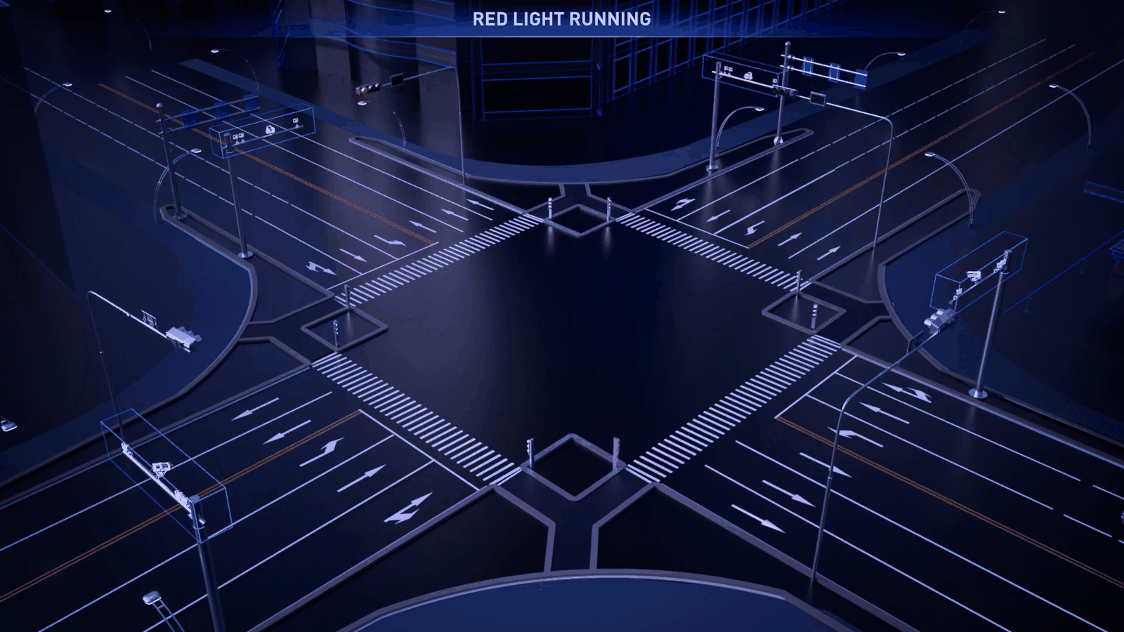
E
07 / ENFORCEMENT
AI-Powered Enforcement
A transparent enforcement pipeline should detect offences, validate evidence and protect public trust.
1
2
3
4
Capture
Verify
Issue
Appeal
Cameras and sensors detect red-light running, illegal stops, speed and lane violations.
AI flags evidence; human review confirms plate, location, time and offence category.
Automated fine notification connects to vehicle registry and payment channels.
Public-facing portal allows dispute review, audit trails and oversight reporting.
Accuracy threshold
Audit trail
No fine without evidence confidence and review
Every decision must be logged
Privacy controls
Transparency
Defined retention and access rules
Monthly reports and independent oversight
Outcome: enforcement that is consistent, data-backed and harder to manipulate.
AI-Powered Traffic Analytics
11

Slide 12
AI
08 / OPPORTUNITY
What More Can AI Do?
Four high-value use cases that move Zimbabwe from reactive enforcement to proactive network optimization.
1. Dynamic Signal Timing
2. Real-time Incident Detection
Adjust green-light phases based on real-time volumes, queue length and pedestrian demand.
Flag crashes, stalled vehicles, flooding or abnormal congestion for rapid response.
3. Predictive Analytics
4. Public Transport Optimization
Forecast congestion hotspots using weather, events, school terms and historic traffic flows.
Use GPS and payment data to plan routes, regulate loading points and reduce CBD chaos.
Priority sequence: start with signals and incidents, then integrate forecasting and public transport once data quality improves.
AI-Powered Traffic Analytics
12

Slide 13
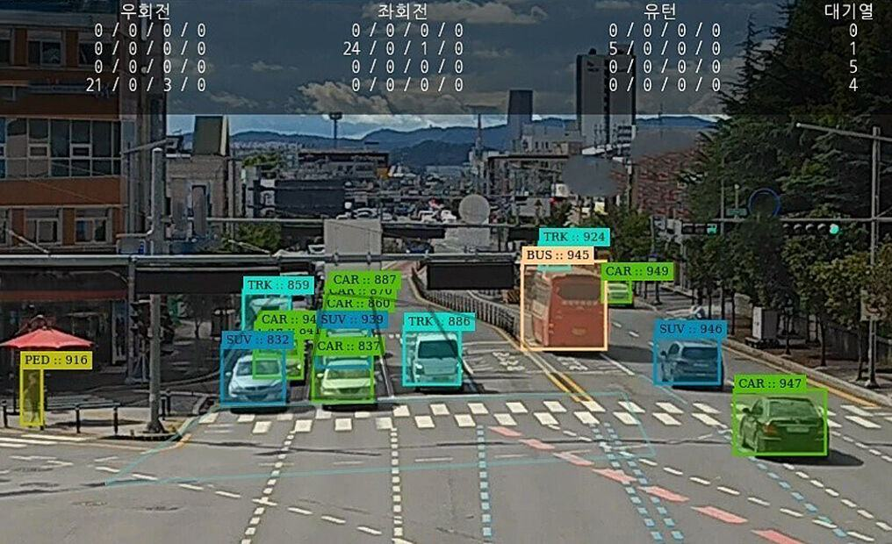
KE
09 / CASE STUDY
Nairobi, Kenya - Nota AI
Smart intersection technology shows how AI can support intelligent transport systems in African cities.
South Korean firm Nota AI supplied smart intersection technology for an intelligent transport system in Nairobi, Kenya.
Computational efficiency
Lower memory load
Reduced computational complexity for edge deployment
Optimised AI models need less device memory
Low power
Low latency
Fits intersections with limited power and rugged conditions
Supports live signal and incident decisions
Lesson for Zimbabwe: prioritize edge AI and low-latency systems where connectivity is uneven.
AI-Powered Traffic Analytics
13

Slide 14
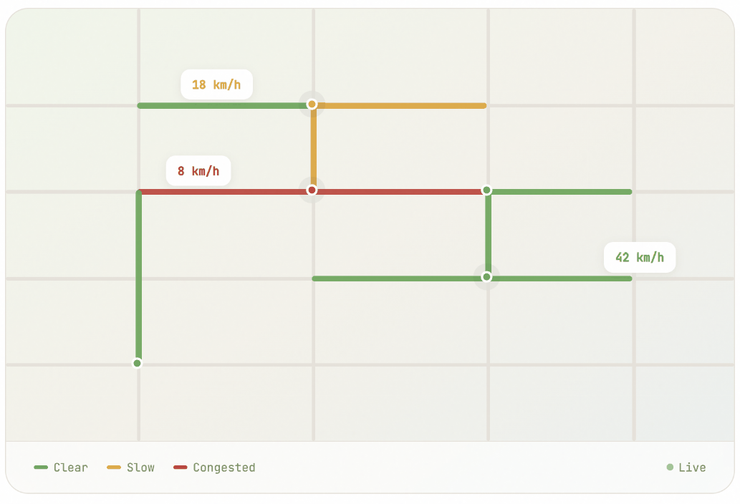
IN
09 / CASE STUDY
Pune, India - Google AI Case Study
Smartphone speed data can reduce CAPEX by using existing digital mobility signals.
Trafficure app concept
In 2026, Pune partnered with Google India to launch the Trafficure app, using live speed data from smartphones to monitor congestion and inform traffic control.
Replicable data model
Can be approximated using Google Maps/Waze-style speed feeds
Lower upfront CAPEX
Does not require immediate heavy roadside hardware investment
Real-time monitoring
Identifies slow, clear and congested segments quickly
Lesson for Zimbabwe: begin with mobile and platform data while building long-term sensor infrastructure.
AI-Powered Traffic Analytics
14

Slide 15
?
10 / GAPS
The Missing Pieces
The current environment has the foundation for AI, but the system needs integration, scope expansion and data discipline.
Fragmented Systems
Limited AI Scope
ZRP, ZINARA and VID databases are not fully integrated, limiting real-time coordination.
Current deployment focuses on enforcement, not yet on optimization and prevention.
Data Gaps
Public Transport Blind Spot
No centralized traffic data repository for city-wide analytics and model training.
Kombis operate largely outside the formal digital system, limiting route optimization.
Without solving these gaps, AI risks becoming a fine-collection tool rather than a traffic improvement system.
AI-Powered Traffic Analytics
15

Slide 16
1
RECOMMENDATION 01
Unified Traffic Data Platform
Connect ZRP, ZINARA, VID, CVR and local council databases into a single cloud-based platform.
ZRP
Platform architecture
Enforcement
Integrated database
Connect all traffic data sources
Councils
Cloud
Data Hub
ZINARA
Real-time dashboard
National traffic command center
Local operations
Roads & tolling
Open data APIs
Controlled developer and agency access
Implementation progress
65% target readiness for pilot
CVR
VID
65%
Vehicle registry
Vehicle inspection
AI-Powered Traffic Analytics
16

Slide 17
2
RECOMMENDATION 02
Adaptive Traffic Signal Control
Install sensors and cameras at key intersections to feed real-time data into an AI signal engine.
Current Problem
AI Solution
Traffic lights operate on fixed timers, ignoring actual traffic volume and causing unnecessary delays.
Sensors and cameras feed live traffic data to an engine that adjusts signal timing dynamically.
Target intersections:
20-30 high-congestion nodes in Harare, including Simon Muzenda/Chiremba Road and Seke Road intersections
Expected impact: 30-40% reduction in peak wait times
AI-Powered Traffic Analytics
17

Slide 18
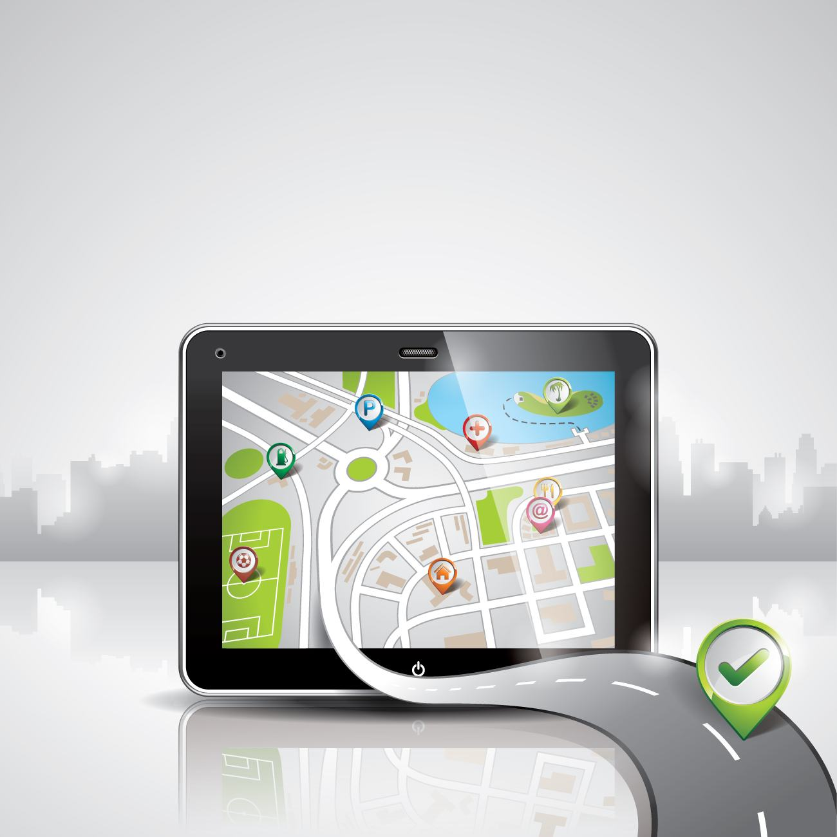
3
RECOMMENDATION 03
Public Transport Digitization
Bring kombis and buses into the formal data system to optimize routes, kerbside management and commuter experience.
1
2
3
4
Register routes
GPS tracking
Tap-and-go data
Optimise network
Digitise operator, route, vehicle and licence records.
Track live bus/kombi positions and route adherence.
Capture demand patterns through fare systems.
Redesign stops, ranks, corridors and timetables.
From informal movement to measurable flow
Less CBD chaos
Better commuter information
Safer operations
Designated ranks and data-informed kerbside control
Arrival times, routes and service reliability
Driver compliance, speed monitoring and route discipline
Digitization should be designed with operators, not imposed on them; adoption depends on incentives and simple tools.
AI-Powered Traffic Analytics
18

Slide 19
4
RECOMMENDATION 04
AI Research & Innovation Hub
Create a local research and deployment ecosystem for Zimbabwean traffic patterns.
Lead institutions: AI Institute Africa, NUST, University of Zimbabwe and Ministry of ICT working together to develop locally trained AI models for Zimbabwean traffic patterns.
Lead Institutions
International Partners
AI Institute Africa, NUST, UZ
Vitronic, Nota AI, global academics
Funding Source
Output Goals
$1.5m digital skills program
Open-source prediction models
Purpose: reduce dependence on imported models and build local technical capacity for long-term operations.
AI-Powered Traffic Analytics
19

Slide 20
5
RECOMMENDATION 05
Strengthen PPP Enforcement & Transparency
PPP models must balance investment, public value, enforcement credibility and social accountability.
Current PPP structure
Accountability checklist
Vitronic Machine Vision Middle East is investing $60-80 million under a revenue-sharing model from fines, raising concerns about revenue extraction versus genuine traffic improvement.
✓
Public performance dashboard
Fines, appeals, false positives, hotspot outcomes
✓
Independent technical audit
Model accuracy, bias, uptime, cyber-security
Investment Model
Oversight
$60-80m revenue-sharing from fines
Independent committee needed
✓
Appeal mechanism
Accessible dispute and evidence review process
Transparency
Civil Society
✓
Traffic impact reporting
Prove congestion and safety improvements, not only revenue
Monthly reports required
Representation in oversight
AI-Powered Traffic Analytics
20

Slide 21
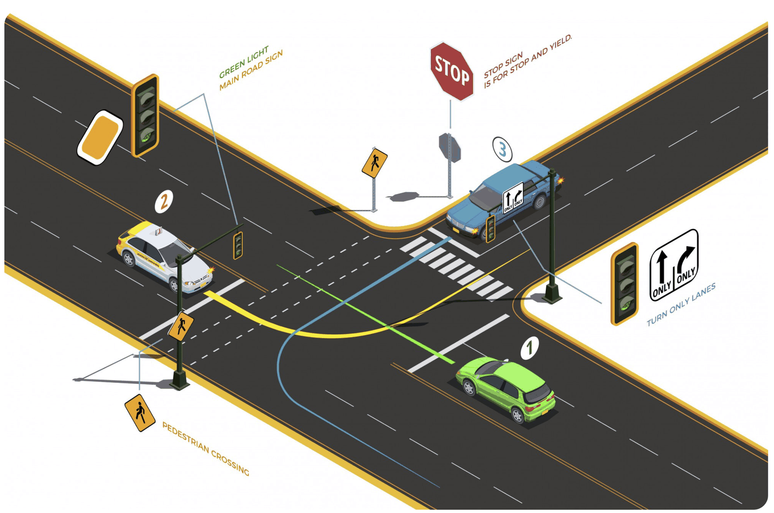
Thank you
AI-powered traffic management can move Zimbabwe from reactive enforcement to proactive mobility intelligence.
Call to action
1.
Launch a traffic data integration pilot
2.
Select 20-30 high-congestion nodes
3.
Create an independent AI oversight model
4.
Digitise priority public transport routes
Dr Simon Muzviyo - Managing Director, City Parking Pvt Ltd
Zimbabwe Traffic Intelligence Roadmap

