Slide 1
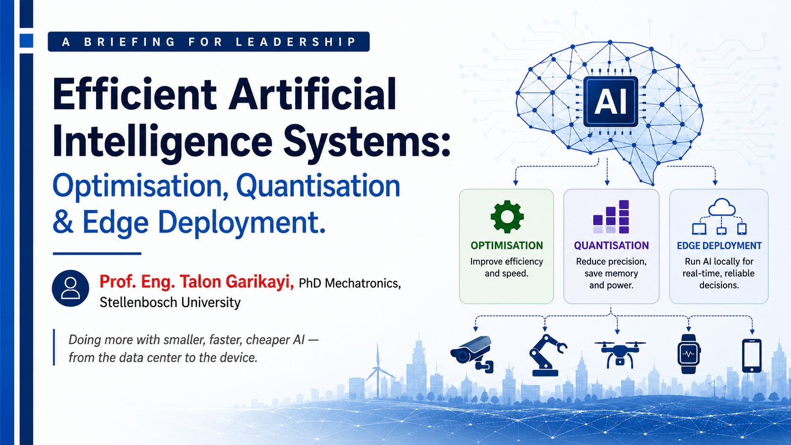

Slide 2
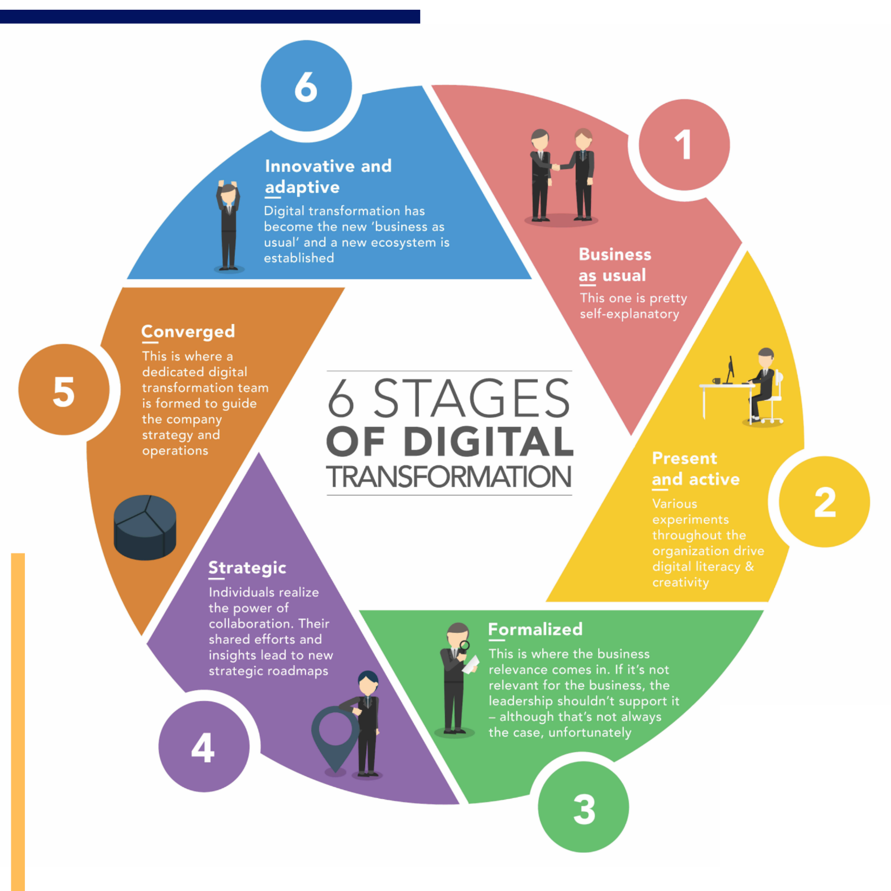
How do you assist an organisation that does not believe they have a problem?
Innovation is key.
Digital Transformation is just like any organisational Transformation and requires careful planning and execution to avoid conflicts.
Is AI – chihuta?

Slide 3

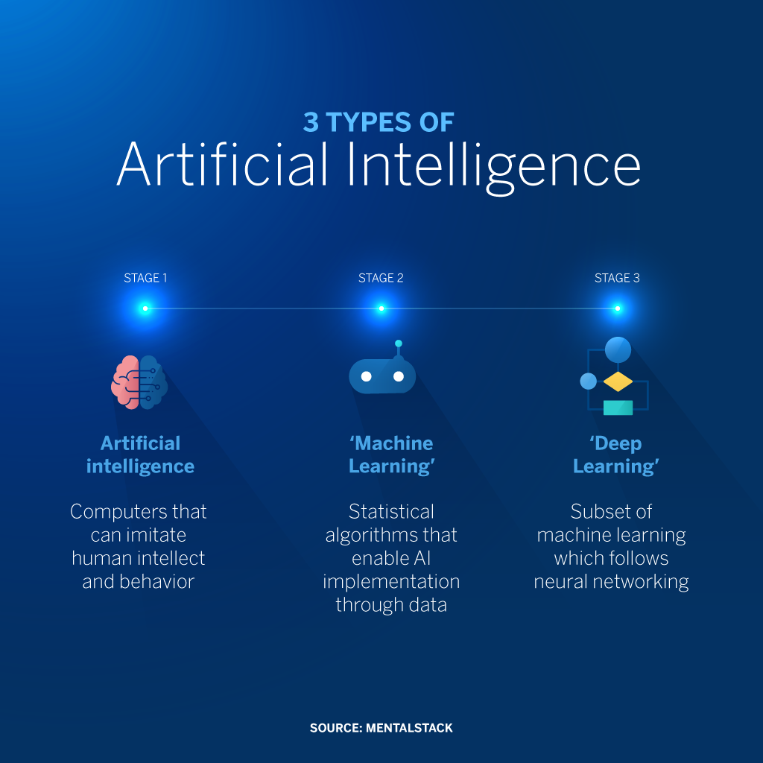

Slide 4
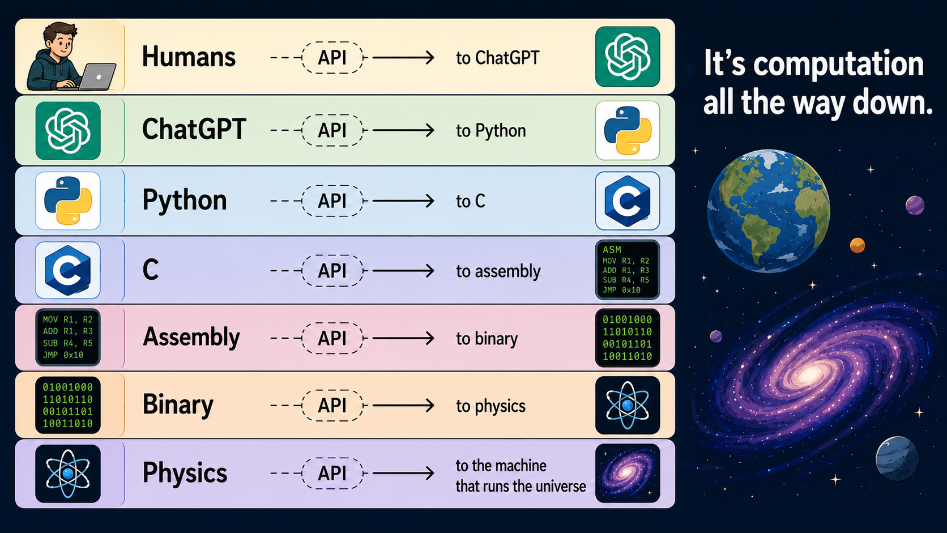
Notes:
Let us not forget to embrace the fundamentals of computer engineering
Prompting alone can create consumers and not developers

Slide 5
EXECUTIVE SUMMARY
Why efficient AI matters now
Costs are scaling faster than value. Compute, memory, and energy for state-of-the-art models double on short cycles, pressuring unit economics.
Latency and privacy are product features. Customers and regulators expect on-device intelligence, offline resilience, and data minimisation.
Efficiency unlocks new markets. Smaller models deploy where large ones cannot — vehicles, factories, handhelds, wearables, and remote sites.
Three levers compound. Optimisation, quantisation, and edge deployment together can cut total cost of inference by an order of magnitude.
Efficient AI Systems · Optimisation, Quantisation & Edge Deployment
2 / 16

Slide 6
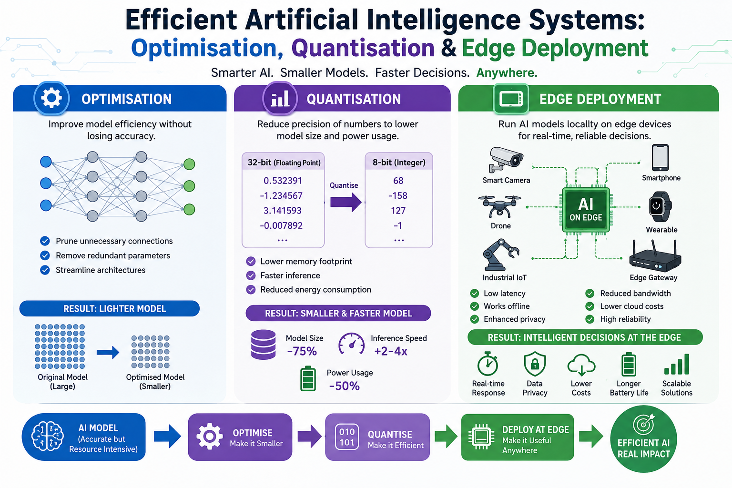

Slide 7
THE LANDSCAPE
The efficiency imperative
10×
60%
<100 ms
70%
Model size growth
Inference share
User tolerance
Data stays local
Frontier model parameters every 1–2 years
Of total AI compute spend over a model's life
Latency threshold for real-time experiences
Edge AI keeps sensitive data off the network
Efficient AI Systems · Optimisation, Quantisation & Edge Deployment
3 / 16

Slide 8
FRAMEWORK
Three compounding pillars of efficient AI
01
02
03
Optimisation
Quantisation
Edge Deployment
Make the model itself leaner — through pruning, distillation, and architecture search — before you touch the bits.
Reduce numerical precision (FP16 → INT8 → INT4) to shrink memory and accelerate compute with minimal accuracy loss.
Run inference close to the data on phones, vehicles, gateways, and sensors — cutting latency, cost, and exposure.
Efficient AI Systems · Optimisation, Quantisation & Edge Deployment
4 / 16

Slide 9
PILLAR 01
Optimisation — a smaller model is a better model
What it means
Typical outcomes
Model optimisation reshapes a network so it does the same job with fewer parameters, fewer operations, and less memory traffic — without retraining from scratch each time.
2–10× reduction in model size
30–70% lower inference latency
Comparable accuracy when done well
Compatible with downstream quantisation
Enables deployment on commodity hardware
Why leadership should care
It is the highest-leverage cost reduction in the stack. A 4× smaller model often serves 3–5× more requests on the same hardware footprint.
Efficient AI Systems · Optimisation, Quantisation & Edge Deployment
5 / 16

Slide 10
PILLAR 01
Core optimisation techniques
Pruning
Knowledge distillation
Remove redundant weights or entire neurons. Sparse models keep accuracy while shrinking compute.
Train a small "student" model to mimic a large "teacher." Captures behaviour at a fraction of the size.
Up to 90% parameter reduction
5–10× smaller students
Neural architecture search
Operator fusion & compilation
Automatically discover model shapes tuned to a target device and budget.
Merge layers and use optimised kernels via TensorRT, XLA, or OpenVINO.
Hardware-aware by design
1.5–3× speedups, no accuracy cost
Efficient AI Systems · Optimisation, Quantisation & Edge Deployment
6 / 16

Slide 11
PILLAR 02
Quantisation — fewer bits, same intelligence
From 32-bit floats to 8-bit (or 4-bit) integers
Quantisation maps high-precision weights and activations onto a lower-precision number system. The model runs on cheaper math units, fits in smaller memory, and moves fewer bytes per inference — usually with negligible accuracy loss.
FP32
FP16 / BF16
INT8
INT4
Baseline
2× smaller
4× smaller, ~2–4× faster
8× smaller, edge-friendly
Each step roughly halves memory; speed gains depend on hardware support.
Efficient AI Systems · Optimisation, Quantisation & Edge Deployment
7 / 16

Slide 12
PILLAR 02
Two paths: post-training vs. quantisation-aware
Post-Training Quantisation (PTQ)
Quantisation-Aware Training (QAT)
Quantise after the model is trained
Simulate low precision during training
Strengths
Strengths
No retraining required
Hours, not weeks, to deploy
Works on any pre-trained model
Best accuracy at low bit widths
Robust on critical workloads
Industry standard for production
Trade-offs
Trade-offs
Larger accuracy drop at INT4
Sensitive to calibration data
Requires training infrastructure
Longer time-to-deploy
Efficient AI Systems · Optimisation, Quantisation & Edge Deployment
8 / 16

Slide 13
PILLAR 02
The accuracy–efficiency trade-off
Reading the chart
Each precision step cuts memory by half. Accuracy stays essentially flat down to INT8 and only meaningfully drops at INT4 for most workloads.
Practical guidance
Default to INT8 for production. Reserve INT4 for latency-critical edge cases and validate on representative data.
Illustrative values; actual results depend on model and task.
Efficient AI Systems · Optimisation, Quantisation & Edge Deployment
9 / 16

Slide 14
PILLAR 03
Edge deployment — intelligence at the source
Bringing inference to where data is created
Edge AI runs models on the device that captures the signal — a phone, camera, vehicle ECU, factory PLC, or wearable. The cloud becomes optional, not mandatory.
Lower latency
Stronger privacy
Resilient operation
Bandwidth & cost
Round-trip time eliminated; real-time UX feasible.
Raw data never leaves the device or premises.
Works offline; tolerates intermittent connectivity.
Cuts cloud egress and per-inference compute spend.
Efficient AI Systems · Optimisation, Quantisation & Edge Deployment
10 / 16

Slide 15
PILLAR 03
The edge hardware landscape
Tier | Examples | Typical workload | Power envelope
Mobile NPU / SoC | Apple Neural Engine, Qualcomm Hexagon, Google Tensor | On-device LLMs, vision, speech | 1–10 W
Edge accelerator | NVIDIA Jetson, Intel Movidius, Hailo, Coral | Robotics, smart cameras, kiosks | 5–30 W
Automotive / industrial | Nvidia Drive, NXP, Qualcomm Ride | ADAS, perception, control | 20–100 W
Microcontroller | ARM Cortex-M, ESP32, STM32 | Keyword spotting, anomaly detect | < 1 W
Efficient AI Systems · Optimisation, Quantisation & Edge Deployment
11 / 16

Slide 16
PILLAR 03
Frameworks and toolchains
Model formats
Runtimes
Optimisation tooling
ONNX — portable interchange
TensorFlow Lite — mobile & MCU
Core ML — Apple ecosystem
GGUF — quantised LLMs
ONNX Runtime, TFLite Runtime
NVIDIA TensorRT
Intel OpenVINO
Qualcomm QNN, Apple ANE
PyTorch quantisation, AIMET
NNCF, Olive, Optimum
llama.cpp, MLC-LLM
Hardware vendor SDKs
Efficient AI Systems · Optimisation, Quantisation & Edge Deployment
12 / 16

Slide 17
BUSINESS VALUE
Where efficient AI changes the game
Consumer devices
Automotive & mobility
On-device assistants, translation, photography — no cloud dependency, privacy-by-default.
ADAS perception and driver monitoring within tight power and latency budgets.
Industrial & energy
Healthcare
Predictive maintenance and quality inspection on the factory floor and in the field.
Diagnostic models at the bedside or in the clinic with regulatory-grade data control.
Retail & logistics
Financial services
Smart cameras and handhelds for inventory, loss prevention, and fulfilment.
Lower-cost serving of LLMs for support, compliance, and analyst productivity.
Efficient AI Systems · Optimisation, Quantisation & Edge Deployment
13 / 16

Slide 18
Zimbabwe’s
AI Research and Innovation Driven Ecosystems
Examples

Slide 19
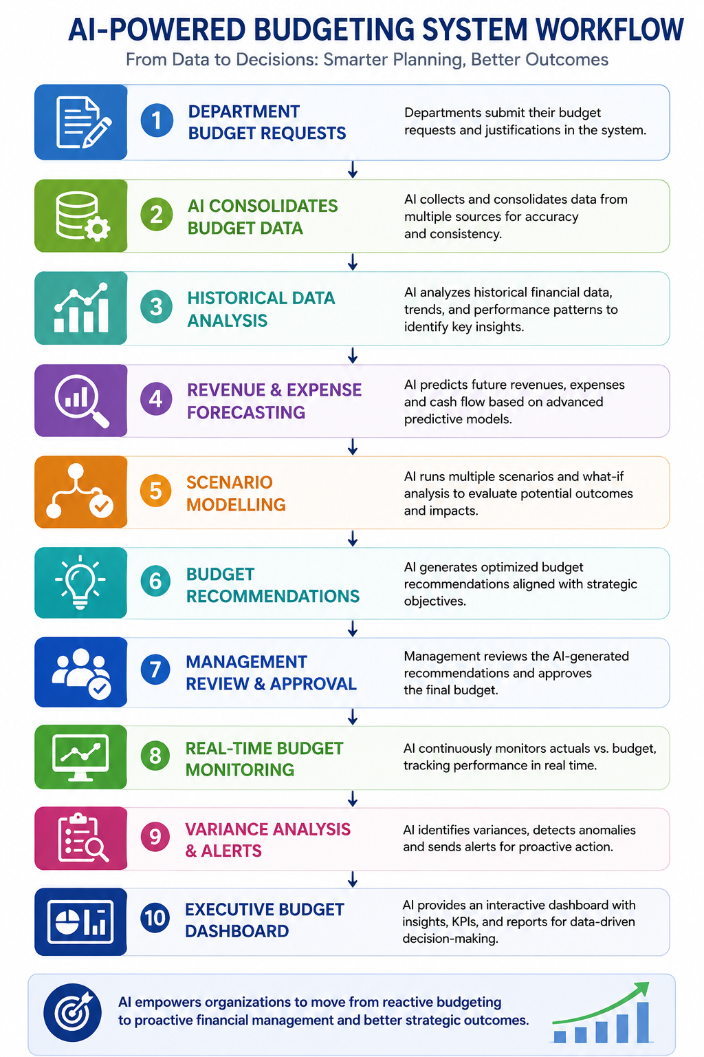
https://southmews.budgeting.co.zw/
Imagine a Budgeting System that is Linked to your Annual Procurement Plan

Slide 20
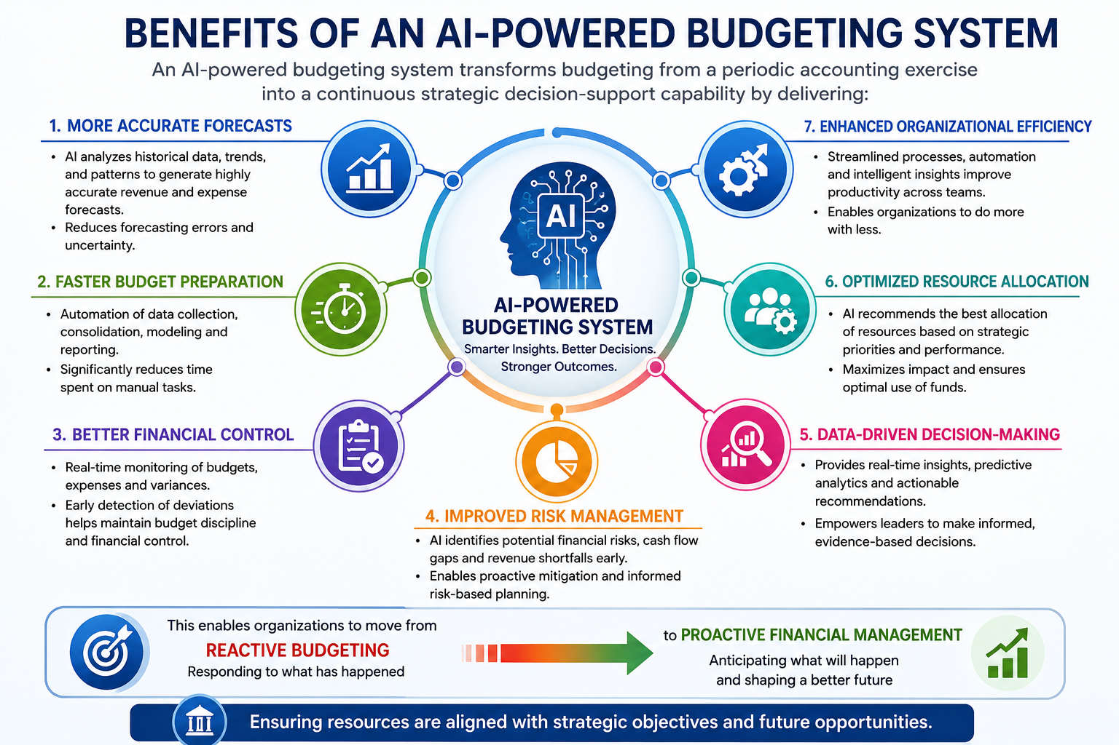

Slide 21
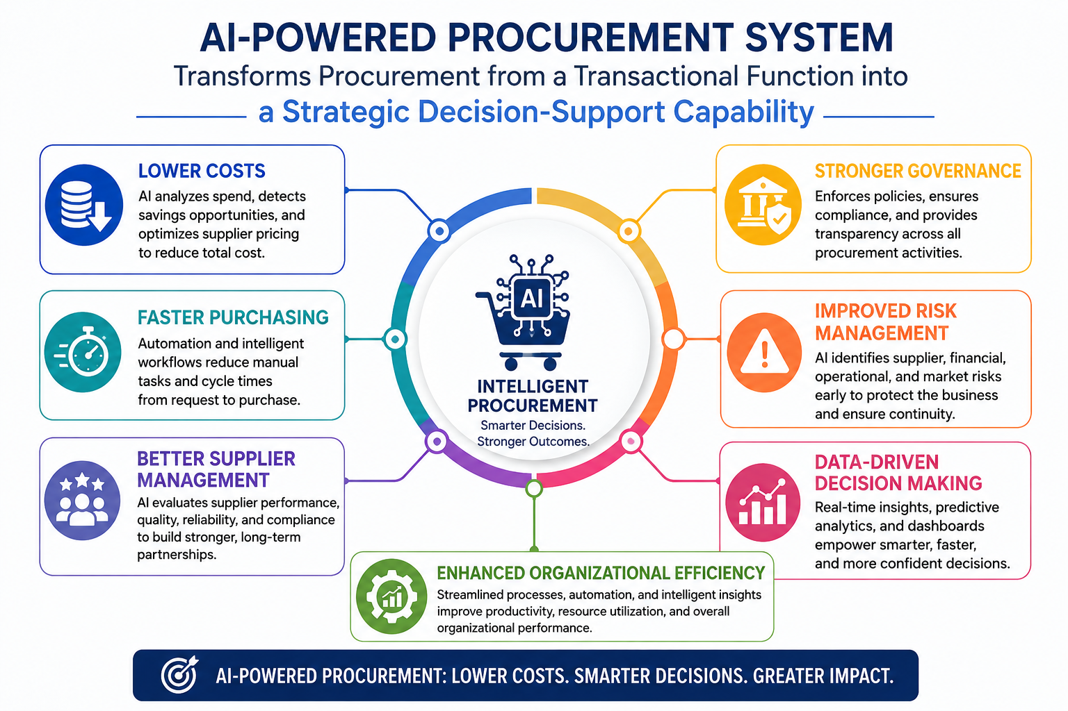

Slide 22
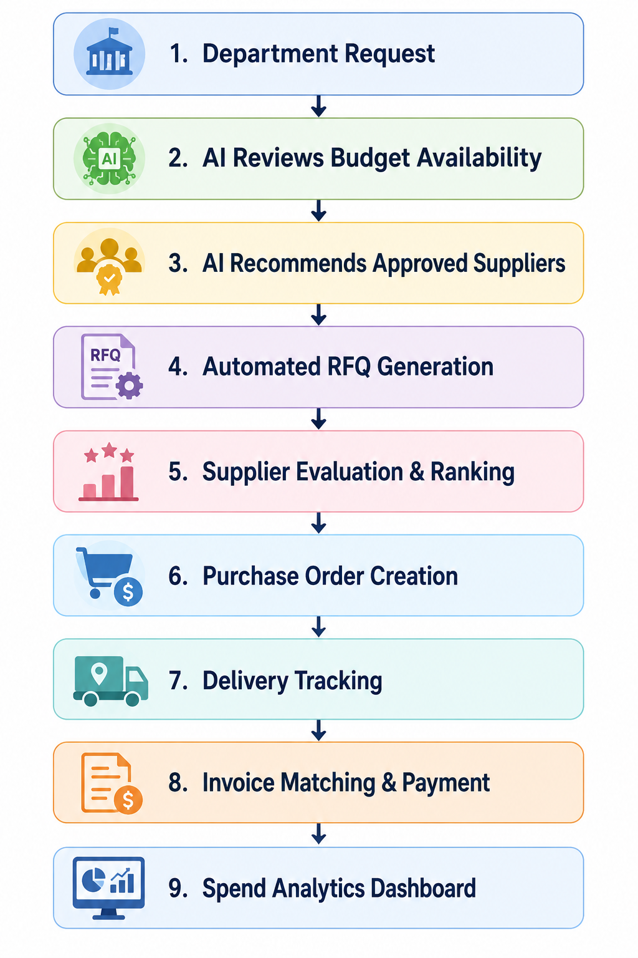
https://clear-tweak-72430870.figma.site/
Imagine a Procurement Plan that is linked to your Annual Budget

Slide 23
PLAN
A pragmatic implementation roadmap
Phase 1
Phase 2
Phase 3
Phase 4
Audit & baseline
Optimise & quantise
Edge pilot
Scale & govern
Profile current models for cost, latency, and accuracy. Identify top three workloads by spend.
Apply pruning, distillation, and INT8 quantisation. Establish accuracy regression gates.
Select one high-value scenario; deploy to target hardware; validate UX and operations.
Standardise toolchain, MLOps, and monitoring. Roll out across product lines.
Efficient AI Systems · Optimisation, Quantisation & Edge Deployment
14 / 16

Slide 24
Phase | Goal | Outcome
1. Audit & Baseline | Understand current performance | Benchmark and identify opportunities
2. Optimise & Quantise | Reduce model size and cost | Faster, smaller, cheaper AI
3. Edge Pilot | Validate deployment on real devices | Proven business value
4. Scale & Govern | Enterprise-wide adoption | Sustainable and governed AI operations

Slide 25
RISK
Risks and considerations
Accuracy regressions
Toolchain fragmentation
Aggressive quantisation can degrade rare-case performance. Mitigate with QAT and per-segment evaluation.
Each accelerator has its own SDK. Pick a portable format (ONNX) and a primary runtime.
Edge fleet operations
Security & IP
Model updates, A/B testing, and monitoring on devices require new MLOps muscles.
Models on devices can be extracted. Use encryption, attestation, and obfuscation where stakes are high.
Talent & culture
Regulatory shifts
Efficiency engineering is a distinct discipline. Build or partner deliberately.
Privacy and AI rules are moving fast. Edge architectures help, but governance is still required.
Efficient AI Systems · Optimisation, Quantisation & Edge Deployment
15 / 16

Slide 26
CONCLUSION
The bottom line and next steps
Efficient AI is a strategic capability, not a tactical fix.
Combining optimisation, quantisation, and edge deployment compounds savings, opens new product surfaces, and reduces dependence on ever-larger cloud spend.
Then why AI?-
Reliability, consistency, affordability, durability and trust
Efficient AI Systems · Optimisation, Quantisation & Edge Deployment
16 / 16

Slide 27


Slide 28
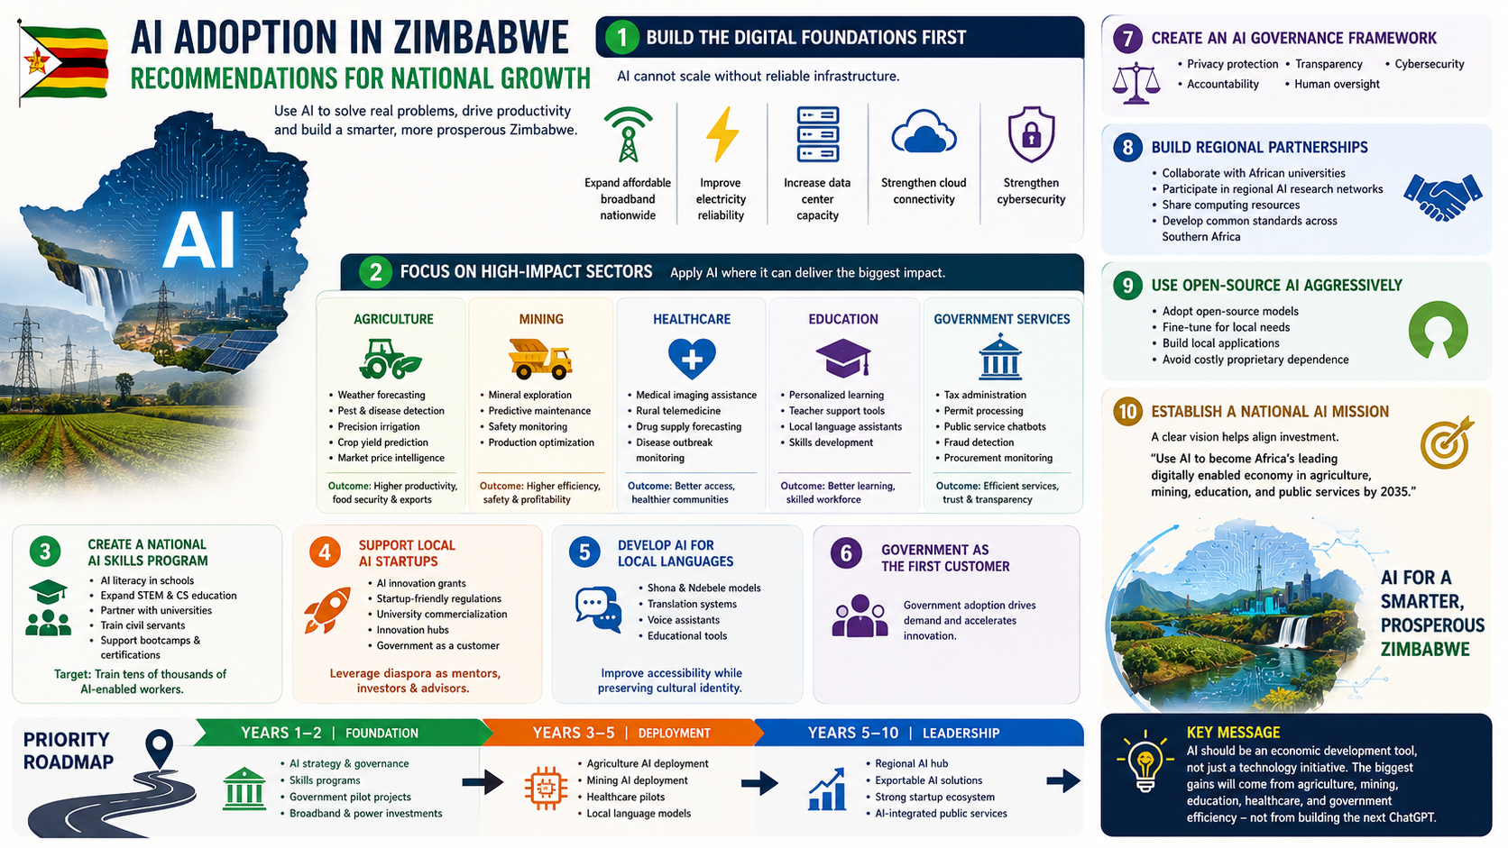

Slide 29

Conclusion
Expand affordable broadband nationwide.
Improve electricity reliability and grid resilience.
Increase data center capacity.
Strengthen cloud connectivity and cybersecurity.

